Slide 1
Build your first app
Android Developer Fundamentals V2
Lesson 1

Slide 2
1.0 Introduction to Android

Slide 3

Contents
Android is an ecosystem
Android platform architecture
Android Versions
Challenges of Android app development
App fundamentals

Slide 4
What is Android?
Mobile operating system based on Linux kernel
User Interface for touch screens
Used on over 80% of all smartphones
Powers devices such as watches, TVs, and cars
Over 2 Million Android apps in Google Play store
Highly customizable for devices / by vendors
Open source

Slide 5
Android user interaction
Touch gestures: swiping, tapping, pinching
Virtual keyboard for characters, numbers, and emoji
Support for Bluetooth, USB controllers and peripherals

Slide 6
Android and sensors
Sensors can discover user action and respond
Device contents rotate as needed
Walking adjusts position on map
GPS & wifi tracking
Games

Slide 7
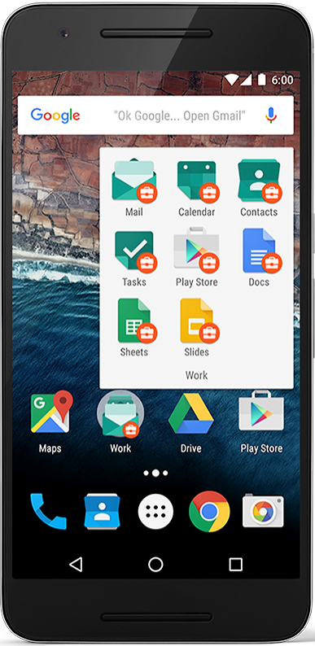
Android home screen
Launcher icons for apps
Self-updating widgets for live content
Can be multiple pages
Folders to organize apps

Slide 8
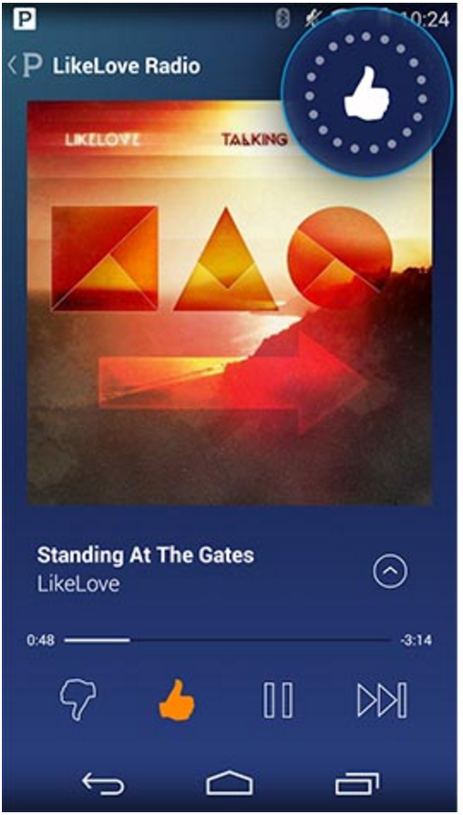
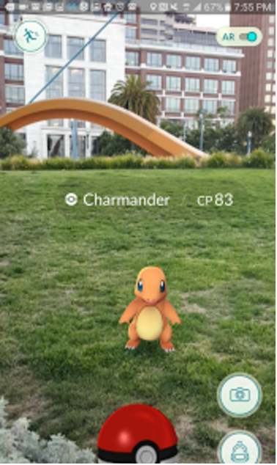
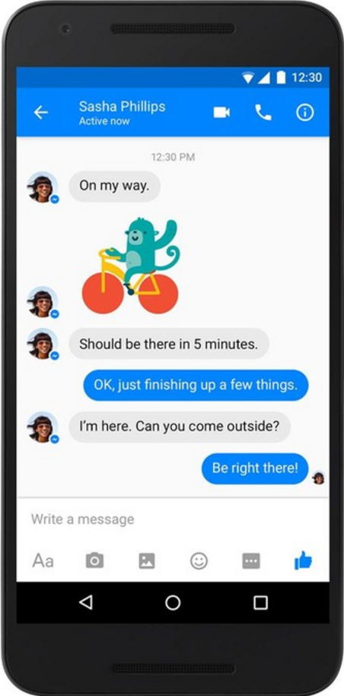
Android app examples
Pandora
Pokemon GO
Facebook
Messenger

Slide 9
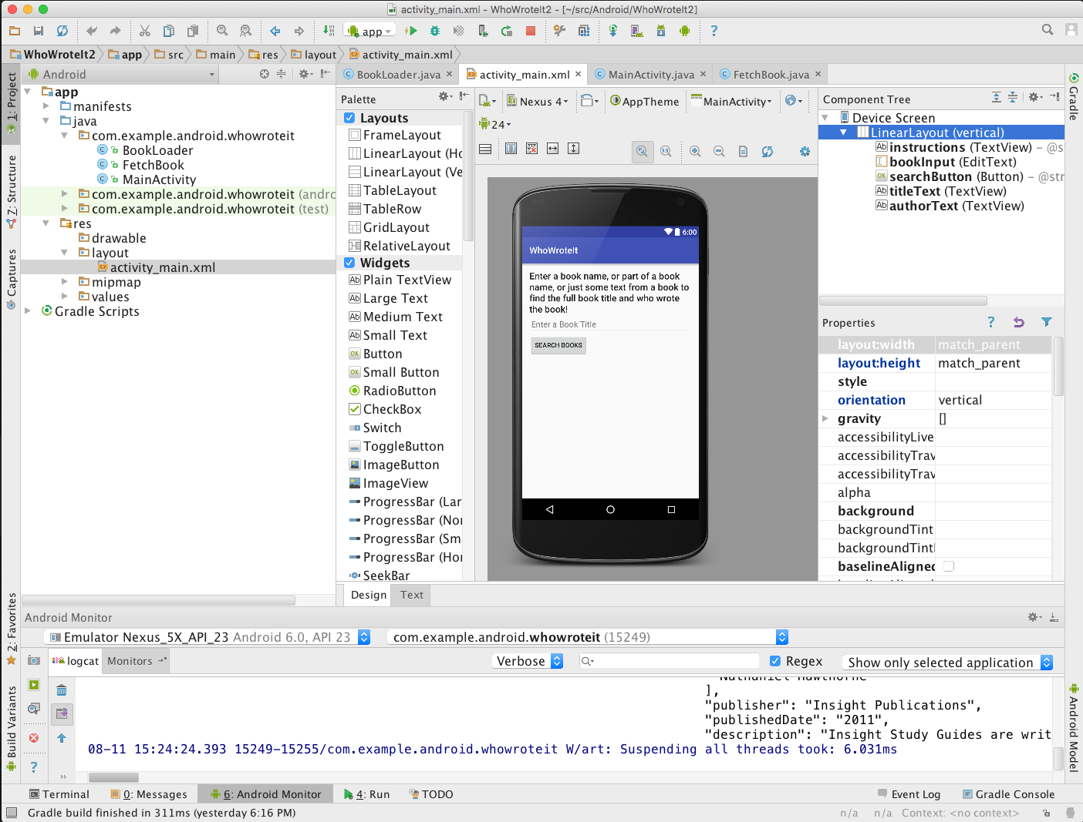
Android Studio
Official Android IDE
Develop, run, debug, test, and package apps
Monitors and performance tools
Virtual devices
Project views
Visual layout editor

Slide 10
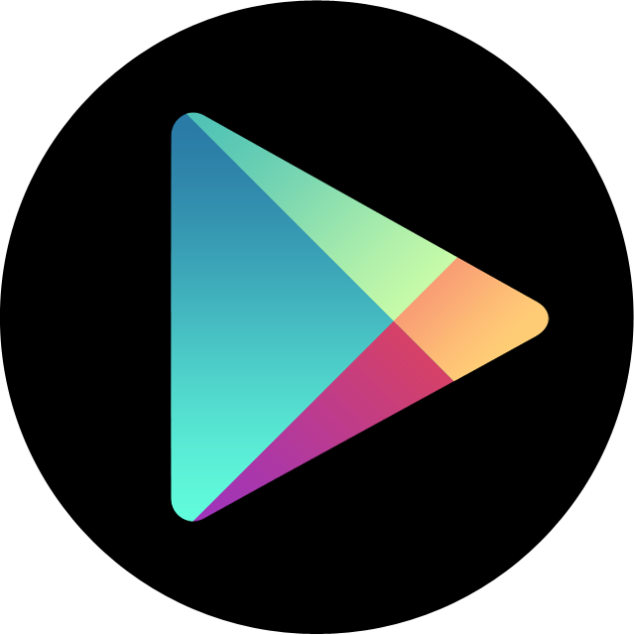
Google Play store
Publish apps through Google Play store:
Official app store for Android
Digital distribution service operated by Google

Slide 11
Android Platform Architecture

Slide 12
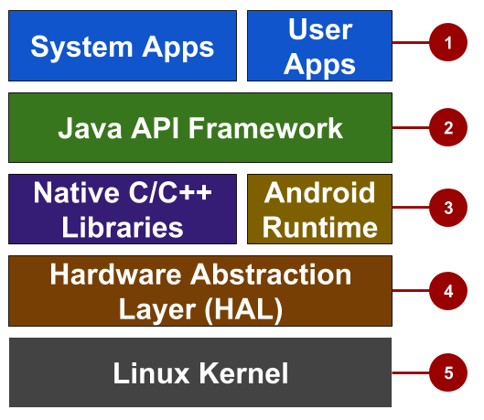
Android stack
System and user apps
Android OS API in Java framework
Expose native APIs; run apps
Expose device hardware capabilities
Linux Kernel

Slide 13

Older Android versions
Codename | Version | Released | API Level
Honeycomb | 3.0 - 3.2.6 | Feb 2011 | 11 - 13
Ice Cream Sandwich | 4.0 - 4.0.4 | Oct 2011 | 14 - 15
Jelly Bean | 4.1 - 4.3.1 | July 2012 | 16 - 18
KitKat | 4.4 - 4.4.4 | Oct 2013 | 19 - 20
Lollipop | 5.0 - 5.1.1 | Nov 2014 | 21 - 22
Notes:
There were earlier versions before Feb 2011.

Slide 14
Newer Android versions
Codename | Version | Released | API Level
Marshmallow | 6.0 - 6.0.1 | Oct 2015 | 23
Nougat | 7.0 - 7.1 | Sept 2016 | 24 - 25
Oreo | 8.0 - 8.1 | Sept 2017 | 26 - 27
Pie | 9.0 | Aug 2018 | 28
Notes:
There were earlier versions before Feb 2011.

Slide 15
App Development

Slide 16
What is an Android app?
One or more interactive screens
Written using Java Programming Language and XML
Uses the Android Software Development Kit (SDK)
Uses Android libraries and Android Application Framework
Executed by Android Runtime Virtual machine (ART)

Slide 17
Challenges of Android development
Multiple screen sizes and resolutions
Performance: make your apps responsive and smooth
Security: keep source code and user data safe
Compatibility: run well on older platform versions
Marketing: understand the market and your users

Slide 18
App building blocks
Resources: layouts, images, strings, colors as XML and media files
Components: activities, services, and helper classes as Java code
Manifest: information about app for the runtime
Build configuration: APK versions in Gradle config files

Slide 19
The development process

Slide 20
END

