Slide 1
User Interaction
Android Developer Fundamentals V2
Lesson 4

Slide 2
Accepting user input
Freeform text and numbers: EditText (using keyboard)
Providing choices: CheckBox, RadioButton, Spinner
Switching on/off: Toggle, Switch
Choosing value in range of values: SeekBar

Slide 3
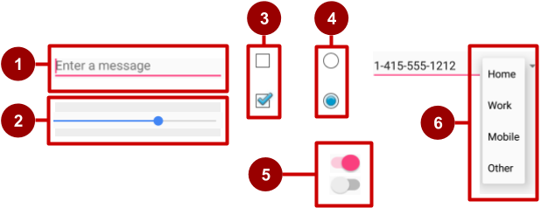
Examples of input controls
EditText
SeekBar
CheckBox
RadioButton
Switch
Spinner

Slide 4
How input controls work
Use EditText for entering text using keyboard
Use SeekBar for sliding left or right to a setting
Combine CheckBox elements for choosing more than one option
Combine RadioButton elements into RadioGroup — user makes only one choice
Use Switch for tapping on or off
Use Spinner for choosing a single item from a list

Slide 5
View focus

Slide 6
Clickable versus focusable
Clickable—View can respond to being clicked or tapped
Focusable—View can gain focus to accept input
Input controls such as keyboards send input to the view that has focus

Slide 7
Focus
The View that receives user input has "Focus"
Only one View can have focus
Focus makes it unambiguous which View gets the input
Focus is assigned by
User tapping a View
App guiding the user from one text input control to the next using the Return, Tab, or arrow keys
Calling requestFocus() on any View that is focusable

Slide 8
Which View gets focus next?
Topmost view under the touch
After user submits input, focus moves to nearest neighbor—priority is left to right, top to bottom
Arrange input controls in a layout from left to right and top to bottom in the order you want focus assigned
Specify ordering in XML
android:id="@+id/top"
android:focusable="true"
android:nextFocusDown="@+id/bottom"

Slide 9
Set focus explicitly
Use methods of the View class to set focus
setFocusable() sets whether a view can have focus
requestFocus() gives focus to a specific view
setOnFocusChangeListener() sets listener for when view gains or loses focus
onFocusChanged() called when focus on a view changes

Slide 10
Find the view with focus
Activity.getCurrentFocus()
ViewGroup.getFocusedChild()

Slide 11
Freeform text and numbers

Slide 12
EditText for multiple lines of text
EditText default
Alphanumeric keyboard
Suggestions appear
Tapping Return (Enter) key starts new line
Return key

Slide 13
Customize with inputType
Set in Attributes pane of layout editor
XML code for EditText:
<EditText
android:id="@+id/name_field"
android:inputType = "textPersonName"
...

Slide 14
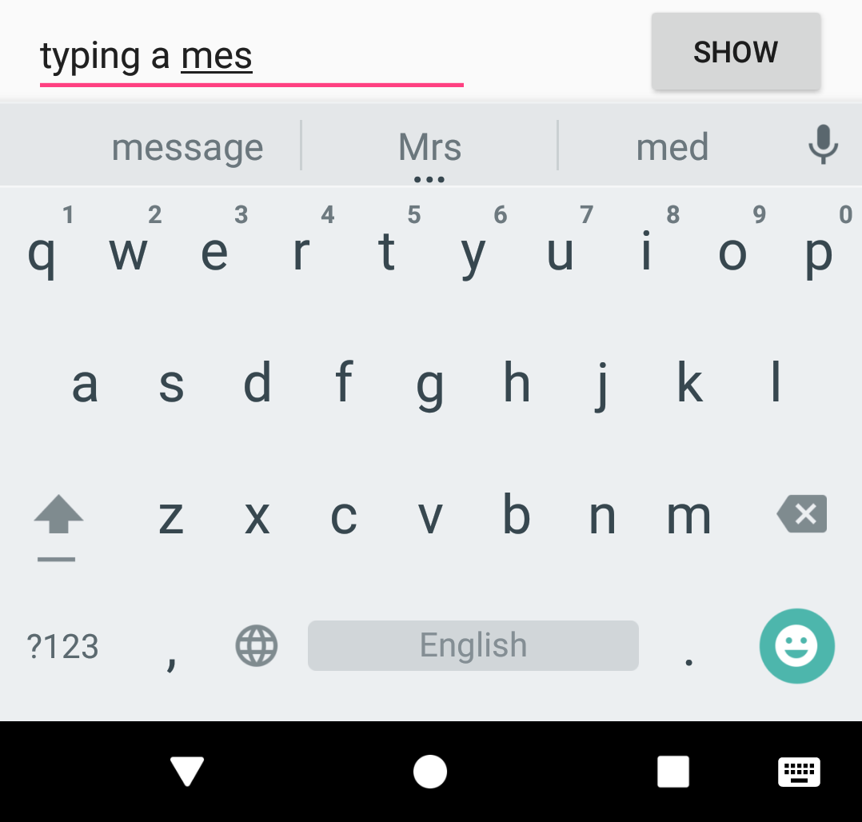
EditText for message
android:inputType ="textShortMessage"
Single line of text
Tapping Emoticons key changes keyboard to emoticons
Emoticons

Slide 15
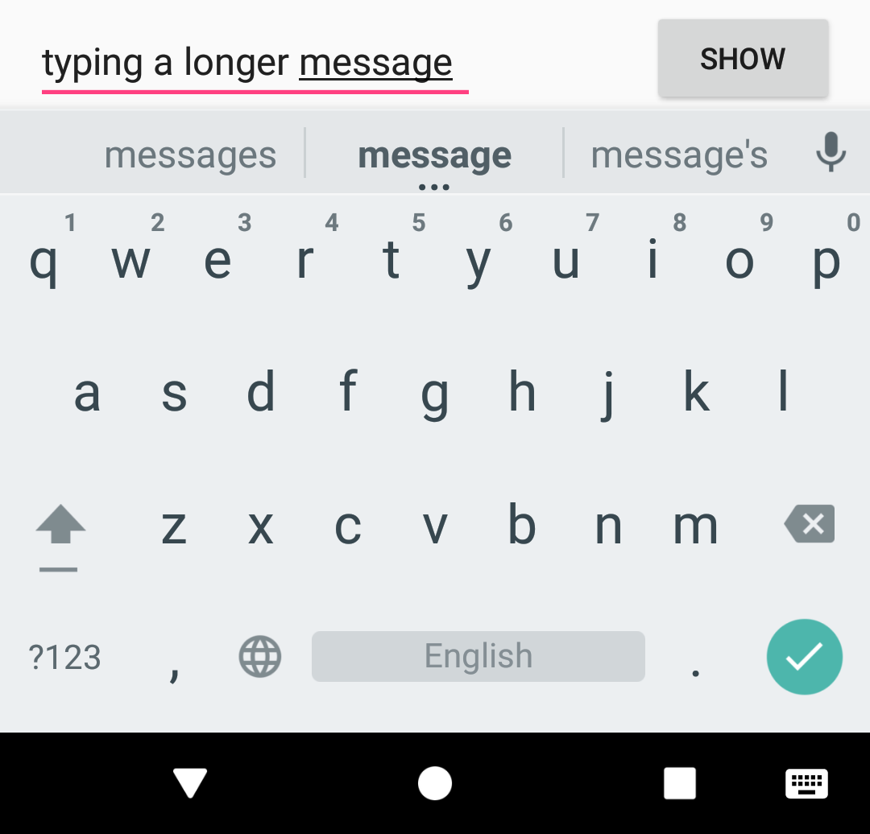
EditText for single line
Both work:
android:inputType ="textLongMessage"
android:inputType ="textPersonName"
Single line of text
Tapping Done key advances focus to next View
Done key

Slide 16
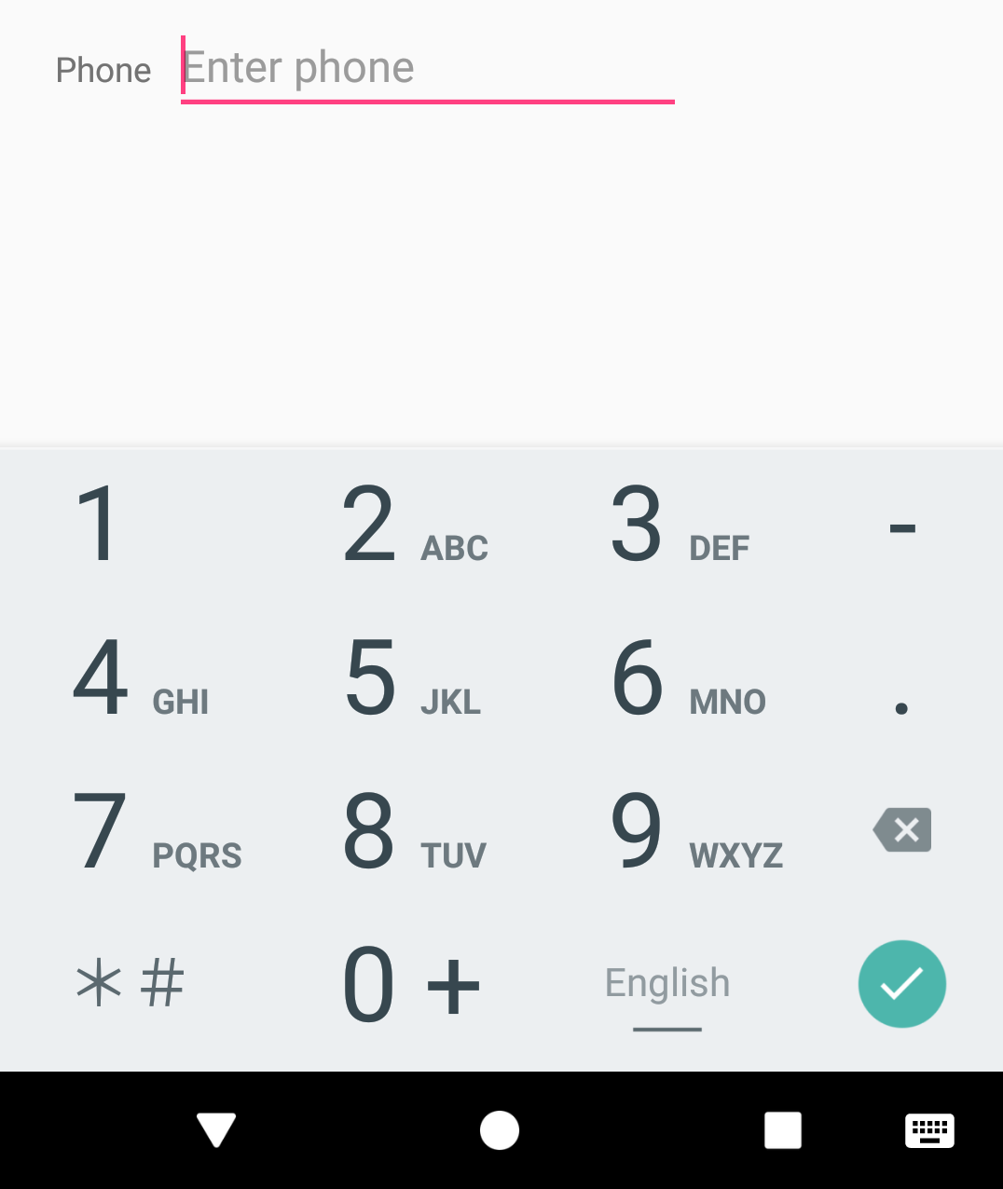
EditText for phone number entry
android:inputType ="phone"
Numeric keypad (numbers only)
Tapping Done key advances focus to next View
Done key

Slide 17
Getting text
Get the EditText object for the EditText view
EditText simpleEditText = findViewById(R.id.edit_simple);
Retrieve the CharSequence and convert it to a string
String strValue = simpleEditText.getText().toString();

Slide 18
Input types
Common input types
textCapCharacters: Set to all capital letters
textCapSentences: Start each sentence with a capital letter
textPassword: Conceal an entered password
number: Restrict text entry to numbers
textEmailAddress: Show keyboard with @ conveniently located
phone: Show a numeric phone keypad
datetime: Show a numeric keypad with a slash and colon for entering the date and time

Slide 19
Providing choices

Slide 20
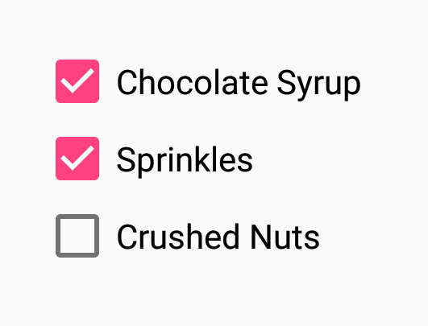
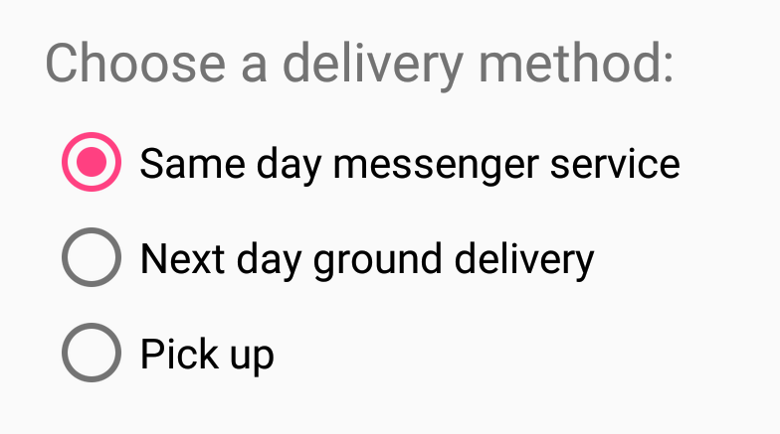
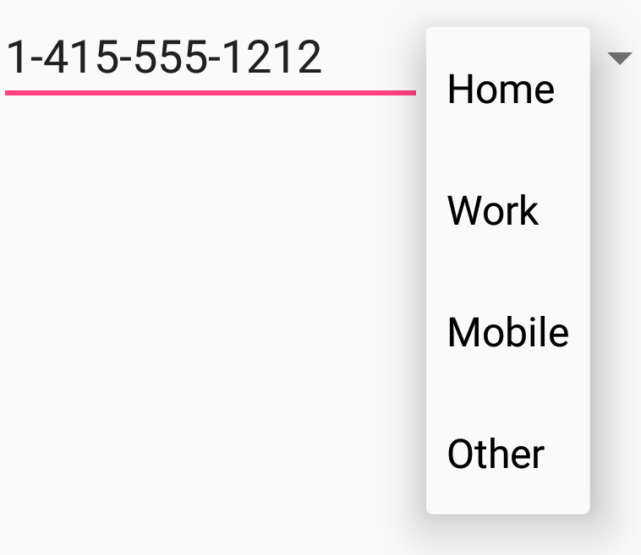
UI elements for providing choices
CheckBox and RadioButton
ToggleButton and Switch
Spinner

Slide 21
CheckBox
User can select any number of choices
Checking one box does not uncheck another
Users expect checkboxes in a vertical list
Commonly used with a Submit button
Every CheckBox is a View and can have an onClick handler

Slide 22
RadioButton
Put RadioButton elements in a RadioGroup in a vertical list (horizontally if labels are short)
User can select only one of the choices
Checking one unchecks all others in group
Each RadioButton can have onClick handler
Commonly used with a Submit button for the RadioGroup

Slide 23
Toggle buttons and switches
User can switch between on and off
Use android:onClick for click handler
Toggle buttons
Switches

Slide 24
RecyclerView

Slide 25
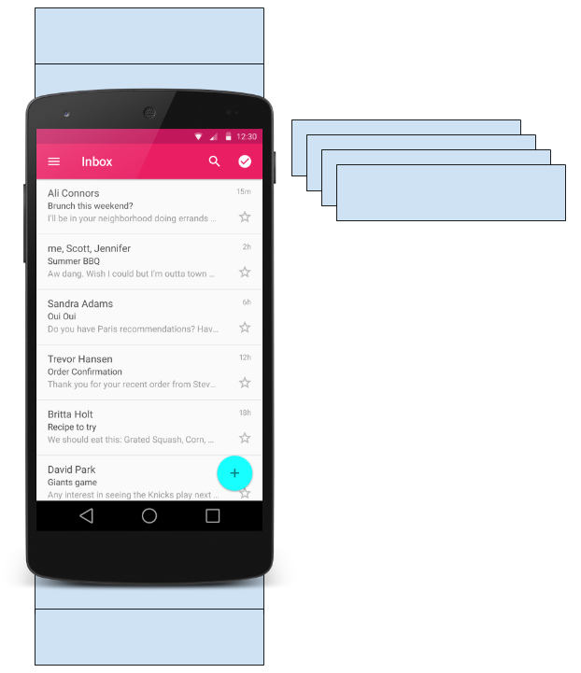
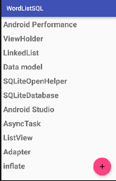
What is a RecyclerView?
RecyclerView is scrollable container for large data sets
Efficient
Uses and reuses limited number of View elements
Updates changing data fast

Slide 26
Components
How components fit together overview

Slide 27
Layout Manager
What is a layout manager?
Use to position View items inside a RecyclerView
Reuses View items that are no longer visible to the user
Built-in layout managers
LinearLayoutManager
GridLayoutManager
StaggeredGridLayoutManager
Extend RecyclerView.LayoutManager

Slide 28
Adapter
What is an adapter?
Helps incompatible interfaces work together
Example: Takes data from database Cursor and prepares strings to put into a View
Intermediary between data and View
Manages creating, updating, adding, deleting View items as underlying data changes
RecyclerView.Adapter

Slide 29
Adapter
What is a ViewHolder?
Used by the adapter to prepare one View with data for one list item
Layout specified in an XML resource file
Can have clickable elements
Is placed by the layout manager
RecyclerView.ViewHolder

Slide 30
Implementing RecyclerView

Slide 31
Implementation
Steps Summary
Add RecyclerView to layout
Create XML layout for item
Extend RecyclerView.Adapter
Extend RecyclerView.ViewHolder
In Activity onCreate(), create RecyclerView with adapter and layout manager

Slide 32
Activity layout
Add RecyclerView to XML Layout
<android.support.v7.widget.RecyclerView
android:id="@+id/recyclerview"
android:layout_width="match_parent"
android:layout_height="match_parent">
</android.support.v7.widget.RecyclerView>

Slide 33
Item layout
Create layout for 1 list item
<LinearLayout xmlns:android="http://schemas.android.com/apk/res/android" android:id="@+id/listitem" android:layout_width="match_parent" android:layout_height="wrap_content"> <TextView android:id="@+id/word" android:layout_width="match_parent" android:layout_height="wrap_content" /> </LinearLayout>

Slide 34
Adapter: Create
Implement the adapter
public class WordListAdapter extends RecyclerView.Adapter <WordListAdapter.WordViewHolder> {
ArrayList<String> mWordList;
public WordListAdapter(ArrayList<String> wordList) { this.mWordList=wordList; }
}

Slide 35
Adapter: onCreateViewHolder()
Adapter has 3 required methods
onCreateViewHolder()
inBindViewHolder()
getItemCount()
Let's take a look!

Slide 36
Adapter: onCreateViewHolder()
onCreateViewHolder()
@Override public WordViewHolder onCreateViewHolder(ViewGroup parent,int viewType){ // Inflate an item view. View mItemView = LayoutInflater.from(
parent.getContext()).inflate(R.layout.listitem, parent, false); return new WordViewHolder(mItemView); }

Slide 37
Adapter: onBindViewHolder()
onBindViewHolder()
@Override public void onBindViewHolder(WordViewHolder holder, int position) { holder.wordItemView.setText(mWordList.get(position)); }
@Override public int getItemCount() { return mWordList.size(); }

Slide 38
Adapter: ViewHolder Class
Create the view holder in adapter class
class WordViewHolder extends RecyclerView.ViewHolder { public TextView wordItemView; public WordViewHolder(View itemView) { super(itemView); wordItemView = itemView.findViewById(R.id.word); // itemView.setOnClickListener(this); } } If you want to handle mouse clicks:
class WordViewHolder extends RecyclerView.ViewHolder
implements View.OnClickListener { //.. }

Slide 39
Create RecyclerView
Create the RecyclerView in Activity onCreate()
mRecyclerView = findViewById(R.id.recyclerview);
mAdapter = new WordListAdapter(mWordList);
mRecyclerView.setAdapter(mAdapter);
mRecyclerView.setLayoutManager(new
LinearLayoutManager(this));

Slide 40
END

