Slide 1
Chapter 3 Process Description and Control
Notes:
These slides are intended to help a teacher develop a presentation. This PowerPoint covers the entire chapter and includes too many slides for a single delivery. Professors are encouraged to adapt this presentation in ways which are best suited for their students and environment.

Slide 2
What is a “process”?
A program in execution
An instance of a program running on a computer
The entity that can be assigned to and executed on a processor
A unit of activity characterized by the execution of a sequence of instructions, a current state, and an associated set of system instructions

Slide 3
Process Elements
A process is comprised of:
Program code
A set of data
A number of attributes describing the state of the process

Slide 4
Process Elements
While the process is running it has a number of elements including
Identifier
State
Priority
Program counter
Memory pointers
Context data
I/O status information
Accounting information
Notes:
Mention that this list is not necessarily complete, and may include optional elements (e.g. not all OS’s may need a process to have accounting information)

Slide 5
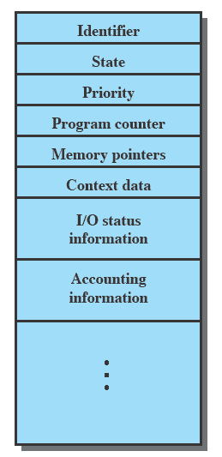
Process Control Block
Contains the process elements
Created and manage by the operating system
Allows support for multiple processes
Notes:
Emphasise that the Process Control Block contains sufficient information so that it is possible to interrupt a running process and later resume execution as if the interruption had not occurred.

Slide 6
A Few Linux Commands
PS
TOP
HTOP
PSTREE
WHO
WHOAMI
KILL
W
DF
FREE
SLEEP
ECHO
PGREP
LS

Slide 7
A Few C Function
FORK (CreateProcess)
EXECL
EXIT
SLEEP
PAUSE
WAIT (WaitForSingleObject)
GETCWD
CHDIR

Slide 8
Trace of the Process
The behavior of an individual process is shown by listing the sequence of instructions that are executed
This list is called a Trace
Dispatcher is a small program which switches the processor from one process to another

Slide 9
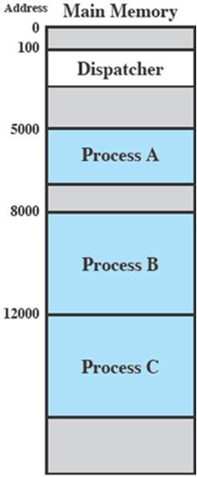
Process Execution
Consider three processes being executed.
All are in memory (plus the Dispatcher).
Lets ignore virtual memory for this.

Slide 10
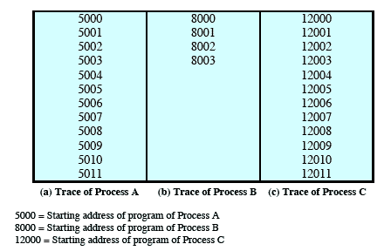
Trace from the processes point of view:
Each process runs to completion
Notes:
Animated slide
Wipes down to give impression of process progression

Slide 11
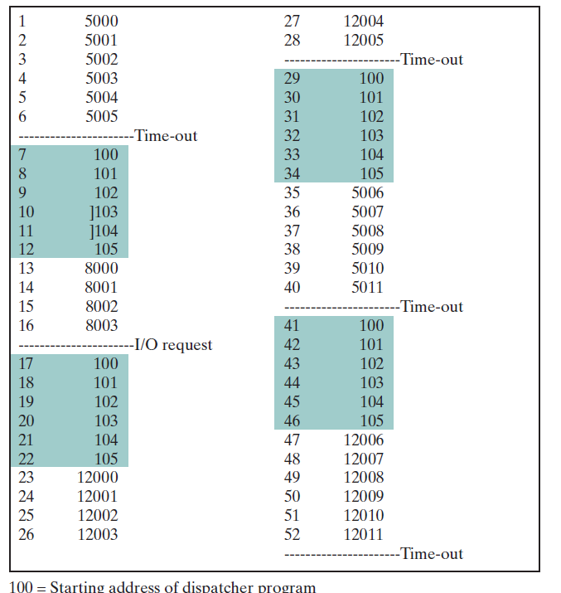
Trace from Processors point of view

Slide 12
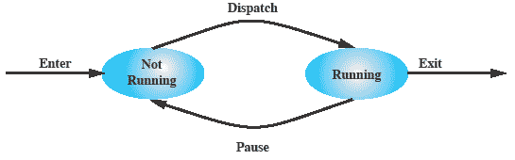
Two-State Process Model
Process may be in one of two states
Running
Not-running
Notes:
Emphasize that you are introducing a Simple model and that this will be expanded.
The operating system’s principal responsibility is controlling the execution of processes;
this includes determining the interleaving pattern for execution and allocating resources to processes.
The first step in designing an OS to control processes is to describe the behaviour that we would like the processes to exhibit. In the most simple model, a process is either running, or it is not.

Slide 13
Queuing Diagram
Notes:
Animated slide The animation only shows one process moving.
There needs to be some structure so that the OS can keep track of the processes. This could be a simple queue which is managed by the dispatcher routine of the OS.

Slide 14
Process Birth
Notes:
There are many reasons why a process may be created or terminated.

Slide 15
Process Creation
The OS builds a data structure to manage the process
Traditionally, the OS created all processes
But it can be useful to let a running process create another
This action is called process spawning
Parent Process is the original, creating, process
Child Process is the new process
Notes:
Typically, the “related” processes need to communicate and cooperate with each other. Achieving this cooperation is a difficult task for the programmer; discussed further in Chapter 5.

Slide 16
Process Termination
There must be some way that a process can indicate completion.
This indication may be:
A HALT instruction generating an interrupt alert to the OS.
A user action (e.g. log off, quitting an application)
A fault or error
Parent process terminating

Slide 17
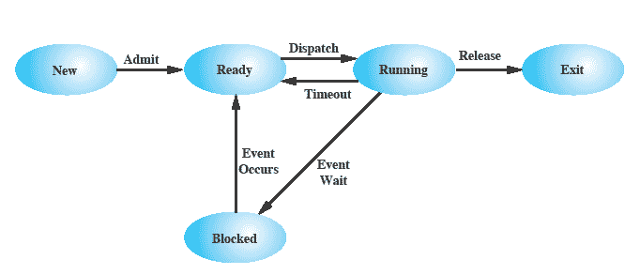
Five-State Process Model
Notes:
If all processes were always ready to execute, then the simple FIFO queuing model would suffice.
However, even with simple examples, this implementation is inadequate:
some processes in the Not Running state are ready to execute,
while others are blocked, waiting for an I/O operation to complete.
In a two state model, the dispatcher would have to scan the list looking for the process that is not blocked and that has been in the queue the longest.
But we could split the Not Running state into two states:
Ready and
Blocked.
For good measure, we have added two additional states that will prove useful (new and exit)
Suggestion:
Mention that “Wait” and “Blocked” have the same meaning here.
Talk through the state transitions.

Slide 18
Process States
Notes:
If all processes were always ready to execute, then the simple FIFO queuing model would suffice.
However, even with simple examples, this implementation is inadequate:
some processes in the Not Running state are ready to execute,
while others are blocked, waiting for an I/O operation to complete.
In a two state model, the dispatcher would have to scan the list looking for the process that is not blocked and that has been in the queue the longest.
But we could split the Not Running state into two states:
Ready and
Blocked.
For good measure, we have added two additional states that will prove useful (new and exit)
Suggestion:
Mention that “Wait” and “Blocked” have the same meaning here.
Talk through the state transitions.

Slide 19
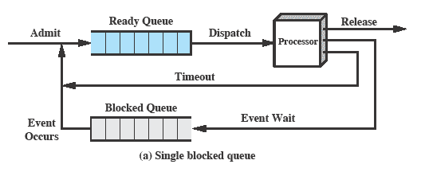
Using Two Queues
Notes:
In the simplest solution, this model would require an additional queue for the blocked processes.
But when an event occurs the dispatcher would have to cycle through the entire queue to see which process is waiting for the event.
This can cause huge overhead when their may be 100’s or 1000’s of processes

Slide 20
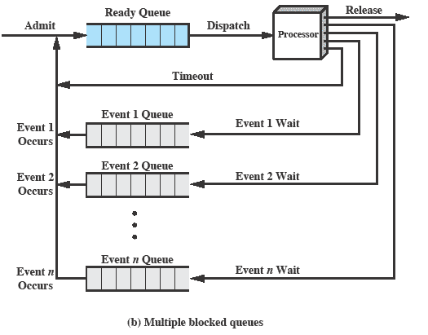
Multiple Blocked Queues
Notes:
More efficient to have a separate ‘blocked’ queue for each type of event.

Slide 21
Suspended Processes
Processor is faster than I/O so all processes could be waiting for I/O
Swap these processes to disk to free up more memory and use processor on more processes
Blocked state becomes suspend state when swapped to disk
Two new states
Blocked/Suspend
Ready/Suspend
Notes:
Mention that the aim is to fully utilize the processor.

Slide 22
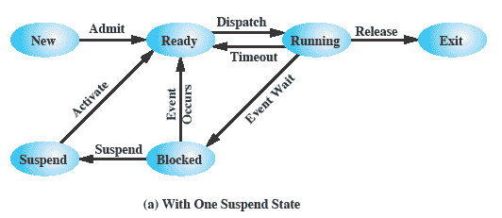
One Suspend State
Notes:
Again, the simple solution is to add a single state – but this only allows processes which are blocked to be swapped out.

Slide 23
Reason for Process Suspension
Reason | Comment
Swapping | The OS needs to release sufficient main memory to bring in a process that is ready to execute.
Other OS Reason | OS suspects process of causing a problem.
Interactive User Request | e.g. debugging or in connection with the use of a resource.
Timing | A process may be executed periodically (e.g., an accounting or system monitoring process) and may be suspended while waiting for the next time.
Parent Process Request | A parent process may wish to suspend execution of a descendent to examine or modify the suspended process, or to coordinate the activity of various descendants.
Notes:
The comments are summarized due to space on slide

Slide 24
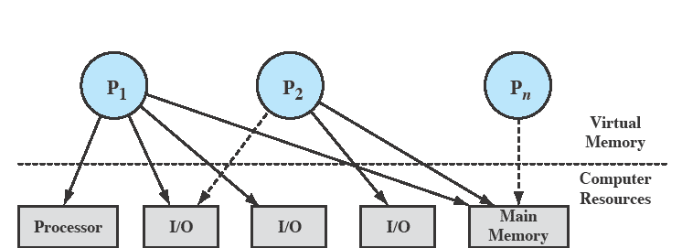
Processes and Resources
Notes:
The OS controls events within the computer system. It schedules and dispatches processes for execution by the processor, allocates resources to processes, and responds
to requests by user processes for basic services.
Fundamentally, we can think of the OS as that entity that manages the use of system resources by processes.
In this slide –
There are a number of processes (P1, . . ., Pn,) that have been created and exist in virtual memory.
Each process, during the course of its execution, needs access to certain system resources, including the processor, I/O devices, and main memory.
In the figure, process P1 is running; at least part of the process is in main memory, and it has control of two I/O devices.
Process P2 is also in main memory but is blocked waiting for an I/O device allocated to P1.
Process Pn has been swapped out and is therefore suspended.

Slide 25
Operating System Control Structures
OS manages processes and resources, it must have information about the current status of each process and resource.
Tables are constructed for each entity the operating system manages

Slide 26
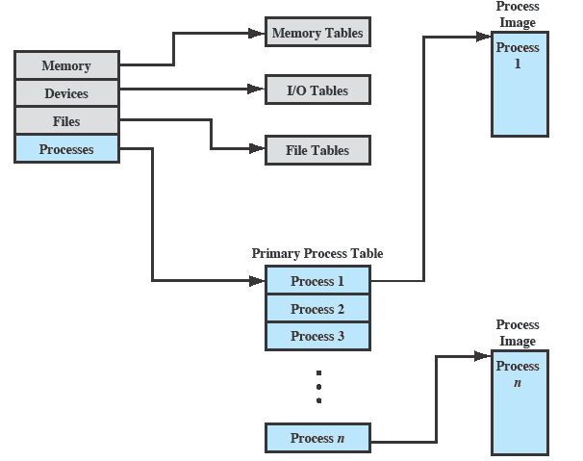
OS Control Tables
Notes:
A general idea of the scope of the tables is in Figure 3.11, which shows four different types of tables maintained by the OS:
memory,
I/O,
file,
process.
Although the details will differ from one OS to another, fundamentally, all operating systems maintain information in these four categories.
The next few slides mention details of these four tables.
You may prefer to stick with this diagram and discuss each from here

Slide 27
Memory Tables
Memory tables are used to keep track of both main and secondary memory.
Must include this information:
Allocation of main memory to processes
Allocation of secondary memory to processes
Protection attributes for access to shared memory regions
Information needed to manage virtual memory
Notes:
Memory tables are used to keep track of both main (real) and secondary (virtual) memory.
Some of main memory is reserved for use by the OS; the remainder is available for use by processes.
Processes are maintained on secondary memory using some sort of virtual memory or simple swapping mechanism.

Slide 28
I/O Tables
Used by the OS to manage the I/O devices and channels of the computer.
The OS needs to know
Whether the I/O device is available or assigned
The status of I/O operation
The location in main memory being used as the source or destination of the I/O transfer
Notes:
I/O tables are used by the OS to manage the I/O devices and channels of the computer system.
At any given time, an I/O device may be available or assigned to a particular process.
If an I/O operation is in progress, the OS needs to know the status of the I/O operation and the location in main memory being used as the
source or destination of the I/O transfer.

Slide 29
File Tables
These tables provide information about:
Existence of files
Location on secondary memory
Current Status
other attributes.
Sometimes this information is maintained by a file management system
Notes:
The OS may also maintain file tables.
Much, if not all, of this information may be maintained and used by a file management system, in which case the OS has little or no knowledge of files.
In other operating systems, much of the detail of file management is managed by the OS itself.

Slide 30
Process Tables
To manage processes the OS needs to know details of the processes
Current state
Process ID
Location in memory
etc
Notes:
Finally, the OS must maintain process tables to manage processes.
The remainder of this section is devoted to an examination of the required process tables.
Note: Although Figure 3.11 (earlier slide ) shows four distinct sets of tables, it should be clear that these tables must be linked or cross-referenced in some fashion.
Memory, I/O, and files are managed on behalf of processes, so there must be some reference to these resources, directly or indirectly, in the process tables.
The files referred to in the file tables are accessible via an I/O device and will, at some times, be in main or virtual memory.
The tables themselves must be accessible by the OS and therefore are subject to memory management.

Slide 31
Process Identification
Each process is assigned a unique numeric identifier.
Many of the other tables controlled by the OS may use process identifiers to cross-reference process tables
Notes:
In virtually all operating systems, each process is assigned a unique numeric identifier,
which may simply be an index into the primary process table (see Figure 3.11);
otherwise there must be a mapping that allows the OS to locate the appropriate tables based on the process identifier.
This identifier is useful in several ways.
Many of the other tables controlled by the OS may use process identifiers to cross-reference process tables.
For example,
The memory tables may be organized so as to provide a map of main memory with an indication of which process is assigned to each region.
Similar references will appear in I/O and file tables.
When processes communicate with one another, the process identifier informs the OS of the destination of a particular communication.
When processes are allowed to create other processes, identifiers indicate the parent and descendents of each process.
In addition to these process identifiers, a process may be assigned a user identifier that indicates the user responsible for the job.

Slide 32
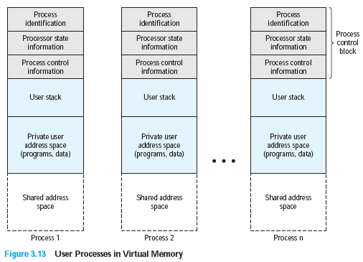
Structure of Process Images in Virtual Memory
Notes:
Figure 3.13 suggests the structure of process images in virtual memory.
Each process image consists of
a process control block,
a user stack,
the private address space of the process, and
any other address space that the process shares with other processes.
In the figure, each process image appears as a contiguous range of addresses. In an actual implementation, this may not be the case; it will depend on the memory management scheme and the way in which control structures are organized by the OS.
The process control block may contain structuring information, including pointers that allow the linking of process control blocks.
Thus, the queues that were described in the preceding section could be implemented as linked lists of process control blocks.

Slide 33
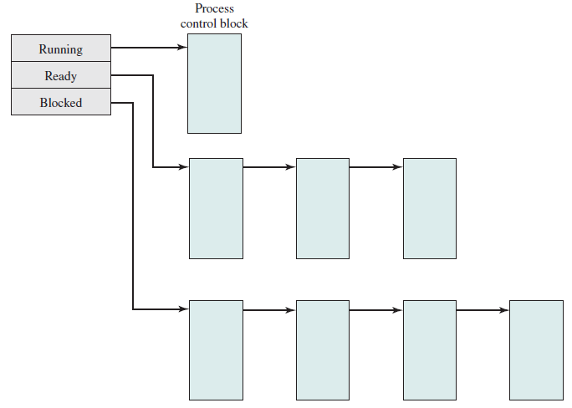
Structure of Process Images in Virtual Memory
Notes:
Figure 3.13 suggests the structure of process images in virtual memory.
Each process image consists of
a process control block,
a user stack,
the private address space of the process, and
any other address space that the process shares with other processes.
In the figure, each process image appears as a contiguous range of addresses. In an actual implementation, this may not be the case; it will depend on the memory management scheme and the way in which control structures are organized by the OS.
The process control block may contain structuring information, including pointers that allow the linking of process control blocks.
Thus, the queues that were described in the preceding section could be implemented as linked lists of process control blocks.

Slide 34
Modes of Execution
Most processors support at least two modes of execution
User mode
Less-privileged mode
User programs typically execute in this mode
System mode
More-privileged mode
Kernel of the operating system
Notes:
The less-privileged mode is often referred to as the user mode, because user programs typically would execute in this mode.
Mention that System Mode is also known as
Control Mode
Kernel Mode
Protected Mode
Certain instructions can only be executed in the more-privileged mode.
Including reading or altering a control register, such as the program status word;
primitive I/O instructions;
Instructions that relate to memory management.
In addition, certain regions of memory can only be accessed in the more-privileged mode.
Table 3.7 lists the functions typically found in the kernel of an OS.
Questions: How does the processor know in which mode it is to be executing? And how does it change
Answer:
Typically a flag (single bit) in the program status word (PSW). This bit is changed in response to certain events.
Typically, when a user makes a call to an operating system service or when an interrupt triggers execution of an operating system routine, the mode is set to the kernel mode and, upon return from the service to the user process, the mode is set to user mode.

Slide 35
Process Creation
Once the OS decides to create a new process it:
Assigns a unique process identifier
Allocates space for the process
Initializes process control block
Sets up appropriate linkages
Creates or expand other data structures

Slide 36
Switching Processes
The steps in a process switch are:
Save context of processor including program counter and other registers
Update the process control block of the process that is currently in the Running state
Move process control block to appropriate queue – ready; blocked; ready/suspend
Notes:
If the currently running process is to be moved to another state (Ready, Blocked, etc.), then the OS must make substantial changes in its environment.
The steps involved in a full process switch are as follows:
1. Save the context of the processor, including program counter and other registers.
2. Update the process control block of the process that is currently in the Running state.
This includes changing the state of the process to one of the other states (Ready; Blocked; Ready/Suspend; or Exit). Other relevant fields must also be updated, including the reason for leaving the Running state and accounting information.
3. Move the process control block of this process to the appropriate queue (Ready;Blocked on Eventi; Ready/Suspend).
More next slide

Slide 37
Switching Processes
Select another process for execution
Update the process control block of the process selected
Update memory-management data structures
Restore context of the selected process
Notes:
4. Select another process for execution;
5. Update the process control block of the process selected. This includes changing the state of this process to Running.
6. Update memory management data structures. This may be required, depending on how address translation is managed;
7. Restore the context of the processor to that which existed at the time the selected process was last switched out of the Running state, by loading in the previous values of the program counter and other registers.

Slide 38
Is the OS a Process?
If the OS is just a collection of programs and if it is executed by the processor just like any other program, is the OS a process?
If so, how is it controlled?
Who (what) controls it?
Notes:
If the OS is just a collection of programs and if it is executed by the processor just like any other program, is the OS a process?
If so, how is it controlled? These interesting questions have inspired a number of design approaches.

Slide 39
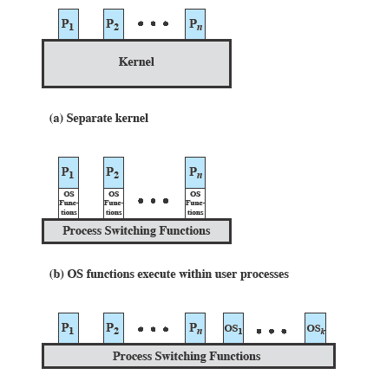
Execution of the Operating System
Notes:
This figure is explained in the following slides

Slide 40
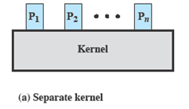
Non-process Kernel
Execute kernel outside of any process
The concept of process is considered to apply only to user programs
Operating system code is executed as a separate entity that operates in privileged mode
Notes:
The key point is that the concept of process is considered to apply only to user programs. The operating system code is executed as a separate entity that operates in privileged mode.
Common on many older operating systems,
Execute the kernel of the OS outside of any process.
When the currently running process is interrupted or issues a supervisor call,
the mode context of this process is saved and control is passed to the kernel.
The OS has its own region of memory to use and its own system stack for controlling procedure calls and returns.
The OS can perform any desired functions and restore the context of the interrupted process, which causes execution to resume in the interrupted user process.
Or, the OS can complete the function of saving the environment of the process and proceed to schedule and dispatch another process. Whether this happens depends on the reason for the interruption and the circumstances at the time.
The key point is that the concept of process is considered to apply only to user programs. The operating system code is executed as a separate entity that operates in privileged mode.

Slide 41
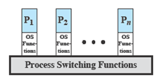
Execution Within User Processes
Execution Within User Processes
Operating system software within context of a user process
No need for Process Switch to run OS routine
Notes:
Common with operating systems on smaller computers (PCs, workstations)
Execute virtually all OS software in the context of a user process
The view is that the OS is primarily a collection of routines that the user calls to perform various functions, executed within the environment of the user’s process.
At any given point, the OS is managing n process images.
Each image includes not only the regions illustrated, but also program, data, and stack areas for kernel programs.
Figure 3.16 suggests a typical process image structure for this strategy.
A separate kernel stack is used to manage calls/returns while the process is in kernel mode.
Operating system code and data are in the shared address space and are shared by all user processes.
When an interrupt, trap, or supervisor call occurs, the processor is placed in kernel mode and control is passed to the OS.
To pass control from a user program to the OS, the mode context is saved and a mode switch takes place to an operating system routine.
However, execution continues within the current user process. Thus, a process switch is not performed, just a mode switch within the same process.
If the OS, upon completion of its work, determines that the current process should continue to run, then a mode switch resumes the interrupted program within the current process.
This is one of the key advantages of this approach:
A user program has been interrupted to employ some operating system routine, and then resumed, and all of this has occurred without incurring the penalty of two process switches.

Slide 42
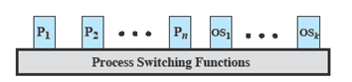
Process-based Operating System
Process-based operating system
Implement the OS as a collection of system process
Notes:
Another alternative is to implement the OS as a collection of system processes.
As in the other options, the software that is part of the kernel executes in a kernel mode.
In this case, however, major kernel functions are organized as separate processes.
Again, there may be a small amount of process switching code that is executed outside of any process.
This approach has several advantages.
It imposes a program design discipline that encourages the use of a modular OS with minimal, clean interfaces between the modules.
Some noncritical operating system functions are conveniently implemented as separate processes.
Implementing the OS as a set of processes is useful in a multiprocessor or multicomputer environment, in which some of the operating system services can be shipped out to dedicated processors, improving performance.

Slide 43
Unix SVR4 System V Release 4
Most of the OS executes in the user process
System Processes - Kernel mode only
User Processes
User mode to execute user programs and utilities
Kernel mode to execute instructions that belong to the kernel.
Notes:
UNIX System V makes use of a simple but powerful process facility that is highly visible to the user.
System processes run in kernel mode and execute operating system code to perform administrative and housekeeping functions, such as allocation of memory and process swapping.
User processes operate in:
user mode to execute user programs and utilities
in kernel mode to execute instructions that belong to the kernel.
A user process enters kernel mode by issuing a system call, when an exception (fault) is generated, or when an interrupt occurs.

Slide 44
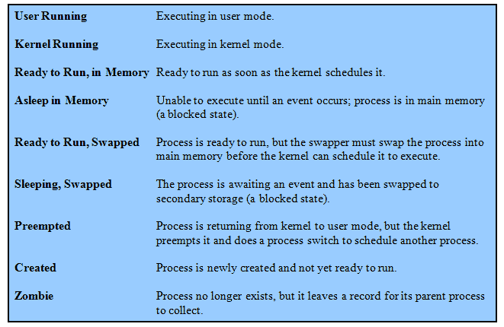
UNIX Process States

Slide 45
Process Creation
Process creation is by means of the kernel system call,fork( ).
This causes the OS, in Kernel Mode, to:
Allocate a slot in the process table for the new process.
Assign a unique process ID to the child process.
Copy of process image of the parent, with the exception of any shared memory.

Slide 46
Process Creation cont…
Increment the counters for any files owned by the parent, to reflect that an additional process now also owns those files.
Assign the child process to the Ready to Run state.
Returns the ID number of the child to the parent process, and a 0 value to the child process.

Slide 47
After Creation
After creating the process the Kernel can do one of the following, as part of the dispatcher routine:
Stay in the parent process.
Transfer control to the child process
Transfer control to another process.

