Slide 1
Chapter 11
I/O Management and Disk Scheduling
Notes:
These slides are intended to help a teacher develop a presentation. This PowerPoint covers the entire chapter and includes too many slides for a single delivery. Professors are encouraged to adapt this presentation in ways which are best suited for their students and environment.

Slide 2
Differences in I/O Devices
Devices differ in a number of areas
  Data Rate
  Application
  Complexity of Control
  Unit of Transfer
  Error Conditions
Notes:
Each of these are covered in subsequent slides
This diversity makes a uniform and consistent approach to I/O, both from the point of view of the operating system and from the point of view of user processes, difficult to achieve.

Slide 3
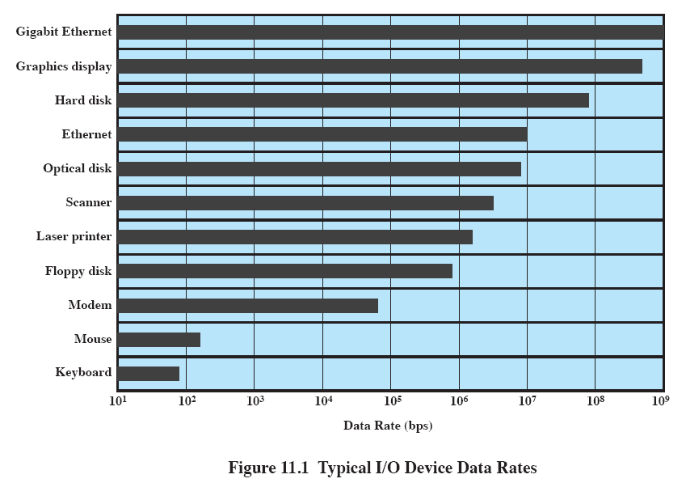
Data Rate
Notes:
There may be differences of several orders of magnitude between the data transfer rates.

Slide 4
Efficiency
Most I/O devices extremely slow compared to main memory
Use of multiprogramming allows for some processes to be waiting on I/O while another process executes
I/O cannot keep up with processor speed
Notes:
Efficiency is important because I/O operations often form a bottleneck in a computing system.
One way to tackle this problem is multiprogramming, which, as we have seen, allows some processes to be waiting on I/O operations while another process is executing.
However, even with the vast size of main memory in today’s machines, often I/O is not keeping up with the activities of the processor.
Swapping is used to bring in additional ready processes to keep the processor busy, but this in itself is an I/O operation.
Thus, a major effort in I/O design has been schemes for improving the efficiency of the I/O.
The area that has received the most attention, because of its importance, is disk I/O.

Slide 5
Disk Performance Parameters
The actual details of disk I/O operation depend on many things
Notes:
The actual details of disk I/O operation depend on the computer system, the operating system, and the nature of the I/O channel and disk controller hardware.
A general timing diagram of disk I/O transfer is shown in Figure 11.6.

Slide 6
Positioning the Read/Write Heads
When the disk drive is operating, the disk is rotating at constant speed.
Track selection involves moving the head in a movable-head system or electronically selecting one head on a fixed-head system.
Notes:
When the disk drive is operating, the disk is rotating at constant speed.
To read or write, the head must be positioned at the desired track and at the beginning of the desired sector on that track.
Track selection involves moving the head in a movable-head system or electronically selecting one head on a fixed-head system.

Slide 7
Disk Performance Parameters
Access Time is the sum of:
  Seek time: The time it takes to position the head at the desired track
  Rotational delay or rotational latency: The time its takes for the beginning of the sector to reach the head
    The average rotational delay is half of the 1 rotate time
Transfer Time is the time taken to transfer the data.
Notes:
Access Time is the sum of
Seek Time is the time it takes to position the head at the track.
Rotational delay is the time it takes for the beginning of the sector to reach the head
Once the head is in position, the read or write operation is then performed as the sector moves under the head;
this is the data transfer portion of the operation; the time required for the transfer is the transfer time.

Slide 8
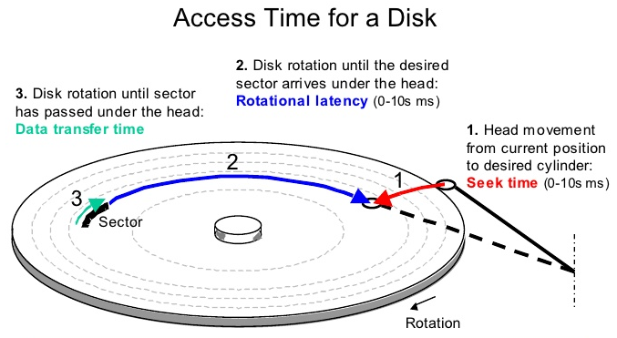
Disk Performance Parameters
Notes:
Access Time is the sum of
Seek Time is the time it takes to position the head at the track.
Rotational delay is the time it takes for the beginning of the sector to reach the head
Once the head is in position, the read or write operation is then performed as the sector moves under the head;
this is the data transfer portion of the operation; the time required for the transfer is the transfer time.

Slide 9
Disk Performance Parameters
Assume that we have a disk with :
  Average seek time: 10 ms
  Rotation rate: 3600 RPM
  Transfer rate: 2 MB/second
  Sector size: 512 bytes
  Controller overhead: 5 ms
What is the average transfer time of a sector?
5 + 10 + 8.3 + 0.2 = 23.5
Notes:
Access Time is the sum of
Seek Time is the time it takes to position the head at the track.
Rotational delay is the time it takes for the beginning of the sector to reach the head
Once the head is in position, the read or write operation is then performed as the sector moves under the head;
this is the data transfer portion of the operation; the time required for the transfer is the transfer time.

Slide 10
Disk Scheduling Policies
FIFO
LIFO
SSTF
SCAN
C-SCAN

Slide 11
Disk Scheduling Policies
To compare various schemes, consider a disk head is initially located at track 100.
  assume a disk with 200 tracks and that the disk request queue has random requests in it.
  Assume that moving the head between two consecutive tracks takes 1 ms.
The requested tracks, in the order received by the disk scheduler, are
  55, 58, 39, 18, 90, 160, 150, 38, 184.

Slide 12
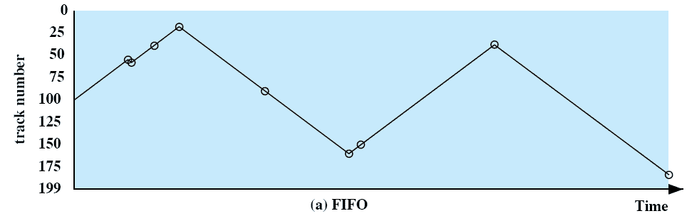
First-in, first-out (FIFO)
Process request sequentially
Fair to all processes
Approaches random scheduling in performance if there are many processes
55, 58, 39, 18, 90, 160, 150, 38, 184
Avg Seek time= (45+3+19+21+72+70+10+112+146)/9 = 55.3 ms
Notes:
Movie icon jumps to animation at http://gaia.ecs.csus.edu/%7ezhangd/oscal/DiskApplet.html
The simplest form of scheduling is first-in-first-out (FIFO) scheduling, which processes items from the queue in sequential order.
This strategy has the advantage of being fair, because every request is honored and the requests are honored in the order received.
This figure illustrates the disk arm movement with FIFO.
This graph is generated directly from the data in Table 11.2a.
As can be seen, the disk accesses are in the same order as the requests were originally received.
With FIFO, if there are only a few processes that require access and if many of the requests are to clustered file sectors, then we can hope for good performance.
But, this technique will often approximate random scheduling in performance, if there are many processes competing for the disk.

Slide 13
Last-in, first-out
Good for transaction processing systems
  The device is given to the most recent user so there should be little arm movement
Possibility of starvation since a job may never regain the head of the line
Notes:
In transaction processing systems, giving the device to the most recent user should result in little or no arm movement for moving through a sequential file.

Slide 14
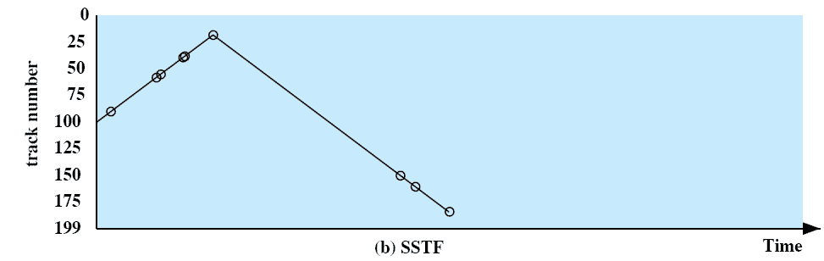
Shortest Service Time First (SSTF)
Select the disk I/O request that requires the least movement of the disk arm from its current position
Always choose the minimum seek time
55, 58, 39, 18, 90, 160, 150, 38, 184
Avg Seek time=(10+32+3+16+1+20+132+10+24)/9 = 27.5 ms
Notes:
Select the disk I/O request that requires the least movement of the disk arm from its current position.
Thus, we always choose to incur the minimum seek time.
Always choosing the minimum seek time does not guarantee that the average seek time over a number of arm movements will be minimum.
However, this should provide better performance than FIFO.
Because the arm can move in two directions, a random tie-breaking algorithm may be used to resolve cases of equal distances.

Slide 15
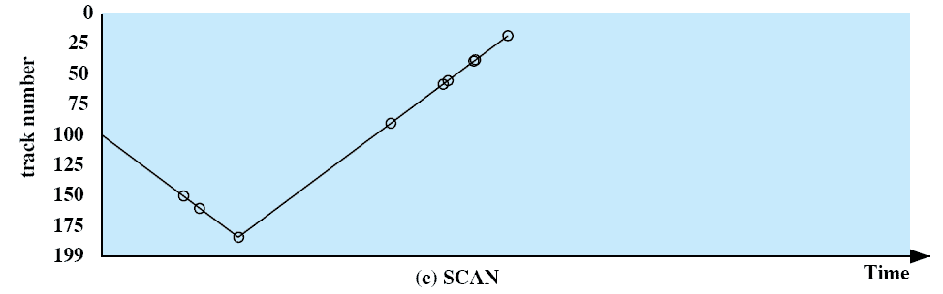
SCAN (Elevator)
Arm moves in one direction only, satisfying all outstanding requests until it reaches the last track in that direction then the direction is reversed
55, 58, 39, 18, 90, 160, 150, 38, 184
Avg Seek time=(50+10+24+94+32+3+16+1+20)/9 = 27.7 ms
Notes:
With SCAN, the arm is required to move in one direction only, satisfying all outstanding requests en route, until it reaches the last track in that direction or until there are no more requests in that direction.
The service direction is then reversed and the scan proceeds in the opposite direction, again picking up all requests in order.
This latter refinement is sometimes referred to as the LOOK policy.
The SCAN policy favors jobs whose requests are for tracks nearest to both innermost and outermost tracks and favors the latest-arriving jobs.

Slide 16
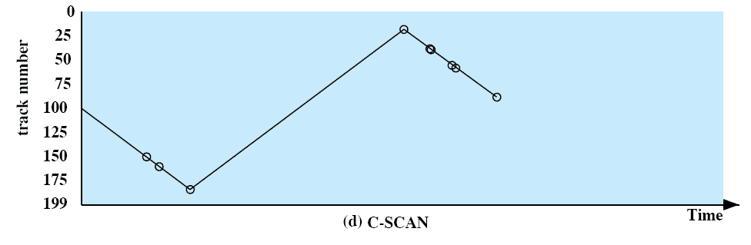
C-SCAN
Restricts scanning to one direction only
When the last track has been visited in one direction, the arm is returned to the opposite end of the disk and the scan begins again
55, 58, 39, 18, 90, 160, 150, 38, 184
Avg Seek time=(50+10+24+166+20+1+16+3+32)/9 = 35.8 ms
Notes:
The C-SCAN (circular SCAN) policy restricts scanning to one direction only.
Thus, when the last track has been visited in one direction, the arm is returned to the opposite end of the disk and the scan begins again.
This reduces the maximum delay experienced by new requests.

Slide 17
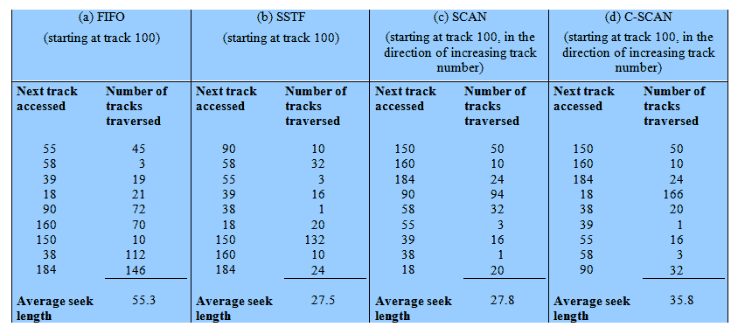
Performance Compared
Comparison of Disk Scheduling Algorithms
Notes:
T

Slide 18
Linux Elevator Scheduler
Maintains a single queue for disk read and write requests
Keeps list of requests sorted by block number
Drive moves in a single direction to satisfy each request
Notes:
The elevator scheduler maintains a single queue for disk read and write requests and performs both sorting and merging functions on the queue.
The elevator scheduler keeps the list of requests sorted by block number.
As the disk requests are handled, the drive moves in a single direction, satisfying each request as it is encountered.

