Slide 1
Chapter 2 Operating System Overview

Slide 2
Operating System
A program that controls the execution of application programs
An interface between applications and hardware
Convenience
Efficiency
Ability to evolve

Slide 3
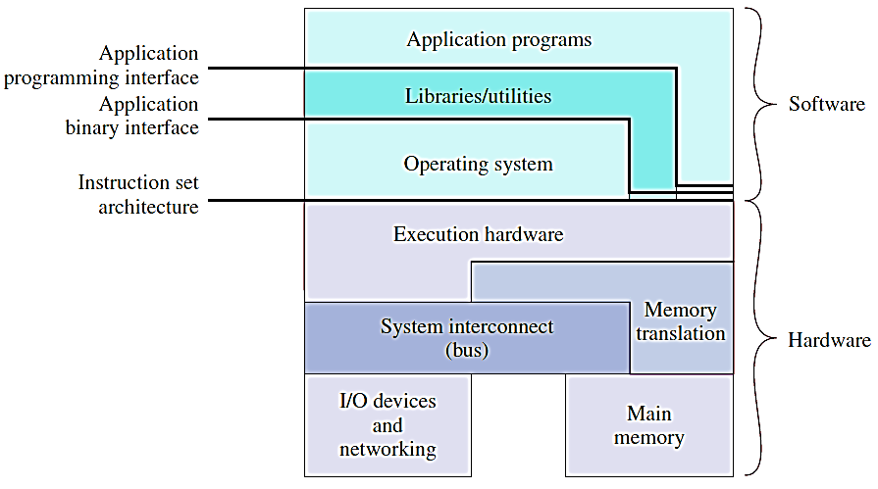
Layers and Views

Slide 4
Services Provided by the OS
Program development
Editors and debuggers
Program execution
Access I/O devices
Controlled access to files
System access
Error detection and response
Internal and external hardware errors
Software errors
Accounting
Collect usage statistics
Monitor performance

Slide 5
Operating System
Responsible for managing resources
Functions same way as ordinary computer software
It is a program that is executed
Operating system relinquishes control of the processor

Slide 6
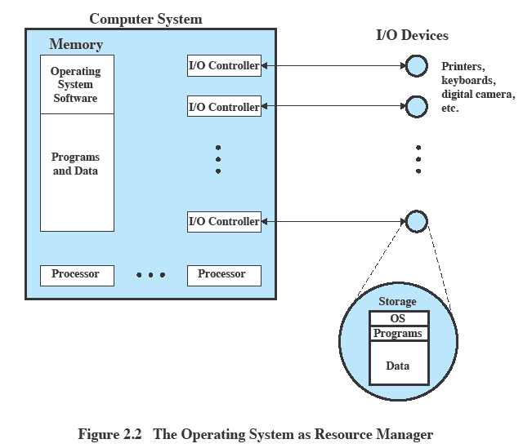
OS as Resource Manager

Slide 7
Kernel
Portion of operating system that is in main memory
Contains most frequently used functions
Also called the nucleus

Slide 8
Evolution of Operating Systems
Hardware upgrades plus new types of hardware
New services
Fixes

Slide 9
Evolution of Operating Systems
Serial processing
No operating system
Machines run from a console with display lights, toggle switches, input device, and printer
Schedule time
Simple batch systems
Monitor
Software that controls the sequence of events
Batch jobs together
Program returns control to monitor when finished

Slide 10
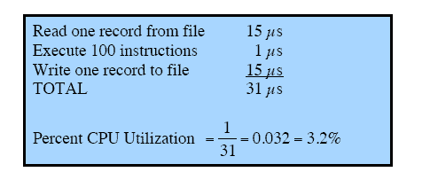
System Utilization Example

Slide 11
Uniprogramming
Processor must wait for I/O instruction to complete before proceeding

Slide 12
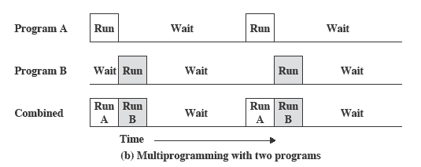
Multiprogramming
When one job needs to wait for I/O, the processor can switch to the other job

Slide 13
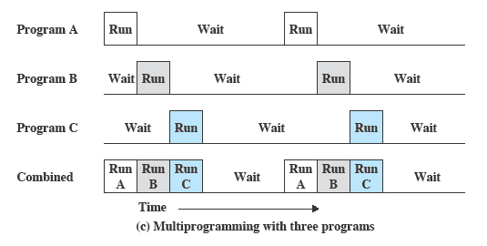
Multiprogramming

Slide 14
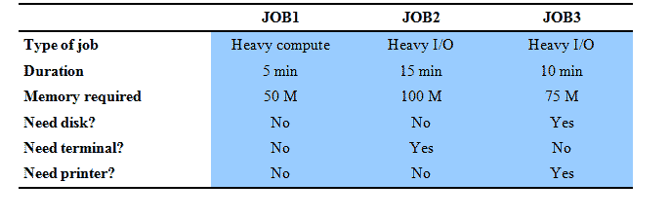
Example

Slide 15
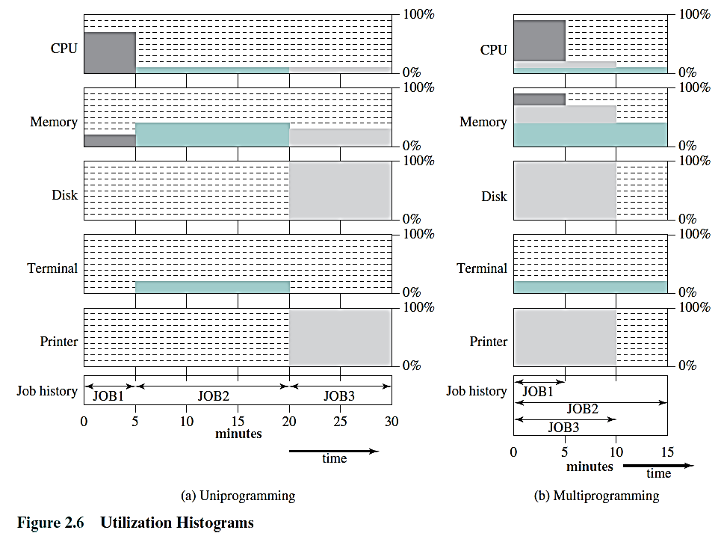
Utilization Histograms

Slide 16
Time Sharing Systems
Using multiprogramming to handle multiple jobs
Processor’s time is shared among multiple users
Multiple users simultaneously access the system through terminals

Slide 17
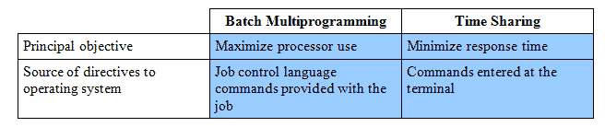
Batch Multiprogramming versus Time Sharing

Slide 18
Major Achievements
Processes
Memory management
Information protection and security
Scheduling and resource management
System structure

Slide 19
Process
A program in execution
An instance of a program running on a computer
The entity that can be assigned to and executed on a processor
A unit of activity characterized by
A set of sequential threads of execution
A current state
An associated set of system resources

Slide 20
Process
Consists of three components
An executable program
Associated data needed by the program
Execution context of the program
Process Control Block (PCB)
All information the operating system needs to manage the process

Slide 21
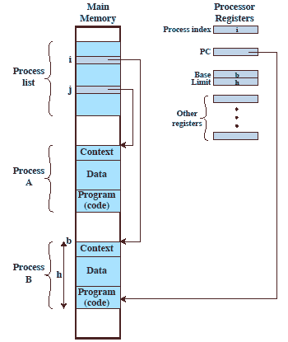
Memory Management
Process isolation
Automatic allocation and management
Support of modular programming
Protection and access control
Long-term storage

Slide 22
Virtual Memory
Implements long-term store
Information stored in named objects called files
Allows programmers to address memory from a logical point of view

Slide 23
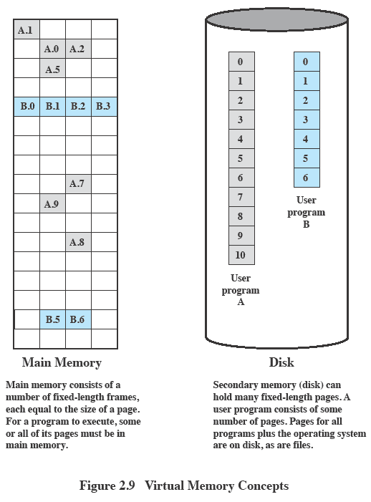
Paging
Allows process to be comprised of a number of fixed-size blocks, called pages
Virtual address is a page number and an offset within the page
Each page may be located anywhere in main memory
Real address or physical address is the main memory address

Slide 24
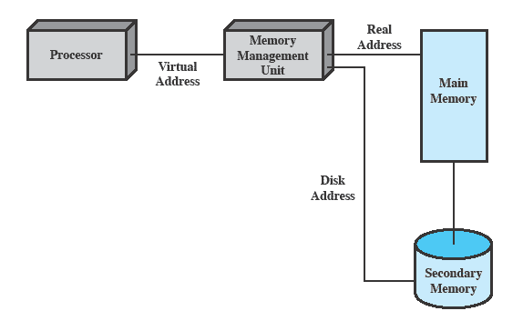
Virtual Memory Addressing

Slide 25
Scheduling and Resource Management
Fairness
Give equal and fair access to resources
Differential responsiveness
Discriminate among different classes of jobs
Efficiency
Maximize throughput, minimize response time, and accommodate as many uses as possible

Slide 26
Modern Operating Systems
Microkernel architecture
Assigns only a few essential functions to the kernel
Address spaces
Interposes communication (IPC)
Basic scheduling
Multithreading
Process is divided into threads that can run concurrently
Thread
Dispatchable unit of work
executes sequentially and is interruptable
Process is a collection of one or more threads

Slide 27
Modern Operating Systems
Symmetric multiprocessing (SMP)
There are multiple processors
These processors share same main memory and I/O facilities
All processors can perform the same functions

Slide 28
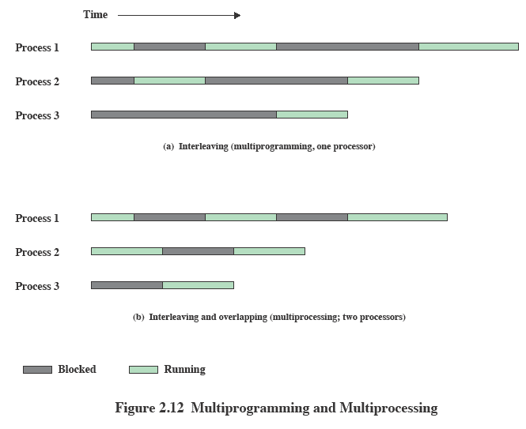
Multiprogramming and Multiprocessing

Slide 29
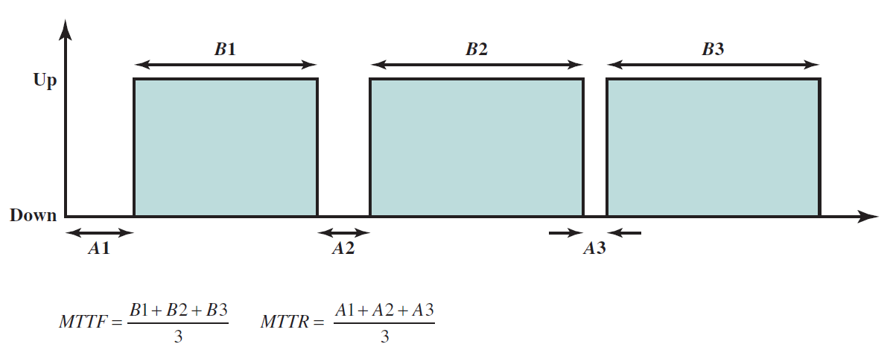
Modern Operating Systems
Reliability
Mean Time To Failure (MTTF)
Mean Time To Repair (MTTR)

Slide 30
Modern Operating Systems
Availability of a system

Slide 31
Modern Operating Systems
Redundancy (a solution to failures)
Spatial (physical) redundancy.
Temporal redundancy.
Information redundancy.

