Slide 1
Chapter 2 Introduction to C Programming
C How to Program, 8/e, GE

Slide 2
We begin by considering a simple C program.

Slide 3
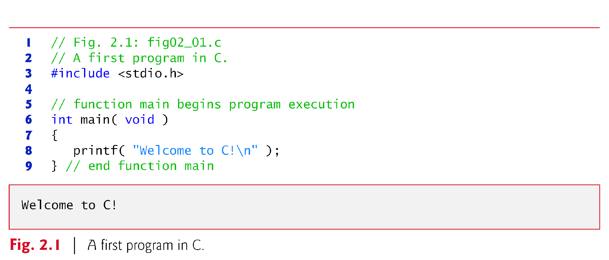
A Simple C Program: Printing a Line of Text

Slide 4
A Simple C Program: Printing a Line of Text (Cont.)
// Fig. 2.1: fig02_01.c // A first program in C
begin with //, indicating that these two lines are comments.
Comments document programs and improve program readability.
Comments do not cause the computer to perform any action when the program is run.

Slide 5
A Simple C Program: Printing a Line of Text (Cont.)
Comments are ignored by the C compiler and do not cause any machine-language object code to be generated.
Comments also help other people read and understand your program.

Slide 6
A Simple C Program: Printing a Line of Text (Cont.)
You can also use /*…*/ multi-line comments in which everything from /* on the first line to */ at the end of the line is a comment.
#include Preprocessor Directive
#include <stdio.h>
is a directive to the C preprocessor.

Slide 7
A Simple C Program: Printing a Line of Text (Cont.)
Lines beginning with # are processed by the preprocessor before compilation.
Line 3 tells the preprocessor to include the contents of the standard input/output header (<stdio.h>) in the program.

Slide 8
2.2 A Simple C Program: Printing a Line of Text (Cont.)
The main Function
int main( void )
is a part of every C program.
The parentheses after main indicate that main is a program building block called a function.

Slide 9
A Simple C Program: Printing a Line of Text (Cont.)
C programs contain one or more functions, one of which must be main.
Every program in C begins executing at the function main.

Slide 10
A Simple C Program: Printing a Line of Text (Cont.)
A left brace, {, begins the body of every function
A corresponding right brace ends each function
This pair of braces and the portion of the program between the braces is called a block.
An Output Statement
printf( "Welcome to C!\n" );
instructs the computer to perform an action, namely to print on the screen the string of characters marked by the quotation marks.
A string is sometimes called a character string, a message or a literal.

Slide 11
A Simple C Program: Printing a Line of Text (Cont.)

Slide 12
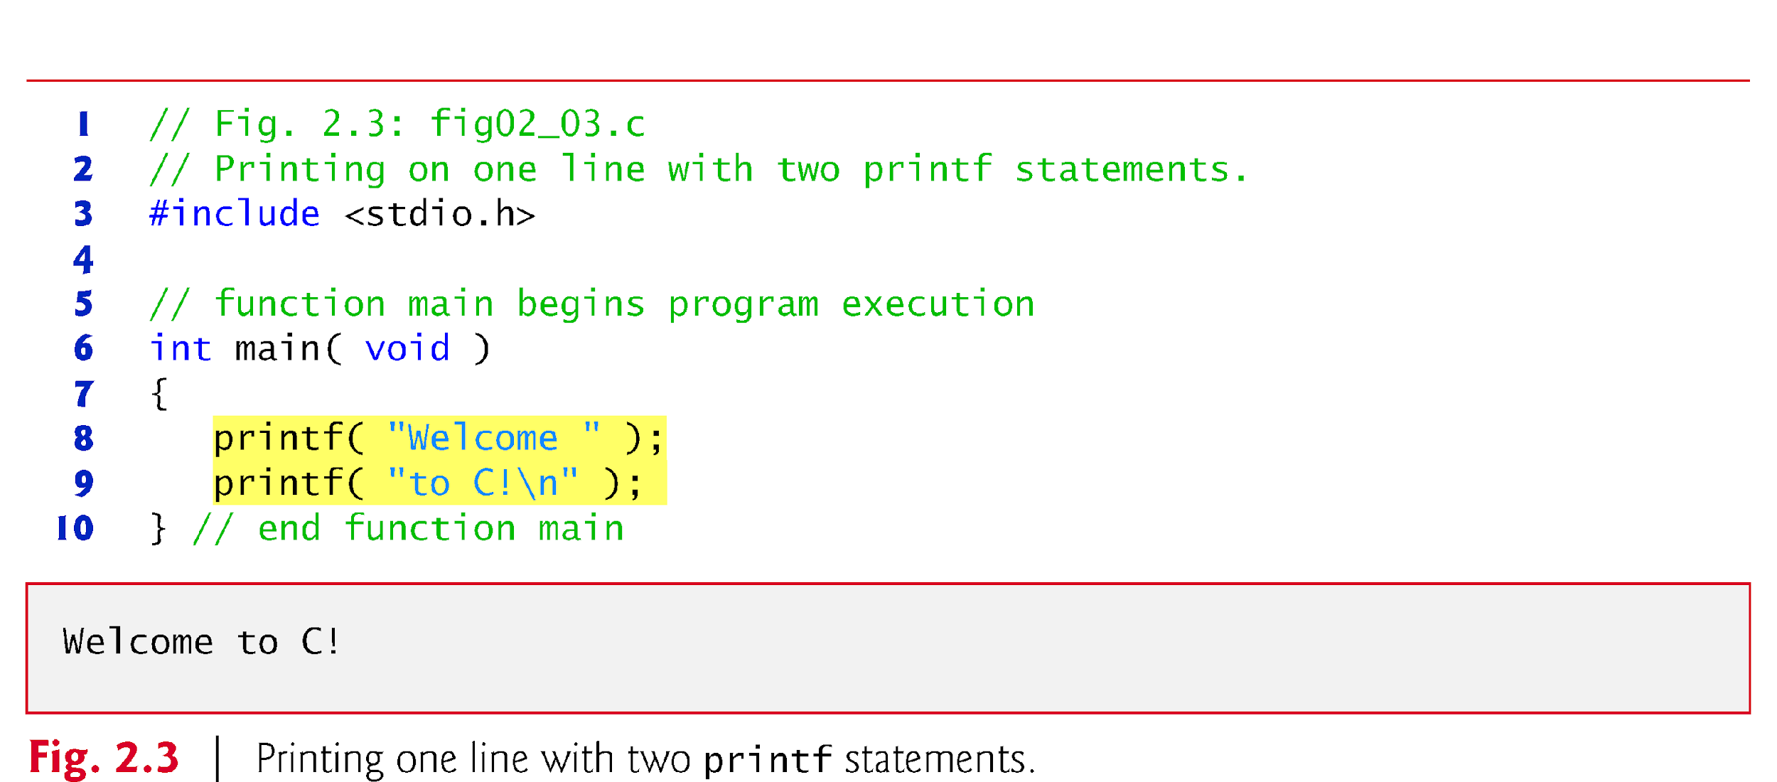
A Simple C Program: Printing a Line of Text (Cont.)
Using Multiple printfs

Slide 13
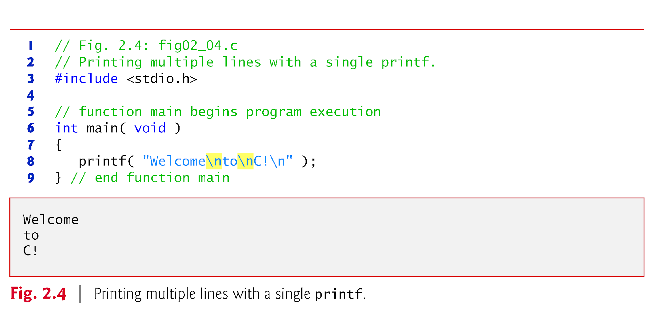
A Simple C Program: Printing a Line of Text (Cont.)

Slide 14
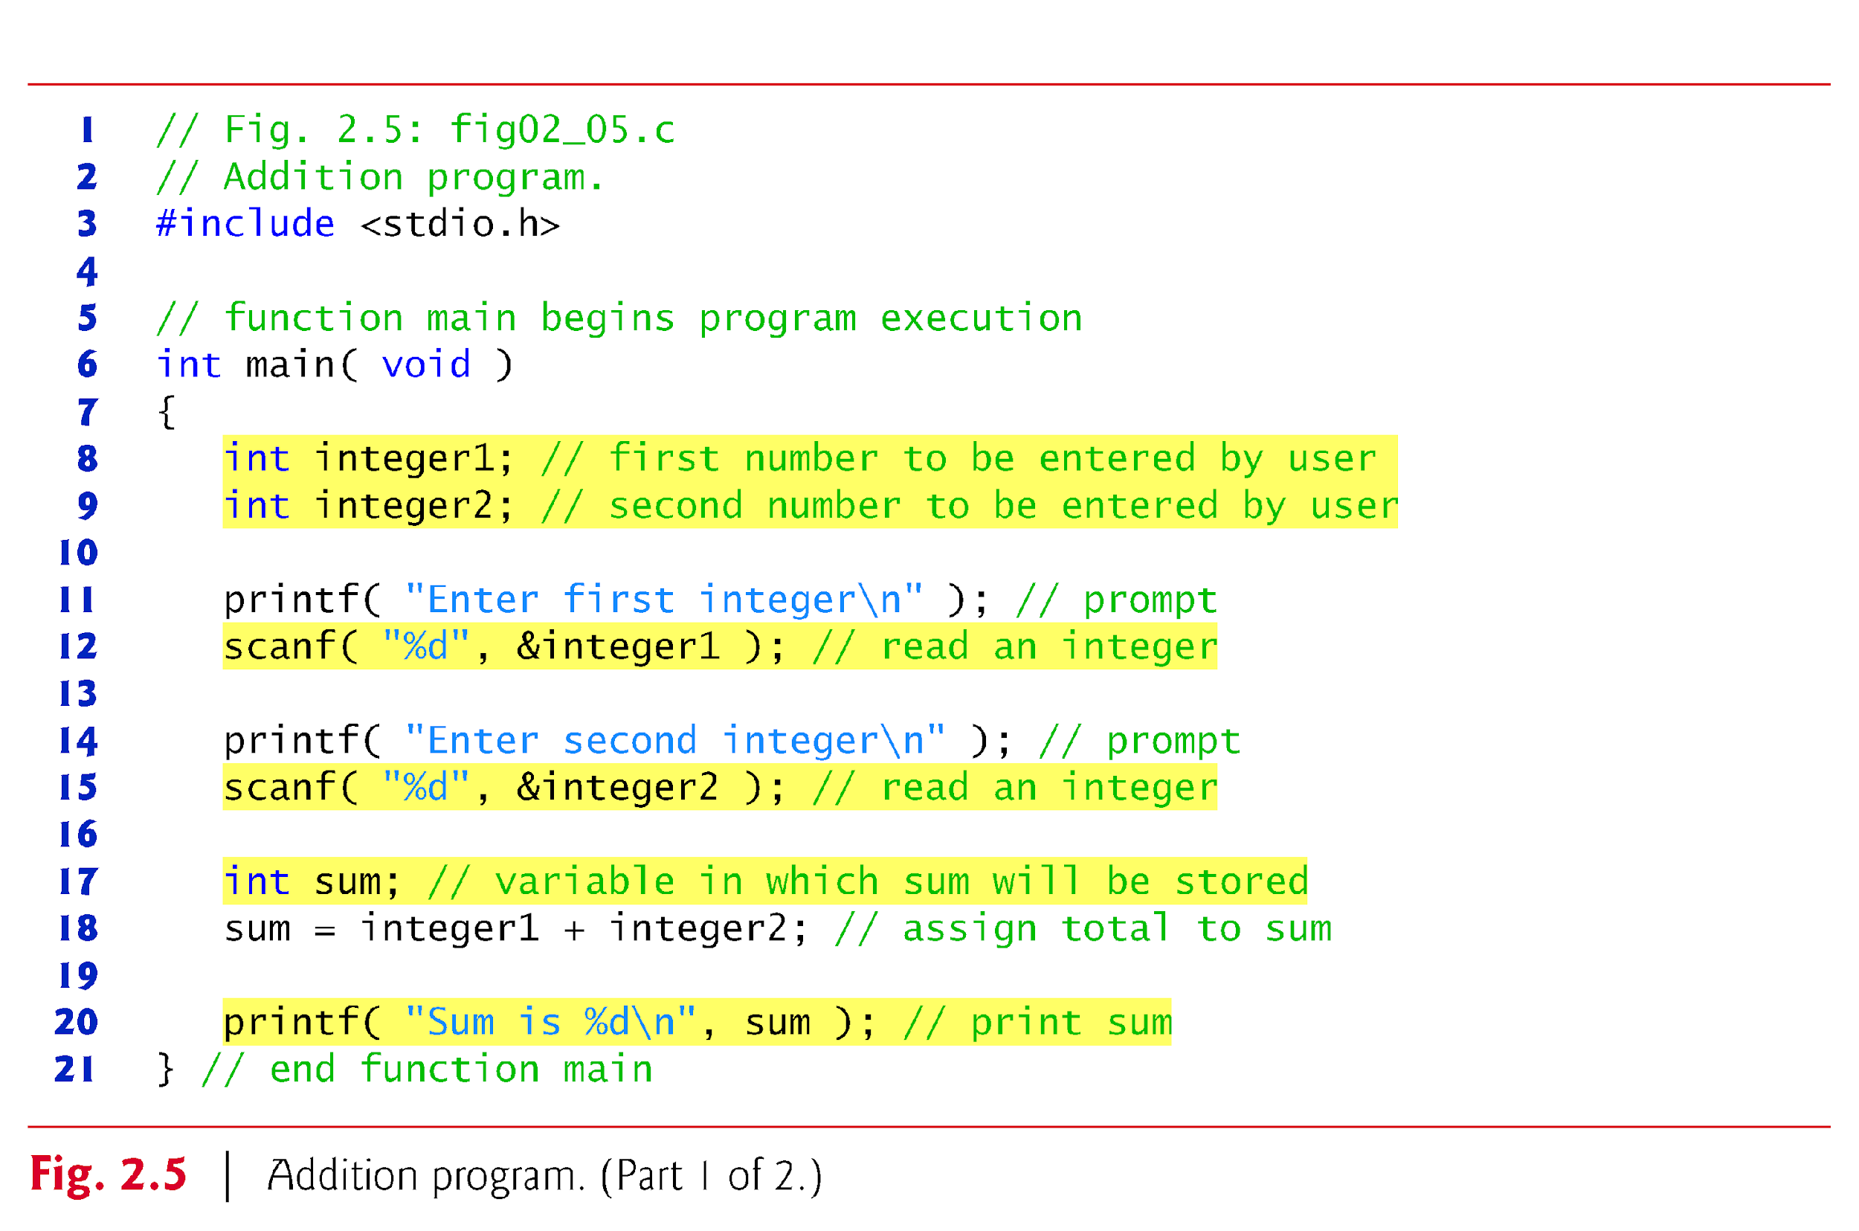
Another Simple C Program: Adding Two Integers

Slide 15
Another Simple C Program: Adding Two Integers

Slide 16
Another Simple C Program: Adding Two Integers (Cont.)
Variables and Variable Definitions
int integer1; // first number to be entered by user int integer2; // second number to be entered by user int sum; // variable in which sum will be stored
are definitions.
The names integer1, integer2 and sum are the names of variables—locations in memory where values can be stored for use by a program.
These definitions specify that the variables integer1, integer2 and sum are of type int, which means that they’ll hold integer values, i.e., whole numbers such as 7, –11, 0, 31914 and the like.

Slide 17
Another Simple C Program: Adding Two Integers (Cont.)
All variables must be defined with a name and a data type before they can be used in a program.
The preceding definitions could have been combined into a single definition statement as follows:
int integer1, integer2, sum;
but that would have made it difficult to describe the variables with corresponding comments

Slide 18
Another Simple C Program: Adding Two Integers (Cont.)
Prompting Messages
printf( "Enter first integer\n" ); // prompt
displays the literal “Enter first integer” and positions the cursor to the beginning of the next line.
This message is called a prompt because it tells the user to take a specific action.

Slide 19
2.3 Another Simple C Program: Adding Two Integers (Cont.)
The scanf Function and Formatted Inputs
The next statement
scanf( "%d", &integer1 ); // read an integer
uses scanf to obtain a value from the user.
The scanf function reads from the standard input, which is usually the keyboard.

Slide 20
Another Simple C Program: Adding Two Integers (Cont.)
This scanf has two arguments, "%d" and &integer1.
The %d conversion specifier indicates that the data should be an integer (the letter d stands for “decimal integer”).
The % in this context is treated by scanf (and printf as we’ll see) as a special character that begins a conversion specifier.
The second argument of scanf begins with an & called followed by the variable name.

Slide 21
2.4 Memory Concepts
Variable names such as integer1, integer2 and sum actually correspond to locations in the computer’s memory.
Every variable has a name, a type and a value.
In the addition program of Fig. 2.5, when the statement
scanf( "%d", &integer1 ); // read an integer
is executed, the value entered by the user is placed into a memory location to which the name integer1 has been assigned.

Slide 22
2.4 Memory Concepts (Cont.)
Whenever a value is placed in a memory location, the value replaces the previous value in that location; thus, this process is said to be destructive.
When the statement
scanf( "%d", &integer2 ); // read an integer
executes, suppose the user enters the value 72.
This value is placed into location integer2, and memory appears as in Fig. 2.7.
These locations are not necessarily adjacent in memory.

Slide 23
2.5 Arithmetic in C

Slide 24
2.5 Arithmetic in C (Cont.)
Integer Division and the Remainder Operator
Integer division yields an integer result
For example, the expression 7 / 4 evaluates to 1 and the expression 17 / 5 evaluates to 3
C provides the remainder operator, %, which yields the remainder after integer division
The expression x % y yields the remainder after x is divided by y
Thus, 7 % 4 yields 3 and 17 % 5 yields 2

Slide 25
2.5 Arithmetic in C (Cont.)
Parentheses for Grouping Subexpressions
Parentheses are used in C expressions in the same manner as in algebraic expressions.
For example, to multiply a times the quantity b + c we write a * ( b + c ).

Slide 26
2.5 Arithmetic in C (Cont.)
Rules of Operator Precedence

Slide 27
