Slide 1
Discrete Math and Its Application to Computer Science
UBİ 501
Lecture - 4
İlker Kocabaş
E.Ü Uluslararası Bilgisayar Enstitüsü
Bornova - İzmir

Slide 2
Flow∗
ALGORITHMS
Introduction
Algorithmic Complexity
Growing Functions
NUMBER THEORY
Modular Arithmetic
Primary Numbers
Greatest Common Divisor (gcd) & Least Common Multipier (lcd)
Ecludian Algorithm for gcd
Number Systems: Decimal, Binary, Octal, ….

Slide 3
Algorithms Introduction (1)
Algorithm:
A finite set of precise instructions for performing a computation or for solving a problem.
Synonyms for a algorithm are: program, recipe, procedure, and many others.
Pseudocode (T: Sözde Kod)
Describing an algorithm by using a specific computure language: Complex instructions and difficult to understand.
Intemadiate step between Natural Language & Programming Language

Slide 4
Algorithms (1) Pseudocode Example
Algorithm-1: Finding the maximum element in a finite sequence
INPUT
procedure max(a₁,a₂,a₃….a_{n}: integers)
max := a₁
for i:=0 to n
if max < a_{i} then max:= a_{i}
output max
DIFINITENESS
OUTPUT

Slide 5
Algorithms Basic Problems in CS
Searching (T: Arama) Algorithms
Finding element a_{i} equals to x
Linear Search, Binary Search, …
Algorithm 2: Linear Search Algorithm
procedure max(x: integer, a₁,a₂,a₃….a_{n}: distinct integers)
i:=1
while (i ≤ n and x ≠ a_{i})
i := i + 1
if i ≤ n then location := i
else location:= 0
output location

Slide 6
Algorithms (1) Basic Problems in CS
Linear Search Example
Find x = 5
while (i ≤ n and x ≠ a_{i})
i := i + 1
if i ≤ n then location := i
else location:= 0
a_{i} | 10 | 1 | 5 | 7 | 11 | 3 | 4 | 12 | 9 | 8 | 6 | 2
i=1 | NO
i=2 |  | NO
i=3 |  |  | YES

Slide 7
Algorithms (1) Basic Problems in CS
Sorting (Sıralama) Algorithms
Sort a sequence A for a given order criteria
Buble Sort, Insertion Sort, …..
A: | 10 | 1 | 5 | 7 | 11 | 3 | 4 | 12 | 9 | 8 | 6 | 2
B: | 1 | 2 | 3 | 4 | 5 | 6 | 7 | 8 | 9 | 10 | 11 | 12

Slide 8
Algorithms (1) Basic Problems in CS
Merging (T: Birleştirme) Algorithms
Merge ordered sequences A & B
A&B: | 1 | 3 | 5 | 7 | 8 | 11 | 2 | 4 | 6 | 9 | 12 | 13
C: | 1 | 2 | 3 | 4 | 5 | 6 | 7 | 8 | 9 | 10 | 11 | 12

Slide 9
Algorithms Algorithmic Complexity (2)
How can the efficiency of an algorithm be analyzed?
Time: “Time used by a computer” to solve a problem
Space: “The amount of Computer memory” required to implement algorithm

Slide 10
Algorithms (2) Running Time
Running time:
Measure the actual time spent by implementation of algorithm.
Deficiencies:
Actual running time changes paltform to platform (1Ghz ≠ 2 Ghz)
There is no information wrt varying n (input size) and input order.
Count the basic operations or steps processed by algorithm

Slide 11
Algorithms (2) Running Time
Running time:
Count the basic operations or steps executed by algorithm
Comparision (T: karşılaştırma) [ Eg. X < Y ]
Assignment (T: Atama) [ Eg. X = 5 ]
Increment/Decriment [ Eg. X = X ± 1 ]
Function Output [ Eg. return/output X ]
Addition/Substruction/Multiplication/Division
………..

Slide 12
Algorithms (2) Running Time
Count the basic operations or steps processed by algorithm
Best Case Analysis: Minimum number of operations executed wrt input behaviour of a given size.
Average Case Analysis: Average number of operations used to solve the problem over all inputs of a given size.
Worst Case Analysis: Maximum number of operations numbers of steps executed wrt input behaviour of a given size.

Slide 13
Algorithms (2) Algorithm 3: Surjectivity
procedure isOnto( f [(1, 2,…, n) → (1, 2,…, m)] : function)
if( m > n ) 1 step comp.
return false 1 step End if exec.
soFarIsOnto := true 1 step ass.
for j := 1 to m m loops: 1 step comp. +1 step increment
soFarIsOnto := false 1 step ass.
for i := 1 to n n loops: 2 steps comp. + inc.
if ( f(i ) = j ) 1 step comp.
soFarIsOnto := true 1 step ass.
if( !soFarIsOnto ) 1 step negation
return false 1 step End
return true; 1 step End

Slide 14
Algorithms (2) Algorithm 3: Surjectivity
Best Case Analysis: 1 operation
if( m > n ) 1 step comp.
return false 1 step End if exec.
Worst Case Analysis: 2+ m(4n+4) = 4mn +4m+2
if( m > n ) 1
return false 1 step End if exec.
soFarIsOnto := true 1
for j := 1 to m m × : [ 1 +1
soFarIsOnto := false 1
for i := 1 to n n ×: ( 1 + 1
if ( f(i ) = j ) 1
soFarIsOnto := true 1)]
if( !soFarIsOnto ) 1
return false 1 step End
return true; 1 step End

Slide 15
Algorithm (2) Comparing Running Times
At most 4mn+4m+2 for first algorithm
At most 6m+2n+2 for second algorithm
Worst case when m ≤ n so replace m by n:
4n ²+4n+2 vs. 8n+2
To tell which is better, look at dominant term:
4n ²+4n+2 vs. 8n+2
So second algorithm is better.

Slide 16
Running Times Issues Big-O Response
Asymptotic notation (Big-O, Big-Ω , Big-Θ) gives partial resolution to problems:
For large n the largest term dominates so 4n ²+4n+2 is modeled by just n ².

Slide 17
Running Times Issues Big-O Response
Asymptotic notation (Big-O, Big-Ω , Big-Θ) gives partial resolution to problems:
Different lengths of basic steps, just change 4n ² to Cn ² for some constant, so doesn’t change largest term

Slide 18
Running Times Issues Big-O Response
Asymptotic notation (Big-O, Big-Ω , Big-Θ) gives partial resolution to problems:
Basic operations on different (but well-designed) platforms will differ by a constant factor. Again, changes 4n ² to Cn ² for some constant.

Slide 19
Running Times Issues Big-O Response
Asymptotic notation (Big-O, Big-Ω , Big-Θ) gives partial resolution to problems:
Even if overestimated by assuming iterations of while-loops that never occurred, may still be able to show that overestimate only represents different constant multiple of largest term.

Slide 20
Big-O, Big-Ω, Big-Θ
Useful for computing algorithmic complexity, i.e. the amount of time that it takes for computer program to run.

Slide 21
Notational Issues
Big-O notation is a way of comparing functions. Notation unconventional:
EG: 3x ³ + 5x ² – 9 = O (x ³)
Doesn’t mean
“3x ³ + 5x ² – 9 equals the function O (x ³)”
Which actually means
“3x ³+5x ² –9 is dominated by x ³”
Read as: “3x ³+5x ² –9 is big-Oh of x ³”

Slide 22
Intuitive Notion of Big-O
Asymptotic notation captures behavior of functions for large values of x.
EG: Dominant term of 3x ³+5x ² –9 is x ³.
As x becomes larger and larger, other terms become insignificant and only x ³ remains in the picture:

Slide 23
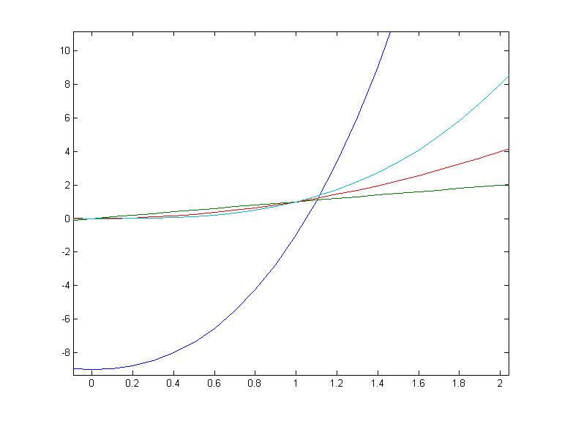
Intuitive Notion of Big-O domain – [0,2]
y = 3x ³+5x ² –9
y = x ³
y = x ²
y = x

Slide 24
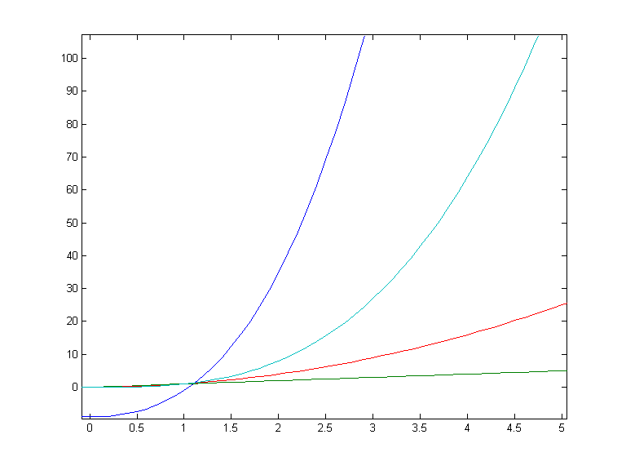
Intuitive Notion of Big-O domain – [0,5]
y = 3x ³+5x ² –9
y = x ³
y = x ²
y = x

Slide 25
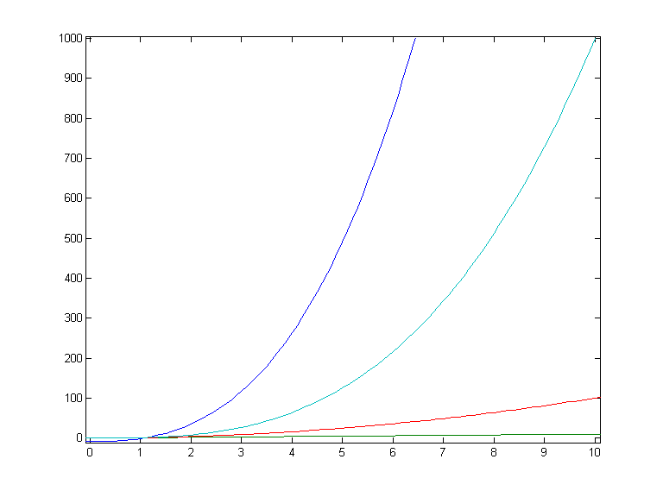
Intuitive Notion of Big-O domain – [0,10]
y = 3x ³+5x ² –9
y = x ³
y = x ²
y = x

Slide 26
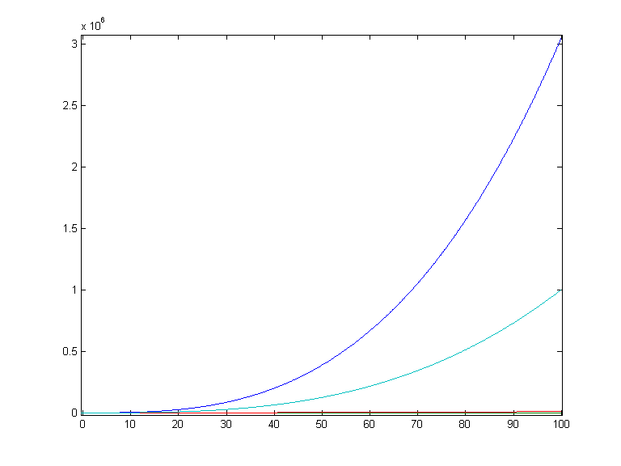
Intuitive Notion of Big-O domain – [0,100]
y = 3x ³+5x ² –9
y = x ³
y = x ²
y = x

Slide 27
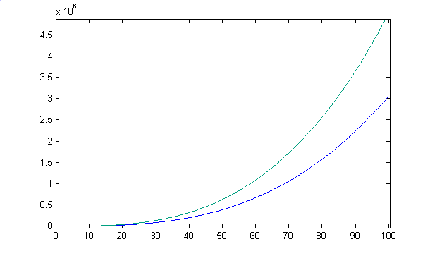
Intuitive Notion of Big-O
In fact, 3x ³+5x ² –9 is smaller than 5x ³ for large enough values of x:
y = 5x ³
y = 3x ³+5x ² –9
y = x ²
y = x

Slide 28
Big-O. Formal Definition
f (x ) is asymptotically dominated by g (x ) if there’s a constant multiple of g (x ) bigger than f (x ) as x goes to infinity:
DEF: Let f , g be functions with domain R_{≥0} or N and codomain R. If there are constants C and k such
∀ x > k, |f (x )| ≤ C ⋅ |g (x )|
then we write:
f (x ) = O ( g (x ) )

Slide 29
Common Misunderstanding
It’s true that 3x ³ + 5x ² – 9 = O (x ³) as we’ll prove shortly. However, also true are:
3x ³ + 5x ² – 9 = O (x ⁴)
x ³ = O (3x ³ + 5x ² – 9)
sin(x) = O (x ⁴)
NOTE: C.S. usage of big-O typically involves mentioning only the most dominant term.
“The running time is O (x ^{2.5})”
Mathematically big-O is more subtle.

Slide 30
Big-O. Example
EG: Show that 3x ³ + 5x ² – 9 = O (x ³).
Previous graphs show C = 5 good guess.
Find k so that
3x ³ + 5x ² – 9 ≤ 5x ³
for x > k
Notes:
As was mentioned in class by a student, there is a simpler proof:
For x > 1, 3x ³ + 5x ² – 9 < 5x ³ + 5x ² < 5x ³ + 5x ³ = 10x ³
Therefore let C=10 and k=1 in the definition of big-O to complete the proof

Slide 31
EG: Show that 3x ³ + 5x ² – 9 = O (x ³).
Find k so that
3x ³ + 5x ² – 9 ≤ 5x ³
for x > k
Collect terms: 5x ² ≤ 2x ³ + 9

Slide 32
EG: Show that 3x ³ + 5x ² – 9 = O (x ³).
Find k so that
3x ³ + 5x ² – 9 ≤ 5x ³
for x > k
Collect terms: 5x ² ≤ 2x ³ + 9
What k will make 5x ² ≤ x ³ for x > k ?

Slide 33
EG: Show that 3x ³ + 5x ² – 9 = O (x ³).
Find k so that
3x ³ + 5x ² – 9 ≤ 5x ³
for x > k
Collect terms: 5x ² ≤ 2x ³ + 9
What k will make 5x ² ≤ x ³ for x > k ?
k = 5 !

Slide 34
EG: Show that 3x ³ + 5x ² – 9 = O (x ³).
Find k so that
3x ³ + 5x ² – 9 ≤ 5x ³
for x > k
Collect terms: 5x ² ≤ 2x ³ + 9
What k will make 5x ² ≤ x ³ for x > k ?
k = 5 !
So for x > 5, 5x ² ≤ x ³ ≤ 2x ³ + 9

Slide 35
EG: Show that 3x ³ + 5x ² – 9 = O (x ³).
Find k so that
3x ³ + 5x ² – 9 ≤ 5x ³
for x > k
Collect terms: 5x ² ≤ 2x ³ + 9
What k will make 5x ² ≤ x ³ for x > k ?
k = 5 !
So for x > 5, 5x ² ≤ x ³ ≤ 2x ³ + 9
Solution: C = 5, k = 5 (not unique!)

Slide 36
EG: Show that 3x ³ + 5x ² – 9 = O (x ³).
Find k so that
3x ³ + 5x ² – 9 ≤ 5x ³
for x > k
Collect terms: 5x ² ≤ 2x ³ + 9
What k will make 5x ² ≤ x ³ for x > k ?
k = 5 !
So for x > 5, 5x ² ≤ x ³ ≤ 2x ³ + 9
Solution: C = 5, k = 5 (not unique!)

Slide 37
Big-O. Negative Example
x ⁴ ≠ O (3x ³ + 5x ² – 9) :
No pair C, k exist for which x > k implies C (3x ³ + 5x ² – 9) ≥ x ⁴
Argue using limits:
x ⁴ always catches up regardless of C. 

Slide 38
Big-O and limits
LEMMA: If the limit as x → ∞ of the quotient |f (x) / g (x)| exists then f (x ) = O ( g (x ) ).
EG: 3x ³ + 5x ² – 9 = O (x ³ ). Compute:
…so big-O relationship proved.

Slide 39
Little-o and limits
DEF: If the limit as x → ∞ of the quotient |f (x) / g (x)| = 0 then f (x ) = o (g (x ) ).
EG: 3x ³ + 5x ² – 9 = o (x ^{3.1} ). Compute:

Slide 40
Big-Ω and Big-Θ
Big-Ω: reverse of big-O. I.e.
f (x ) = Ω(g (x )) ←→ g (x ) = O (f (x ))
so f (x ) asymptotically dominates g (x ).
Big-Θ: domination in both directions. I.e.
f (x ) = Θ(g (x ))
←→
f (x ) = O (g (x )) ∧ f (x ) = Ω(g (x ))
Synonym for f = Θ(g): “f is of order g ”

Slide 41
Useful facts
Any polynomial is big-Θ of its largest term
EG: x ⁴/100000 + 3x ³ + 5x ² – 9 = Θ(x ⁴)
The sum of two functions is big-O of the biggest
EG: x ⁴ ln(x ) + x ⁵ = O (x ⁵)
Non-zero constants are irrelevant:
EG: 17x ⁴ ln(x ) = O (x ⁴ ln(x ))

Slide 42
Big-O, Big-Ω, Big-Θ. Examples
Q: Order the following from smallest to largest asymptotically. Group together all functions which are big-Θ of each other:

Slide 43
Big-O, Big-Ω, Big-Θ. Examples
A:
1.
2.
3. , (change of base formula)
4.
5.
6.
7.
8.
9.
10.

Slide 44
Incomparable Functions
Given two functions f (x ) and g (x ) it is not always the case that one dominates the other so that f and g are asymptotically incomparable.
E.G:
f (x) = |x ² sin(x)| vs. g (x) = 5x ^{1.5}

Slide 45
Incomparable Functions
y = x ²
y = |x ² sin(x)|
y = 5x ^{1.5}

Slide 46
Incomparable Functions
y = x ²
y = 5x ^{1.5}
y = |x ² sin(x)|

Slide 47
Big-O A Grain of Salt
Big-O notation gives a good first guess for deciding which algorithms are faster. In practice, the guess isn’t always correct.
Consider time functions n ⁶ vs. 1000n ^{5.9}. Asymptotically, the second is better. Often catch such examples of purported advances in theoretical computer science publications. The following graph shows the relative performance of the two algorithms:

Slide 48
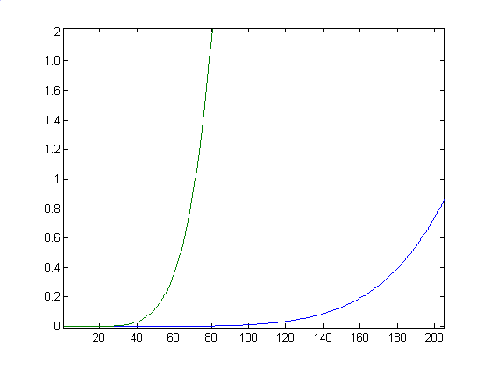
Big-O A Grain of Salt
Running-time
In days
Assuming each operation
takes a nano-second, so
computer runs at 1 GHz
T(n) =
1000n ^{5.9}
T(n) = n ⁶
Input size n

Slide 49
Big-O A Grain of Salt
In fact, 1000n ^{5.9} only catches up to n ⁶ when 1000n ^{5.9} = n ⁶, i.e.:
1000= n ^{0.1}, i.e.:
n = 1000¹⁰ = 10³⁰ operations
= 10³⁰/10⁹ = 10²¹ seconds ≈ 10²¹/(3x10⁷) ≈ 3x10¹³ years
≈ 3x10¹³/(2x10¹⁰)
≈ 1500 universe lifetimes!

Slide 50
Algorithms Extra-1
The world of computation can be subdivided into three classes:
Tractable Problems
Polynomial worst-case complexity (P Class)
Θ(n^{c}), c ≥ 1 constant [Eg.Bubble Sort Algorithm is Θ(n²)]
Intractable Problems (NP Class)
Exponential worst-case complexity (E Class)
Θ(c^{n}), c ≥ 1 constant [Eg.Satisfiability Algorithm is Θ(2^{n})]
Factorial worst-case complexity (F Class)
Θ(n!), [Eg.Traveling Salesman Algorithm is Θ(n!)]
Unsolvable Problems
No algorithms exists for solving them
Halting Problem

Slide 51
Algorithms Extra-2
NP (Nondeterministic Polinomial) Class: Any given solution to L can be verified quickly (in polynomial time).
There is a very large and important class of problems that
we know how to solve exponentially or factorially,
we don't know how to solve polynomially, and
we don't know if they can be solved polynomially at all

Slide 52
Algorithms Extra-3
Definition: A transform (that transforms a problem P to a problem R) is an algorithm T such that:
The algorithm T takes polynomial time
The input of T is I_{P}, and the output of T is I_{R}
Answer(Q_{P},I_{P})=Answer(Q_{R},I_{R})
Definition: We say that problem problem P reduces to problem R if there exists a transform from P to R.
NP-complete Class: ∀P ∋ NP class reduces to NP-complete problem R.

Slide 53
Part-2 Number Theory
Branch of Math dealing with integers and their properties
Before the dawn of computers, many viewed number theory as last bastion of “pure math” which could not be useful
No longer the case. Number theory is crucial for encryption algorithms. Of utmost importance to everyone from Bill Gates, to the CIA, to Osama Bin Laden.

Slide 54
Divisors
DEF: Let a, b and c be integers such that
a = b ·c .
Then b and c are said to divide (or are factors) of a, while a is said to be a multiple of b (as well as of c). The pipe symbol “|” denotes “divides” so the situation is summarized by:
b | a ∧ c | a .
NOTE: Students find notation confusing, and think of “|” in the reverse fashion, perhaps confuse pipe with forward slash “/”

Slide 55
Divisors. Examples
Q: Which of the following is true?
77 | 7
7 | 77
24 | 24
0 | 24
24 | 0

Slide 56
Divisors. Examples
A:
77 | 7: false bigger number can’t divide smaller positive number
7 | 77: true because 77 = 7 · 11
24 | 24: true because 24 = 24 · 1
0 | 24: false, only 0 is divisible by 0
24 | 0: true, 0 is divisible by every number (0 = 24 · 0)

Slide 57
Formula for Number of Multiples up to given n
Q: How many positive multiples of 15 are less than 100?

Slide 58
Formula for Number of Multiples up to given n
A: Just list them:
15, 30, 45, 60, 75, 80, 95.
Therefore the answer is 6.
Q: How many positive multiples of 15 are less than 1,000,000?

Slide 59
Formula for Number of Multiples up to Given n
A: Listing is too much of a hassle. Since 1 out of 15 numbers is a multiple of 15, if 1,000,000 were were divisible by 15, answer would be exactly 1,000,000/15. However, since 1,000,000 isn’t divisible by 15, need to round down to the highest multiple of 15 less than 1,000,000 so answer is ⎣1,000,000/15⎦.
In general: The number of d-multiples less than N is given by:
|{m ∈ Z⁺ | d |m and m ≤ N }| = ⎣N/d⎦

Slide 60
Divisor Theorem
THM: Let a, b, and c be integers. Then:
a|b ∧ a|c → a|(b + c )
a|b → a|bc
a|b ∧ b|c → a|c
EG:
17|34 ∧ 17|170 → 17|204
17|34 → 17|340
6|12 ∧ 12|144 → 6 | 144

Slide 61
Divisor Theorem. Proof of no. 2
In general, such statements are proved by starting from the definitions and manipulating to get the desired results.
EG. Proof of no. 2 (a|b → a|bc ):
Suppose a|b. By definition, there is a number m such that b = am. Multiply both sides by c to get bc = amc = a (mc ). Consequently, bc has been expressed as a times the integer mc so by definition of “|”, a|bc 

Slide 62
Prime Numbers
DEF: A number n ≥ 2 prime if it is only divisible by 1 and itself. A number n ≥ 2 which isn’t prime is called composite.
Q: Which of the following are prime?
0,1,2,3,4,5,6,7,8,9,10

Slide 63
Prime Numbers
A: 0, and 1 not prime since not positive and greater or equal to 2
2 is prime as 1 and 2 are only factors
3 is prime as 1 and 3 are only factors.
4,6,8,10 not prime as non-trivially divisible by 2.
5, 7 prime.
9 = 3 · 3 not prime.
Last example shows that not all odd numbers are prime.

Slide 64
Fundamental Theorem of Arithmetic
THM: Any number n ≥ 2 is expressible as a unique product of 1 or more prime numbers.
Note: prime numbers are considered to be “products” of 1 prime.
We’ll need induction and some more number theory tools to prove this.
Q: Express each of the following number as a product of primes: 22, 100, 12, 17

Slide 65
Fundamental Theorem of Arithmetic
A: 22 = 2·11, 100 = 2·2·5·5,
12 = 2·2·3, 17 = 17
Convention: Want 1 to also be expressible as a product of primes. To do this we define 1 to be the “empty product”. Just as the sum of nothing is by convention 0, the product of nothing is by convention 1.
➔Unique factorization of 1 is the factorization that uses no prime numbers at all.

Slide 66
Primality Testing
Prime numbers are very important in encryption schemes. Essential to be able to verify if a number is prime or not. It turns out that this is quite a difficult problem. First try:
boolean isPrime(integer n)
if ( n < 2 ) return false
for(i = 2 to n -1)
if( i |n ) // “divides”! not disjunction
return false
return true
Q: What is the running time of this algorithm?

Slide 67
Primality Testing
A: Assuming divisibility testing is a basic operation –so O (1) (this is an invalid assumption)– then above primality testing algorithm is O (n).
Q: What is the running time in terms of the input size k ?

Slide 68
Primality Testing
A: Consider n = 1,000,000. The input size is k = 7 because n was described using only 7 digits. In general we have
n = O (10^{k} ). Therefore, running time is O (10^{k} ). REALLY HORRIBLE!
Q: Can we improve algorithm?

Slide 69
Primality Testing
A:
Don’t try number bigger than n/2
After trying 2, don’t try any other even numbers, because know n is odd by this point.
In general, try only smaller prime numbers
In fact, only need to try to divide by prime numbers no larger than as we’ll see next:

Slide 70
Primality Testing
LEMMA: If n is a composite, then its smallest prime factor is ≤
Proof (by contradiction). Suppose the smallest prime factor is > . Then by the fundamental theorem of arithmetic we can decompose n = pqx where p and q are primes > and x is some integer. Therefore
implying that n>n, which is impossible showing that the original supposition was false and the theorem is correct. 

Slide 71
Primality Testing. Example
EG: Test if 139 and 143 are prime.
List all primes up to and check if they divide the numbers.
2: Neither is even
3: Sum of digits trick: 1+3+9 = 13, 1+4+3 = 8 so neither divisible by 3
5: Don’t end in 0 or 5
7: 140 divisible by 7 so neither div. by 7
11: Alternating sum trick: 1-3+9 = 7 so 139 not div. By 11. 1-4+3 = 0 so 143 is divisible by 11.
STOP! Next prime 13 need not be examined since bigger than .
Conclude: 139 is prime, 143 is composite.

Slide 72
Division
Remember long division?
117 = 31·3 + 24
a = dq + r
q the quotient
d the divisor
a the dividend
r the remainder

Slide 73
Division
THM: Let a be an integer, and d be a positive integer. There are unique integers q, r with r ∈ {0,1,2,…,d-1} satisfying
a = dq + r
The proof is a simple application of long-division. The theorem is called the division algorithm though really, it’s long division that’s the algorithm, not the theorem.

Slide 74
Greatest Common Divisor Relatively Prime
DEF Let a,b be integers, not both zero. The greatest common divisor of a and b (or gcd(a,b) ) is the biggest number d which divides both a and b.
Equivalently: gcd(a,b) is smallest number which divisibly by any x dividing both a and b.
DEF: a and b are said to be relatively prime if gcd(a,b) = 1, so no prime common divisors.

Slide 75
Greatest Common Divisor Relatively Prime
Q: Find the following gcd’s:
gcd(11,77)
gcd(33,77)
gcd(24,36)
gcd(24,25)

Slide 76
Greatest Common Divisor Relatively Prime
A:
gcd(11,77) = 11
gcd(33,77) = 11
gcd(24,36) = 12
gcd(24,25) = 1. Therefore 24 and 25 are relatively prime.
NOTE: A prime number are relatively prime to all other numbers which it doesn’t divide.

Slide 77
Greatest Common Divisor Relatively Prime
EG: More realistic. Find gcd(98,420).
Find prime decomposition of each number and find all the common factors:
98 = 2·49 = 2·7·7
420 = 2·210 = 2·2·105 = 2·2·3·35
= 2·2·3·5·7
Underline common factors: 2·7·7, 2·2·3·5·7
Therefore, gcd(98,420) = 14

Slide 78
Greatest Common Divisor Relatively Prime
Pairwise relatively prime: the numbers a, b, c, d, … are said to be pairwise relatively prime if any two distinct numbers in the list are relatively prime.
Q: Find a maximal pairwise relatively prime subset of
{ 44, 28, 21, 15, 169, 17 }

Slide 79
Greatest Common Divisor Relatively Prime
A: A maximal pairwise relatively prime subset of {44, 28, 21, 15, 169, 17} :
{17, 169, 28, 15} is one answer.
{17, 169, 44, 15} is another answer.

Slide 80
Least Common Multiple
DEF: The least common multiple of a, and b (lcm(a,b) ) is the smallest number m which is divisible by both a and b.
Equivalently: lcm(a,b) is biggest number which divides any x divisible by both a and b
Q: Find the lcm’s:
lcm(10,100)
lcm(7,5)
lcm(9,21)

Slide 81
Least Common Multiple
A:
lcm(10,100) = 100
lcm(7,5) = 35
lcm(9,21) = 63
THM: lcm(a,b) = ab / gcd(a,b)
Notes:
Skip proof in lecture

Slide 82
lcm in terms of gcd Proof
THM: lcm(a,b) = ab / gcd(a,b)
Proof. Let g = gcd(a,b).
Notes:
Skip proof in lecture

Slide 83
lcm in terms of gcd Proof
THM: lcm(a,b) = ab / gcd(a,b)
Proof. Let g = gcd(a,b). Factor a and b using g: a = gx, b = gy where x and y are relatively prime.
Notes:
Skip proof in lecture

Slide 84
lcm in terms of gcd Proof
THM: lcm(a,b) = ab / gcd(a,b)
Proof. Let g = gcd(a,b). Factor a and b using g: a = gx, b = gy where x and y are relatively prime. Therefore, ab/gcd(a,b) = gxgy/g = gxy. Notice that a and b both divide gxy. On the other hand, let m be divisible by both a and b.
Notes:
Skip proof in lecture

Slide 85
lcm in terms of gcd Proof
THM: lcm(a,b) = ab / gcd(a,b)
Proof. (continued) On the other hand, let m be divisible by both a and b: So m/g is divisible by both x and y. As x and y have no common prime factors, the fundamental theorem of arithmetic implies that m/g must be divisible by xy.
Notes:
Skip proof in lecture

Slide 86
lcm in terms of gcd Proof
THM: lcm(a,b) = ab / gcd(a,b)
Proof. (continued) …m/g must be divisible by xy. Therefore, m must be divisible by gxy. This shows that any multiple of a and b is bigger than gxy so by definition, gxy = ab/gcd(a,b) is the lcm.
Notes:
Skip proof in lecture

Slide 87
Modular Arithmetic
There are two types of “mod” (confusing):
the mod function
Inputs a number a and a base b
Outputs a mod b a number between 0 and b –1 inclusive
This is the remainder of a÷b
Similar to Java’s % operator.
the (mod) congruence
Relates two numbers a, a’ to each other relative some base b
a ≡ a’ (mod b) means that a and a’ have the same remainder when dividing by b

Slide 88
mod function
Similar to Java’s “%” operator except that answer is always positive. E.G.
-10 mod 3 = 2, but in Java –10%3 = -1.
Q: Compute
113 mod 24
-29 mod 7

Slide 89
mod function
A: Compute
113 mod 24:
-29 mod 7

Slide 90
mod function
A: Compute
113 mod 24:
-29 mod 7

Slide 91
mod function
A: Compute
113 mod 24:
-29 mod 7

Slide 92
mod function
A: Compute
113 mod 24:
-29 mod 7

Slide 93
(mod) congruence Formal Definition
DEF: Let a,a’ be integers and b be a positive integer. We say that a is congruent to a’ modulo b (denoted by a ≡ a’ (mod b) ) iff b | (a – a’ ).
Equivalently: a mod b = a’ mod b
Q: Which of the following are true?
3 ≡ 3 (mod 17)
3 ≡ -3 (mod 17)
172 ≡ 177 (mod 5)
-13 ≡ 13 (mod 26)

Slide 94
(mod) congruence
A:
3 ≡ 3 (mod 17) True. any number is congruent to itself (3-3 = 0, divisible by all)
3 ≡ -3 (mod 17) False. (3-(-3)) = 6 isn’t divisible by 17.
172 ≡ 177 (mod 5) True. 172-177 = -5 is a multiple of 5
-13 ≡ 13 (mod 26) True: -13-13 = -26 divisible by 26.

Slide 95
(mod) congruence Identities
The (mod) congruence is useful for manipulating expressions involving the mod function. It lets us view modular arithmetic relative a fixed base, as creating a number system inside of which all the calculations can be carried out.
a mod b ≡ a (mod b)
Suppose a ≡ a’ (mod b) and c ≡ c’ (mod b) Then:
a+c ≡ (a’+c’ )(mod b)
ac ≡ a’c’ (mod b)
a ^{k} ≡ a’ ^{k} (mod b)

Slide 96
Modular arithmetic harder examples
Q: Compute the following.
307¹⁰⁰¹ mod 102
(-45 · 77) mod 17

Slide 97
Modular arithmetic harder examples
A: Use the previous identities to help simplify:
Using multiplication rules, before multiplying (or exponentiating) can reduce modulo 102:
307¹⁰⁰¹ mod 102 ≡ 307¹⁰⁰¹ (mod 102)
≡ 1¹⁰⁰¹ (mod 102) ≡ 1 (mod 102). Therefore, 307¹⁰⁰¹ mod 102 = 1.

Slide 98
Modular arithmetic harder examples
A: Use the previous identities to help simplify:
Repeatedly reduce after each multiplication:
(-45·77) mod 17 ≡ (-45·77) (mod 17)
≡(6·9) (mod 17) ≡ 54 (mod 17) ≡ 3 (mod 17). Therefore (-45·77) mod 17 = 3.

Slide 99
Modular arithmetic harder examples
A: Use the previous identities to help simplify:
Similarly, before taking sum can simplify modulo 11:
Therefore, the answer is 0.

Slide 100
Proving Modular Identities
We first need:
THM: a ≡ a’ (mod b) ←→ ∃k a = a’ + kb
Proof. ← direction: If a = a’ + kb, then (a-a’ ) = kb so that b | (a-a’ ) which by definition means that a ≡ a’ (mod b)
→ direction: If a ≡ a’ (mod b), by definition
b | (a-a’ ) so for some k we have (a-a’ ) = kb which becomes a = a’ + kb 
This is a handy little theorem as we’ll see next:

Slide 101
Proving Modular Identities
Prove the identity
a ≡ a’ (mod b) ∧ c ≡ c’ (mod b)
---→ ac ≡ a’ c’ (mod b)
Proof. By the previous, we can assume that there are k and l such that
a = a’ + bk and c = c’ + bl
Thus ac = (a’ + bk)(c’ + bl )
= a’c’ +b(kc’+la’+bkl). Therefore
(ac-a’c’ ) = b(kc’+la’+bkl) is divisible by b and hence by definition, ac ≡ a’ c’ (mod b)

Slide 102
Additional Topics
Number theory

