Slide 1
JADE Java Agent Development Environment
Tansu Zafer AŞICI

Slide 2
Introduction to Jade
JADE (Java Agent DEvelopment Framework) is a software framework fully implemented in Java language.
Easy implementation of multi-agent systems using a middle-ware
Compatible with FIPA specifications*
a set of tools that supports the debugging and deployment phase.
*For more information : http://jade.tilab.com/papers/JADETutorialIEEE/JADETutorial_FIPA.pdf

Slide 3
Introduction to Jade
The agent platform can be distributed across machines
not even need to share the same OS
The configuration can be controlled via a remote GUI.
The configuration can be even changed at run-time by creating new agents and moving agents from one machine to another one, as and when required.

Slide 4
Introduction to Jade
The only system requirement is the Java Run Time version 5 or later.
JADE is distributed in Open Source under the LGPL License.
Further details and documentation can be found at http://jade.tilab.com/
BT, Telefonica, CNET, NHK, Imperial College, IRST, KPN, University of Helsinky, INRIA, ATOS, and many others.

Slide 5
Jade Overview
JADE is a middleware that facilitates the development of multi-agent systems. It includes
A runtime environment
where JADE agents can “live” and that must be active on a given host before one or more agents can be executed on that host.
A library of classes
that programmers have to/can use (directly or by specializing them) to develop their agents.
A suite of graphical tools
that allows administrating and monitoring the activity of running agents.

Slide 6
Download JADE https://jade.tilab.com/dl.php?file=JADE-all-4.5.0.zip

Slide 7
Containers and Platforms
Each running instance of the JADE runtime environment is called a Container
it can contain several agents.
The set of active containers is called a Platform.
A single special Main container must always be active in a platform
all other containers register with it as soon as they start.

Slide 8
Containers and Platforms
The first container to start in a platform must be a main container while all other containers must be “normal” (i.e. non-main) containers
Normal containers must “be told” where to find (host and port) their main container (i.e. the main container to register with).
If another main container is started somewhere in the network it constitutes a different platform to which new normal containers can possibly register.

Slide 9
Containers and Platforms

Slide 10
Containers and Platforms
Main Container activating the JADE management GUI (-gui) option.
<classpath> must include all jade classes plus all required application-specific classes.
peripheral container (-container option) that registers to a main container running on host avalon.tilab.com (-host option) and activates an agent called john of class myPackage.MyClass (-agents) option
java -cp <classpath> jade.Boot -gui
java -cp <classpath> jade.Boot -container -host avalon.tilab.com –agents john:myPackage.myClass

Slide 11
Main Container
A main container differs from normal containers as it holds two special agents
Agent Management System (AMS)
Directory Facilitator (DF)

Slide 12
AMS (Agent Management System)
provides the naming service
i.e. ensures that each agent in the platform has a unique name
represents the authority in the platform
for instance it is possible to create/kill agents on remote containers by requesting that to the AMS
This tutorial does not illustrate how to interact with the AMS as this is part of the advanced JADE programming

Slide 13
DF (Directory Facilitator)
provides a Yellow Pages service
means of which an agent can find other agents providing the services he requires in order to achieve his goals.

Slide 14
The “Book Trading” Example
The scenario considered in this example includes some agents selling books and other agents buying books on behalf of their users.
Each buyer agent receives the title of the book to buy (the “target book”) as a command line argument and periodically requests all known seller agents to provide an offer.
As soon as an offer is received the buyer agent accepts it and issues a purchase order.
If more than one seller agent provides an offer the buyer agent accepts the best one (lowest price).
Having bought the target book the buyer agent terminates.

Slide 15
The “Book Trading” Example
Each seller agent has a minimal GUI by means of which the user can insert new titles (and the associated price) in the local catalogue of books for sale.
Seller agents continuously wait for requests from buyer agents.
When asked to provide an offer for a book they check if the requested book is in their catalogue and in this case reply with the price. Otherwise they refuse.
When they receive a purchase order they serve it and remove the requested book from their catalogue.

Slide 16
Creating Jade Agents – The Agent Class
Creating a JADE agent is as simple as defining a class extending the jade.core.Agent class
The setup() method is intended to include agent initializations.

Slide 17
The Agent Class - Agent Identifiers
Each agent is identified by an “agent identifier” represented as an instance of the jade.core.AID class.
The getAID() method of the Agent class allows retrieving the agent identifier.

Slide 18
The Agent Class - Agent Identifiers
An AID object includes a globally unique name plus a number of addresses.
<nickname>@<platform-name> ➔ Globally Unique Name
An agent called Peter living on a platform called P1 = Peter@P1
The addresses included in the AID are the addresses of the platform the agent lives in.
These addresses are only used when an agent needs to communicate with another agent living on a different platform.

Slide 19
The Agent Class - Agent Identifiers
Knowing the nickname of an agent, its AID can be obtained as follows:
String nickname = “Peter”;
AID id = new AID(nickname, AID.ISLOCALNAME);
The ISLOCALNAME constant indicates that the first parameter represents the nickname (local to the platform) and not the globally unique name of the agent.

Slide 20
The Agent Class - Running agents
The created agent can be compiled as follows:
In order to execute the compiled agent the JADE runtime must be started and a nickname for the agent to run must be chosen:
javac –classpath <JADE-classes> BookBuyerAgent.java
java –classpath <JADE-classes>;. jade.Boot buyer:BookBuyerAgent

Slide 21
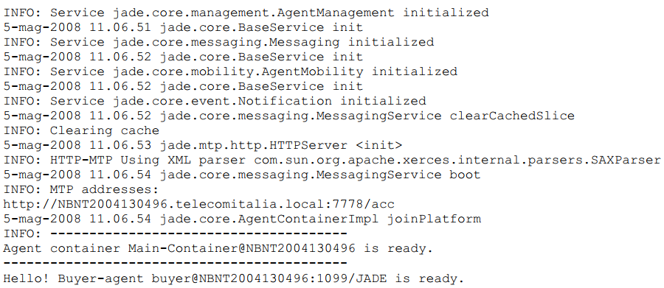
The Agent Class - Running agents
automatically assigned on the basis of the host and port you are running JADE on

Slide 22
The Agent Class - Agent termination
Even if it does not have anything else to do after printing the welcome message, our agent is still running.
In order to make it terminate its doDelete() method must be called.
Similarly to the setup() method, the takeDown() method is invoked just before an agent terminates and is intended to include agent clean-up operations.

Slide 23
The Agent Class - Passing arguments to an agent
Agents may get start-up arguments specified on the command line.
These arguments can be retrieved, as an array of Object, by means of the getArguments()method of the Agent class.
we will describe how to dynamically discover seller agents, next slides!

Slide 24
The Agent Class - Passing arguments to an agent
Get command line arguments here!
Agent terminate and Clean-up Operations

Slide 25
The Agent Class - Passing arguments to an agent
Arguments on the command line are specified included in parenthesis and separated by spaces

Slide 26
Agent Tasks – The Behaviour Class
The actual job an agent has to do is typically carried out within “behaviours”.
A behaviour
represents a task that an agent can carry out.
is implemented as an object of a class that extends jade.core.behaviours.Behaviour.

Slide 27
Agent Tasks – The Behaviour Class
In order to make an agent execute the task implemented by a behaviour object it is sufficient to add the behaviour to the agent by means of the addBehaviour()method of the Agent class.
Behaviours can be added at any time:
when an agent starts (in the setup() method)
from within other behaviours.

Slide 28
Agent Tasks -The Behaviour Class
Each class extending Behaviour must implement the
action() method ➔ that actually defines the operations to be performed when the behaviour is in execution
done() method ➔ that specifies whether or not a behaviour has completed
have to be removed from the pool of behaviours an agent is carrying out.

Slide 29
Behaviours scheduling and execution
An agent can execute several behaviours concurrently.
However it is important to notice that scheduling of behaviours in an agent is not pre-emptive (as for Java threads) but cooperative.
This means that when a behaviour is scheduled for execution its action() method is called and runs until it returns.
Therefore it is the programmer who defines when an agent switches from the execution of a behaviour to the execution of the next one.

Slide 30
Behaviours scheduling and execution
Though requiring a small additional effort to programmers, this approach has several advantages.
Allows having a single Java thread per agent
Provides better performances since behaviour switch is extremely faster than Java thread switch.
Eliminates all synchronization issues between concurrent behaviours accessing the same resources (this speed-up performances too) since all behaviours are executed by the same Java thread.

Slide 31
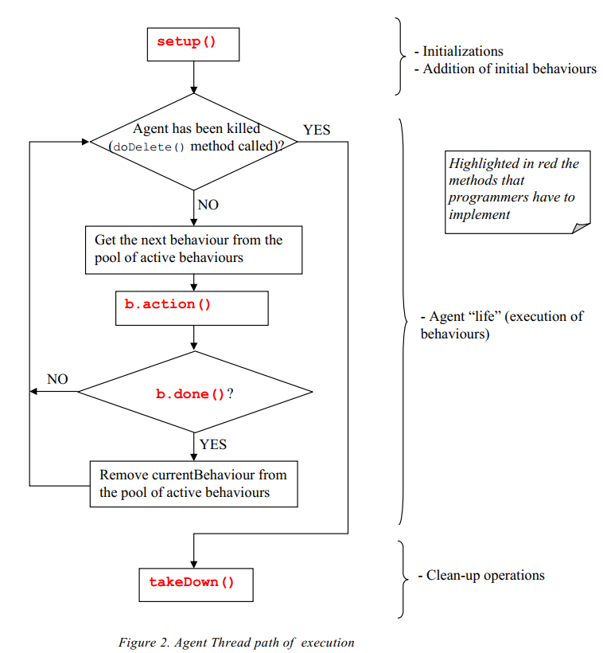
Agent Thread path of execution

Slide 32
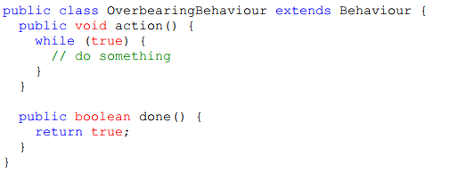
Behaviours scheduling and execution
prevents any other behaviour to be executed since its action() method never returns.

Slide 33
Behaviours scheduling and execution
When there are no behaviours available for execution the agent’s thread goes to sleep in order not to consume CPU time.
It is waken up as soon as there is again a behaviour available for execution.

Slide 34
Types of Behaviours
We can distinguish among three types of behavior
One-shot behaviours
Cyclic behaviours
Generic behaviours

Slide 35
One-shot Behaviours
“One-shot” behaviours that complete immediately and whose action() method is executed only once.
The jade.core.behaviours.OneShotBehaviour already implements the done() method by returning true and can be conveniently extended to implement one-shot behaviours.
Operation X is performed only once.

Slide 36
Cyclic Behaviours
“Cyclic” behaviours that never complete and whose action() method executes the same operations each time it is called.
The jade.core.behaviours.CyclicBehaviour already implements the done() method by returning false and can be conveniently extended to implement cyclic behaviours.
Operation Y is performed repetitively forever (until the agent carrying out the above behaviour terminates).

Slide 37
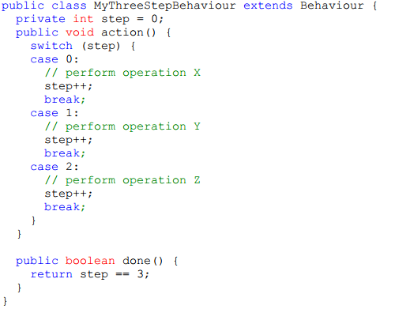
Generic Behaviours
Generic behaviours that embeds a status and execute different operations depending on that status. They complete when a given condition is met.
Operations X, Y and Z are performed one after the other and then the behaviour completes.

Slide 38
Complex Behaviours
JADE provides the possibility of combining simple behaviours together to create complex behaviours.
SequentialBehaviour
ParallelBehaviour
FSMBehaviour
Refer to the Javadoc of the SequentialBehaviour, ParallelBehaviour and FSMBehaviour for the details.

Slide 39
Scheduling operations at given points in time
JADE provides two ready-made classes (in the jade.core.behaviours package) by means of which it is possible to easily implement behaviours that execute certain operations at given points in time.
WakerBehaviour
TickerBehaviour

Slide 40
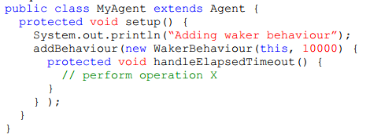
WakerBehaviour
The WakerBehaviour whose action() and done() methods are already implemented in such a way to execute the handleElapsedTimeout() abstract method after a given timeout (specified in the constructor) expires.
Operation X is performed 10 seconds after the “Adding waker behaviour” printout appears.

Slide 41
TickerBehaviour
The TickerBehaviour whose action() and done() methods are already implemented in such a way to execute the onTick() abstract method repetitively waiting a given period (specified in the constructor) after each execution.
Operation Y is performed periodically every 10 seconds.

Slide 42
Behaviours required in the Book Trading example

Slide 43
AGENT COMMUNICATION – The ACLMessage Class
JADE agents provide is the ability to communicate.
The communication paradigm adopted is the asynchronous message passing.
Each agent has a sort of mailbox (the agent message queue) where the JADE runtime posts messages sent by other agents.
Whenever a message is posted in the message queue the receiving agent is notified.

Slide 44
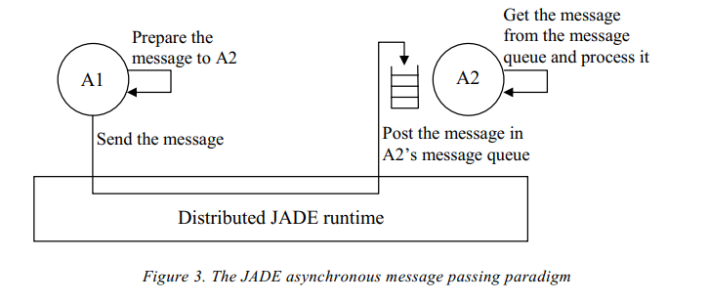
AGENT COMMUNICATION – The ACLMessage Class

Slide 45
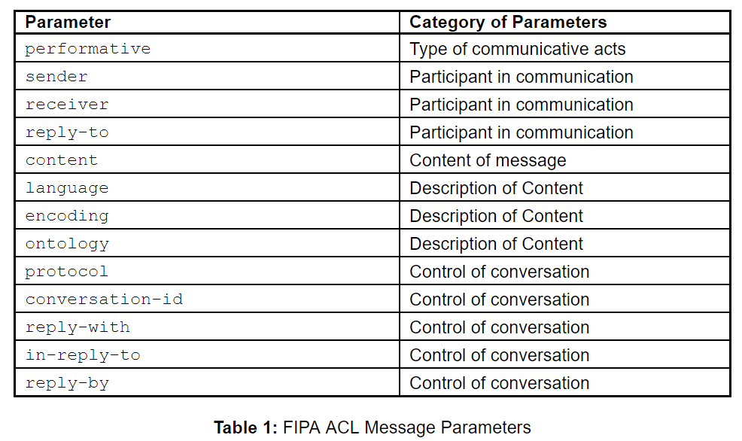
THE ACLMESSAGE CLASS –The ACL language
Messages exchanged by JADE agents have a format specified by the ACL language defined by the FIPA* international standard for agent interoperability.
jade.lang.acl.ACLMessage class that provides get and set methods for handling all fields of a message.
* http://www.fipa.org

Slide 46
THE ACLMESSAGE CLASS –Sending messages
Sending a message to another agent is as simple as filling the fields of an ACLMessage object and then call the send()method of the Agent class.
informs an agent whose nickname is Peter that today it’s raining.

Slide 47
The Book Trading example messages

Slide 48
THE ACLMESSAGE CLASS –Receiving messages
As mentioned above the JADE runtime automatically posts messages in the receiver’s private message queue as soon as they arrive.
An agent can pick up messages from its message queue by means of the receive() method.
This method returns the first message in the message queue (removing it) or null if the message queue is empty and immediately returns.

Slide 49
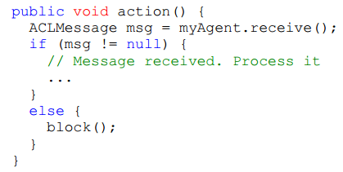
THE ACLMESSAGE CLASS –Blocking a behaviour waiting for a message
the agent’s thread starts a continuous loop that is extremely CPU consuming.
In order to avoid that we would like to execute the action() method of the cyclic behaviour only when a new message is received.
In order to do that we can use the block() method of the Behaviour class.
* The above code is the typical (and strongly suggested) pattern for receiving messages inside a behaviour.

Slide 50
THE ACLMESSAGE CLASS –Selecting messages with given characteristics from the message queue
When a template is specified the receive() method returns the first message (if any) matching it, while ignores all non-matching messages.
Such templates are implemented as instances of the jade.lang.acl.MessageTemplate class that provides a number of factory methods to create templates in a very simple and flexible way.

Slide 51
THE ACLMESSAGE CLASS –Complex conversations
A conversation is a sequence of messages exchanged by two or more agents with well defined causal and temporal relations.
The RequestPerformer behaviour mentioned in Book Trading represents an example of a behaviour carrying out a “complex” conversation.
send a CFP message to several agents (the known seller agents),
get back all the replies
in case at least a PROPOSE reply is received,
a further ACCEPT_PROPOSAL message (to the seller agent that made the proposal) and get back the response.

Slide 52
THE ACLMESSAGE CLASS –Receiving messages in blocking mode
if you call blockingReceive()from within a behaviour, this prevents all other behaviours to run until the call to blockingReceive() returns.
a good programming practice
to receive messages is use blockingReceive()in the setup()and takeDown()methods; use receive() in combination with Behaviour.block()within behaviours.

Slide 53
The ACLMessage Class Book Trading example

Slide 54
THE YELLOW PAGES SERVICE –The DFSERVICE Class
A “yellow pages” service allows agents to publish one or more services they provide so that other agents can find and successively exploit them.
The yellow pages service in JADE (according to the FIPA specification) is provided by an agent called DF (Directory Facilitator).
Each FIPA compliant platform hosts a default DF agent (whose local name is “df”)

Slide 55
THE YELLOW PAGES SERVICE –The DFSERVICE Class

Slide 56
THE YELLOW PAGES SERVICE –Interacting with the DF
To interact with DF by exchanging ACL messages using a
proper content language (the SL0 language)
a proper ontology (the FIPA-agent-management ontology) according to the FIPA specification.
In order to simplify these interactions,
JADE provides the jade.domain.DFService class by means of which it is possible to publish and search for services through method calls.

Slide 57
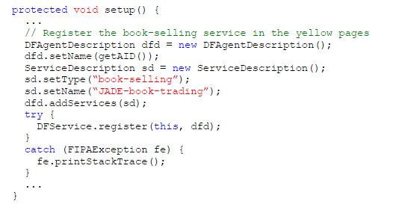
THE YELLOW PAGES SERVICE –Publishing services
In order to publish a service an agent must create a proper description and call the register()static method of the DFService class.

Slide 58
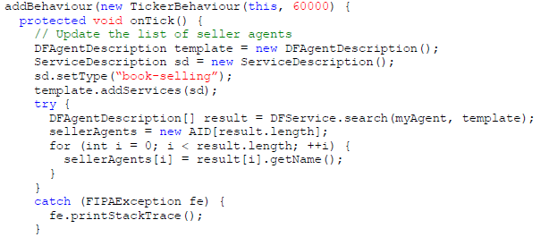
THE YELLOW PAGES SERVICE –Searching for services
The search()static method of the DFService class can be used as exemplified in the code used by the Book buyer agent to dynamically find all agents that provide a service of type “book-selling”.

Slide 59
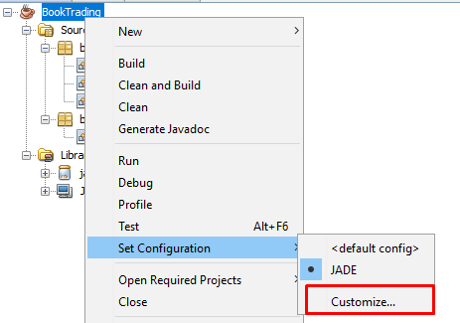
JADE – Netbeans Integration

Slide 60
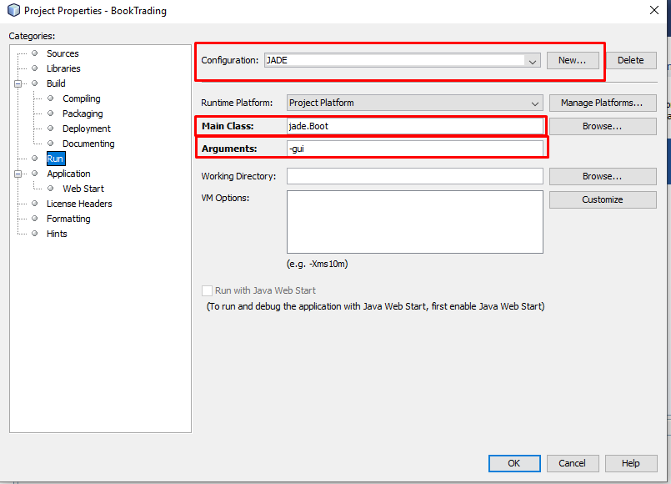
JADE – Netbeans Integration

Slide 61
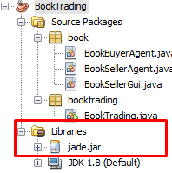
JADE – Netbeans Integration

Slide 62
REFERENCES
G. Caire , «JADE Tutorial - JADE Programming For Beginners» 2009
F. Bellifemine, G. Caire, T. Trucco,G. Rimassa, «JADE PROGRAMMER’S GUIDE», 2010
Foundation for Intelligent Pyhsical Agents: http://www.fipa.org
JADE : http://jade.tilab.com

