Slide 1
Agent-oriented Software Engineering Methodologies
Geylani Kardas, Ph.D.
Ege University International Computer Institute, 35100 Bornova, Izmir, Turkey
geylani.kardas@ege.edu.tr
http://akademik.ube.ege.edu.tr/~kardas/

Slide 2
Agent-oriented Software Engineering Methodologies
Software methodology:
A “methodology” has two important components (Giorgini and Henderson-Sellers, 2005):
one that describes the process elements (development activities and their relations), and
second that focuses on the work products and their documentation
Agent-oriented Software Engineering (AOSE) Methodologies
New and mostly in an early stage
Still in the first context of mostly “academic” methodologies for agent-oriented system development
Few of them have been tested in small, industrial applications
Giorgini, P. and Henderson-Sellers, B. (2005) "Agent-Oriented Methodologies: An Introduction", 1-19, Agent-Oriented Methodologies, Henderson-Sellers, B. and Giorgini, P. (Eds.), Idea Group Publishing, 429p.

Slide 3
Agent-oriented Software Engineering Methodologies
AOSE Methodologies covered in Henderson-Sellers and Giorgini, 2005)
Tropos
MAS-CommonKADs
PASSI
Prometheus
Gaia
ADELFE
MESSAGE
INGENIAS
RAP/AOR
MaSE
Henderson-Sellers, B. and Giorgini, P. (2005) "Agent-Oriented Methodologies”, Idea Group Publishing, 429p.

Slide 4
Agent-oriented Software Engineering Methodologies
A definition of agent-oriented methodologies from a Software Engineering (SE) perspective (Gomez-Sanz and Fuentes-Fernandez, 2015):
An AOSE method is an SE method where the main concept is the Software Agent. In this method:
The notation and vocabulary are based on or reuse concepts from agent research.
There has to be procedures for executing identifiable tasks. These tasks pursue products that realize the agent orientation or parts of it.
There are guidelines for checking the products. These guidelines have also present the agent orientation: as the method concerns agent concepts at least partly, its products also need to do it.
The nature of this method is mainly heuristic, as it relies on features inherent to software agents, for example, adaptiveness or autonomy, to guide the development and structure the system.
There are support tools that assist in the execution of the different activities addressed by the method.
Gomez-Sanz, J. J. and Fuentes-Fernandez, R. (2015) "Understanding Agent-Oriented Software Engineering methodologies", The Knowledge Engineering Review, 30(4): 375-393.

Slide 5
Agent-oriented Software Engineering Methodologies
Common features of AOSE Methodologies
Mostly use society organization metaphor
Aims at providing interaction and coordination models in order to define
social relations,
dependencies between agents,
roles played
by taking into consideration organizational nature of MAS
Mostly describe analysis and design phases of agent and MAS development and does not consider the implementation
Due to the deficiency of an agent-oriented programming language that can be used in implementation

Slide 6
Agent-oriented Software Engineering Methodologies
What it means for a methodology to be “agent-oriented” (Giorgini and Henderson-Sellers, 2005)?:
In an Object-oriented (OO) methodology
OO concepts are used to describe the methodology, which, in turn, can be used to build object-oriented systems
An Agent-oriented (AO) methodology
not constructed on AO principles but
oriented towards the creation of agent-based software
That distinction holds for all methodologies covered in (Giorgini and Henderson-Sellers, 2005) except Tropos which claims to use “agent think” in its very derivation
Giorgini, P. and Henderson-Sellers, B. (2005) "Agent-Oriented Methodologies: An Introduction", 1-19, Agent-Oriented Methodologies, Henderson-Sellers, B. and Giorgini, P. (Eds.), Idea Group Publishing, 429p.

Slide 7
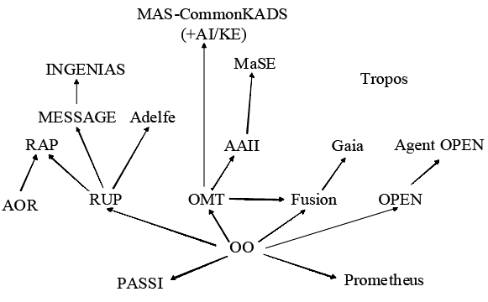
Agent-oriented Software Engineering Methodologies
Genealogy of AOSE Methodologies (Giorgini and Henderson-Sellers, 2005)
Different roots:
AI-based
An extension of object-oriented methodologies
Covering both approaches
Giorgini, P. and Henderson-Sellers, B. (2005) "Agent-Oriented Methodologies: An Introduction", 1-19, Agent-Oriented Methodologies, Henderson-Sellers, B. and Giorgini, P. (Eds.), Idea Group Publishing, 429p.

Slide 8
Tropos (Bresciani et al., 2004)
A requirement-driven AOSE methodology
Models
Actors in the social environment
Social dependencies between the actors
by using i* modelling framework (Yu, 1995)
Actors can be Agents, Positions, or Roles
Social dependencies can exist for
Goals
Softgoals
Tasks
Resources
Bresciani, P., Perini, A., Giorgini, P., Giunchiglia, F. and Mylopoulos, J. (2004) “Tropos: An agent-oriented software development methodology”, Autonomous Agents and Multi-Agent Systems, 8(3): 203-236.
Yu, E. (1995) “Modelling strategic relationships for process reengineering”, PhD thesis, University of Toronto, Department of Computer Science

Slide 9
Tropos
4 phases of Tropos methodology
Early requirements: Understanding the problem at the organizational level
Late requirements: the system-to-be is described within its operational environment, along with relevant functions and qualities
Architectural design: the system’s global architecture is defined in terms of subsystems, interconnected through data, control, and other dependencies
Detailed design: the behavior of each architectural component is further refined

Slide 10
Tropos
Tropos rests on the idea of using requirements modeling concepts to build a model of the system-to-be within its operational environment
This model is incrementally refined and extended, providing a common interface to the various software development activities
The model also serves as a basis for documentation and evolution of the software system
Requirements analysis in Tropos:
Early requirements analysis for understanding the organizational context of the system
Late requirements analysis for definition of the functional and non-functional requirements

Slide 11
Tropos
i* (“distributed intentionality”) modeling framework:
stakeholders are represented as (social) actors
Strategic dependency model describes the network of inter-dependencies among actors
Shown with actor diagrams in Tropos
Strategic rationale model describes and supports the reasoning that each actor goes through concerning its relationships with other actors
Shown with rationale diagrams in Tropos

Slide 12
Tropos
Early Requirements Analysis:
Identification of the domain stakeholders and models them as social actors who depend on one another
Through dependencies, one can answer why questions, in addition to what and how, regarding system functionality
actor diagrams and rationale diagrams are used in this phase
An actor diagram is a graph involving actors who have strategic dependencies among each other

Slide 13
Tropos
A dependency represents an “agreement” (called dependum) between two actors—the depender and the dependee
The depender depends on the dependee to deliver on the dependum
dependum examples:
a goal or softgoal to be fulfilled
a task to be performed
a resource to be delivered
Softgoals represent vaguely defined goals with no clear-cut criteria for their fulfillment
Graphical notation:
Actor: circle
Goal: oval
Softgoal: cloud
Task: hexagon
Resource: rectangle
Dependency: depender → dependum → dependee

Slide 14
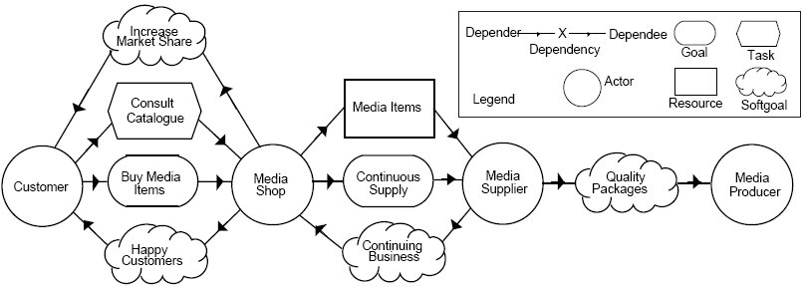
Tropos
An actor diagram example (Giorgini et al., 2005):
Giorgini, P., Kolp, M., Mylopoulos, J. and Castro, J. (2005) "Tropos: A Requirements-Driven Methodology for Agent-Oriented Software", 20-46, Agent-Oriented Methodologies, Henderson-Sellers, B. and Giorgini, P. (Eds.), Idea Group Publishing, 429p.

Slide 15
Tropos
“Means-ends Analysis”: Each goal is analyzed for extending actor diagrams
This analysis is specified using rationale diagrams
Goals of a specific actor are analyzed and dependencies with other actors are established
Goals are decomposed into subgoals and
Positive/negative contributions of subgoals to goals are specified
Late Requirements Analysis:
The conceptual model developed during early requirements is extended to
include the system-to-be as a new actor, along with dependencies between this actor and others in its environment
define functional and non-functional requirements for the system-to-be
Actor diagrams and rationale diagrams are also used in this phase

Slide 16
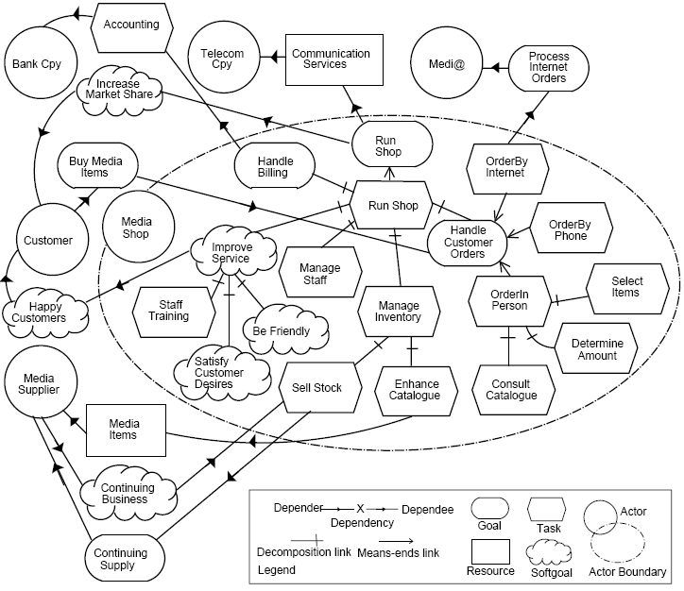
Tropos
A “means-ends” analysis example (Giorgini et al., 2005):
Giorgini, P., Kolp, M., Mylopoulos, J. and Castro, J. (2005) "Tropos: A Requirements-Driven Methodology for Agent-Oriented Software", 20-46, Agent-Oriented Methodologies, Henderson-Sellers, B. and Giorgini, P. (Eds.), Idea Group Publishing, 429p.

Slide 17
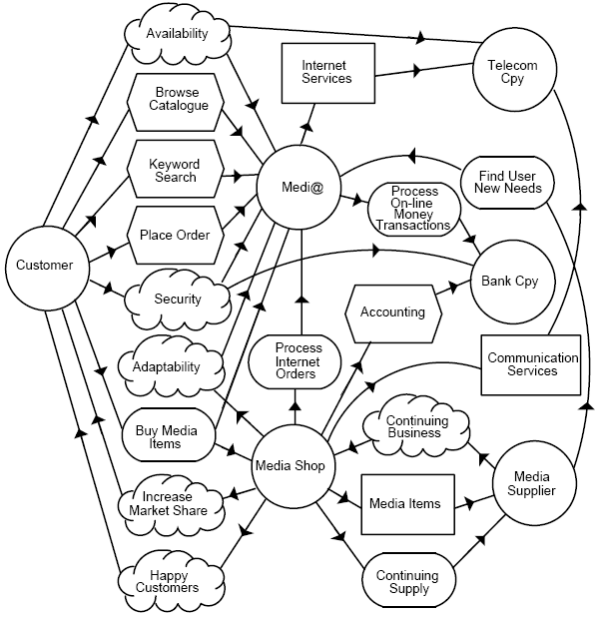
Tropos
An example for the refined actor diagram in which the system-to-be is also represented as an actor (Giorgini et al., 2005):
Giorgini, P., Kolp, M., Mylopoulos, J. and Castro, J. (2005) "Tropos: A Requirements-Driven Methodology for Agent-Oriented Software", 20-46, Agent-Oriented Methodologies, Henderson-Sellers, B. and Giorgini, P. (Eds.), Idea Group Publishing, 429p.

Slide 18
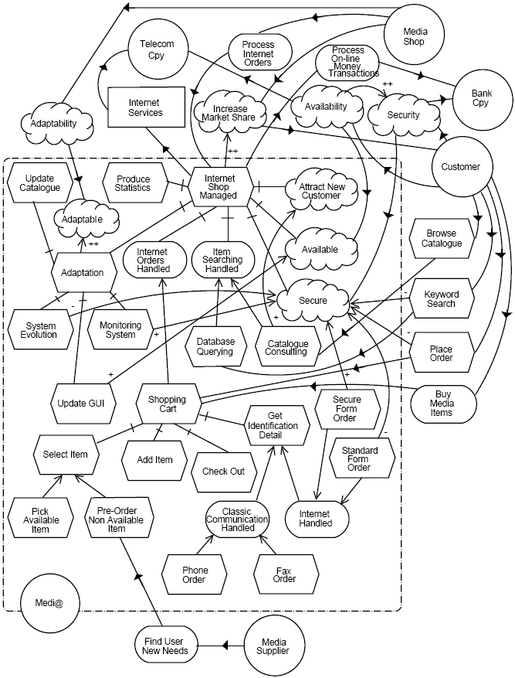
Tropos
A rationale diagram example (Giorgini et al., 2005):
Giorgini, P., Kolp, M., Mylopoulos, J. and Castro, J. (2005) "Tropos: A Requirements-Driven Methodology for Agent-Oriented Software", 20-46, Agent-Oriented Methodologies, Henderson-Sellers, B. and Giorgini, P. (Eds.), Idea Group Publishing, 429p.

Slide 19
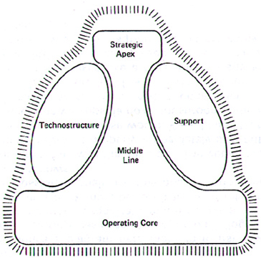
Tropos
Architectural Design:
Based on Organization Theory and Strategic Alliances
Organization Theory describes the structure and design of an organization
Strategic Alliances model the strategic collaborations of independent organizational stakeholders who have agreed to pursue a set of business goals
Structure-in-5 (Mintzberg, 1992) organization style:
specifies that an organization is an aggregate of five sub-structures
Operational Core
Middle Line
Support
Technostructure
Strategic Apex
Mintzberg, H. (1992) “Structure in fives: Designing effective organizations”, Upper Saddle River, NJ, Prentice-Hall

Slide 20
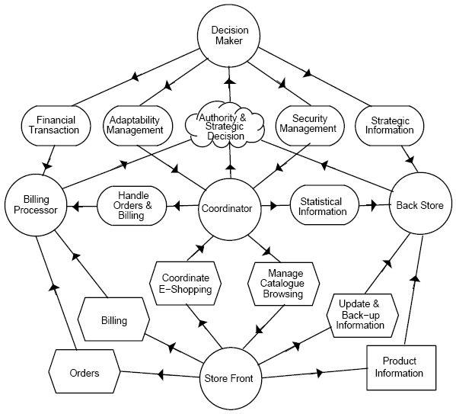
Tropos
A MAS architecture in “Structure-in-5” style (Giorgini et al., 2005):
Giorgini, P., Kolp, M., Mylopoulos, J. and Castro, J. (2005) "Tropos: A Requirements-Driven Methodology for Agent-Oriented Software", 20-46, Agent-Oriented Methodologies, Henderson-Sellers, B. and Giorgini, P. (Eds.), Idea Group Publishing, 429p.

Slide 21
Tropos
Detailed Design:
Intended to introduce additional detail for each architectural component of a system
Consists of defining how the goals assigned to each actor are fulfilled by agents with respect to social patterns
Social patterns in Tropos are design patterns focusing on social and intentional aspects that are recurrent in MAS
Two categories:
Pair patterns
Mediation patterns

Slide 22
Tropos
Pair Patterns:
describe direct interactions between negotiating agents
e.g. booking, call-for-proposal, subscription, or bidding
Mediation Patterns:
feature intermediary agents that help other agents to reach an agreement on an exchange of services
monitor, broker, matchmaker, mediator, embassy, or wrapper
Detailed design also includes actor communication and actor behavior

Slide 23
Gaia (Zambonelli et al., 2003)
Phases:
Analysis Phase aims at defining an environmental model, preliminary roles and interaction models, and a set of organizational rules
Architectural Design Phase aims at defining the system organizational structure to identify complete roles and interaction models
Detailed Design Phase produces a technology-neutral specification of an MAS in terms of an agent model and a services model
Zambonelli, F., Jennings, N.R. and Wooldridge, M. (2003) “Developing multiagent systems: The Gaia methodology”, ACM Transactions on Software Engineering and Methodologies, 12(3): 317-370

Slide 24
Gaia
Gaia does not directly deal with particular modeling techniques
It proposes but does not commit to specific techniques for modeling (e.g., roles, environment, and interactions)
Gaia does not directly deal with MAS implementation issues
Gaia does not explicitly deal with the activities of requirements capture and modeling, and specifically not of early requirements engineering

Slide 25
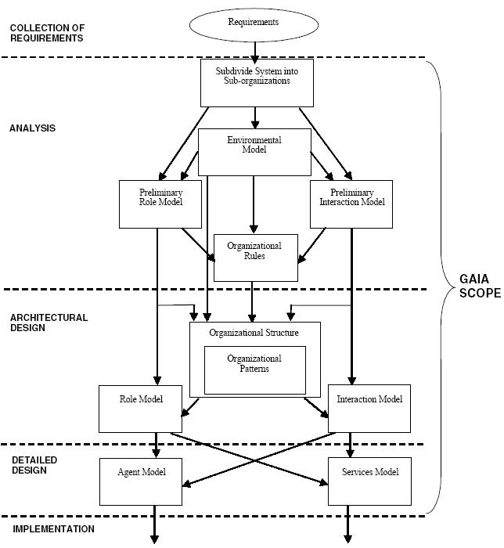
Gaia
Models of the Gaia methodology and their relations in the Gaia process (Zambonelli et al., 2005)
Zambonelli, F., Jennings, N.R. and Wooldridge, M. (2005), "Multi-Agent Systems as Computational Organizations: The Gaia Methodology", 136-172, Agent-Oriented Methodologies, Henderson-Sellers, B. and Giorgini, P. (Eds.), Idea Group Publishing, 429p.

Slide 26
Gaia
Analysis Phase
Covers the definition of the followings:
Goals of the organization
Environmental model
Preliminary role model
Preliminary interaction model
Organizational Rules

Slide 27
Gaia
Architectural Design Phase
Definition of system’s organizational structure with a topology and “control regime”
Organization of MAS for the real world
Application of organizational rules
Completion of Role and Interaction Models
Defining all the activities in which a role will be involved
Defining organizational roles
Defining organizational protocols

Slide 28
Gaia
Detailed Design Phase
Definition of the Agent Model identifying
which agent classes are to be defined to play specific roles and
how many instances of each class have to be instantiated in the actual system
Definition of the Services Model identifying the services associated with
each agent class or
each of the roles to be played by the agent classes
Final result of the Gaia process
Developers are provided with a well-defined set of agent classes to implement and instantiate, according to the defined agent and services model

Slide 29
Gaia
An example of applying Gaia methodology:
Development of an agent-based system for supporting the management of an international conference (Zambonelli et al., 2005)
Setting up and running a conference is a multi-phase process, involving several individuals and groups
Zambonelli, F., Jennings, N.R. and Wooldridge, M. (2005), "Multi-Agent Systems as Computational Organizations: The Gaia Methodology", 136-172, Agent-Oriented Methodologies, Henderson-Sellers, B. and Giorgini, P. (Eds.), Idea Group Publishing, 429p.

Slide 30
Gaia
Analysis:
Environmental model
The environmental resources to be handled by the agents in the MAS are basically papers and review forms
Model implies
identifying the characteristics of papers (e.g., author, title, keywords) and of review forms (i.e., marks) that are of interest to the applications and
modeling the environment as a container of papers and review forms
Preliminary role model
identification of the roles of reviewer, PC Chair, PC Member, author, etc. by identifying the permissions and the responsibilities of these roles
e.g., the role of reviews collector in charge of selecting reviewers and assigning papers to them will have the permission to read papers and review forms but not to change them

Slide 31
Gaia
Analysis:
Preliminary interaction model
identifying and formalizing a preliminary set of interaction protocols based on the defined roles
e.g., the role reviews collector will also identify an interaction with agents playing the role of reviewer
Organizational rules
Some examples
an author cannot act as a reviewer for his or her own paper
the role of reviewer must be played at least three times for each of the submitted papers by three different agents

Slide 32
Gaia
Architectural Design:
Definition of system’s organizational structure
The complexity of the problem typically influences the adopted structure of the real-world organization should be considered as a starting point
e.g. the expected number of papers submitted to the conference
The identified organizational rules may suggest alternative choices to that of mimicking the structure of the real-world organization
For instance, to guarantee that each paper is assigned to at least three reviewers it may be decided to make PC members autonomously select (or bid for) the papers they will review.
That can be challenging for big conferences.
A better alternative would be to opt for a centralized control over the assignment of papers to PC members.

Slide 33
Gaia
Architectural Design:
Completion of role and interaction models
the final organization of the MAS can be properly represented in a complete form i.e., including:
all the involved roles and protocols and
their interactions with the environmental resources

Slide 34
Gaia
Detailed Design:
Definition of the agent model
identifying the actual agents that will be called on to play the roles
the typical one-to-one mapping of roles-to-agents does not necessarily apply
e.g., an agent playing the role of PC member could, in turn, play the role of author and of reviewer

Slide 35
Gaia
Detailed Design:
Definition of the services model
Once the agents are identified, the last step is to identify the services that will compose them
e.g. an agent playing simply a reviewer role will typically imply the sequential execution of a number of phases (receive a paper, review it, send back its review form).
The input of the service will be a request for reviewing a paper.
The output of the service will be the completed review form.
A pre-condition: the same agent has not already executed that service a maximum number of times (i.e., is not already reviewing the maximum allowed # of papers).
The post-condition: the review form has been correctly completed

Slide 36
Methodology Research Assignment
ADELFE
ASEME
ForMAAD
INGENIAS
MAS-CommonKADS
MaSE
PASSI
Prometheus
RAP / AOR
SODA

Slide 37
Thank You
&
Any Questions?

