Slide 1
Model-driven Development of Multi-agent Systems
Geylani Kardas, Ph.D.
Ege University International Computer Institute, 35100 Bornova, Izmir, Turkey
geylani.kardas@ege.edu.tr
http://akademik.ube.ege.edu.tr/~kardas/

Slide 2
Outline
Introduction
Multi-agent System (MAS) Modeling
Complete Model-driven Architecture (MDA) Implementations for MAS
Partial MDA Implementations
Reorganization/Extension of Existing MAS Development Methodologies
General Evaluation

Slide 3
Introduction
Working in a higher abstraction level is of critical importance for the development of Multi-agent Systems (MAS)
Almost impossible to observe code level details of MASs due to their internal complexity, distributedness and openness (Kardas, 2013)
Model Driven Development (MDD):
one of the important software development approaches, aims to change the focus of software development from code to models
Many Agent-oriented Software Engineering (AOSE) researchers believe that the paradigm shift introduced by MDD may also
provide the desired abstraction level and
simplify the development of complex MAS software
Kardas, G. (2013) “Model-driven development of multi-agent systems: a survey and evaluation", The Knowledge Engineering Review, 28(4): 479-503

Slide 4
Introduction
Contributions are mainly based on the Object Management Group’s (OMG) Model-driven Architecture (MDA) (http://www.omg.org/mda/)
MDA defines several model transformations which are based on the Meta-Object Facility (MOF) framework
In MDA, models are first-class artifacts, integrated into the development process through the chain of transformations to coded application
MDA defines model transformations between three different abstraction layers
Computation Independent
Platform Independent
Platform Specific

Slide 5
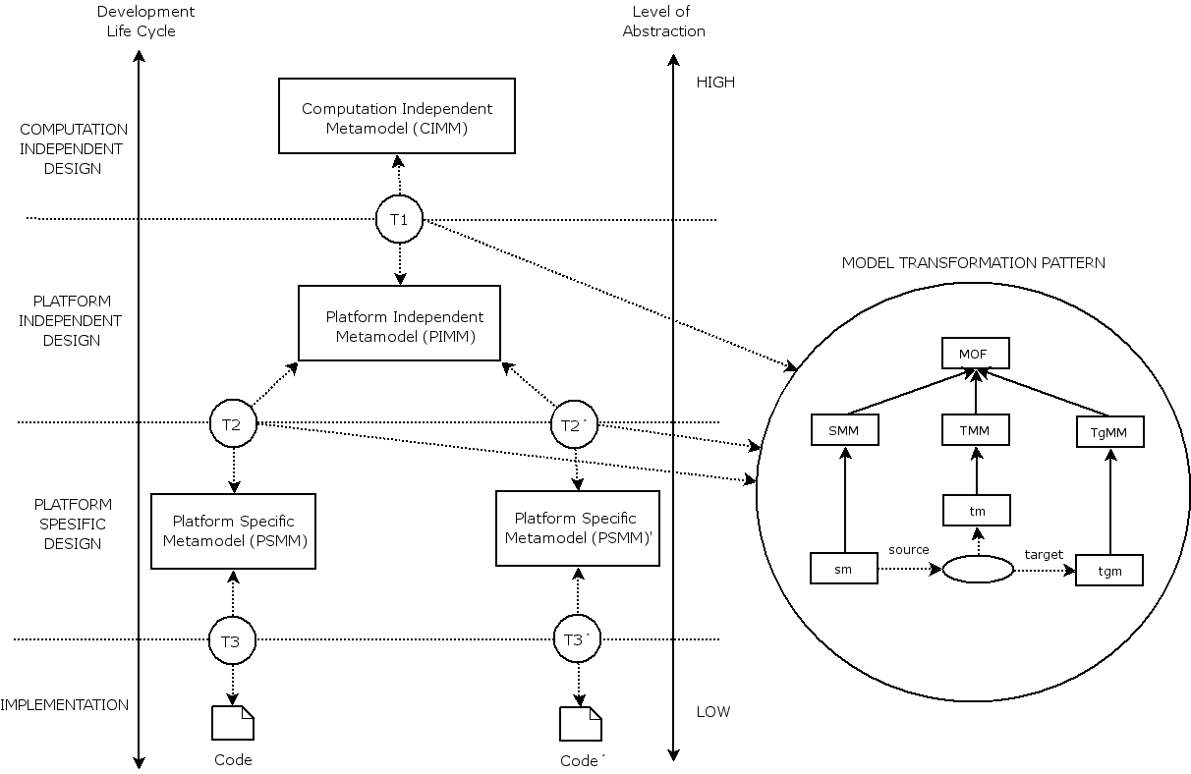
Introduction
Development process and model transformation mechanism in MDA (Kardas et al., 2009)
Kardas, G., Goknil, A., Dikenelli, O., Topaloglu, N. Y. (2009) "Model driven development of semantic web enabled multi-agent systems", International Journal of Cooperative Information Systems, 18(2): 261-308

Slide 6
Introduction
Aspects of a MAS that could be considered at the CIM and the PIM level (Bauer and Odell, 2005):
A CIM deals with the following aspects
use cases, environment model, domain/ontology model, role model, goal/task model, interaction model, organization/society model and business process models
A PIM may consider the following aspects:
interaction protocol model, internal agent model, agent model, service/capability model, acquaintance model and deployment/agent instance model
Bauer, B., Odell, J. (2005) “UML 2.0 and agents: how to build agent-based systems with the new UML standard”, Engineering Applications of Artificial Intelligence, 18(2): 141-157

Slide 7
Introduction
Some AOSE researchers intend to apply the whole MDA for MAS development
Some of them prefer to utilize just MAS metamodels and/or model transformations as needed.
Also some researchers take into account the reorganization of the existing MAS development methodologies to support model-driven agent development
Most of the model driven MAS development efforts originate from MAS Modeling studies which cover:
Metamodels for MAS
Modeling languages for MAS

Slide 8
MAS Modeling
AALAADIN (Ferber and Gutknecht, 1998) appears as the first general-purpose metamodel for MASs.
This metamodel represents a MAS structure with three main concepts - agent, group and role- and their relations.
Some AOSE researchers prefer to define agent metamodels which are specific for their MAS development methodologies
e.g. a unified metamodel (Bernon et al., 2005) composed by merging the most significant contributions of ADELFE, Gaia, PASSI
A similar study (Molesini et al., 2005) introduces a metamodel for SODA to model interaction and social aspects
Those metamodels are
just formal representations for the concepts of the related methodologies
not suitable for the general MAS modeling
Ferber, J., Gutknecht, O. (1998) “A Meta-Model for the Analysis and Design of Organizations in Multi-Agent Systems”, In proc. 3rd Int. Conf. on Multi-Agent Systems, pp. 128-135
Bernon, C., Cossentino, M., Gleizes, M-P., Turci, P., Zambonelli, F. (2005) “A Study of some Multi-Agent Meta-Models”.,Lecture Notes in Computer Science, 3382: 62-77
Molesini, A., Denti, E., Omicini, A. (2005) “MAS Meta-models on Test: UML vs. OPM in the SODA Case Study”, Lecture Notes in Artificial Intelligence, 3690: 163-172

Slide 9
MAS Modeling
Depke et al. (2001) introduce an agent-oriented modeling technique based on Unified Modeling Language (UML)
employ graph transformation rules in MAS requirement specification and analysis
Agents & Artifacts (A&A) metamodel (Omicini et al., 2008):
agents are modeled as proactive entities for the systems’ goals and tasks
artifacts represented the reactive entities providing the services and functions and, hence, constituted the environment for MAS
FAML metamodel (Beydoun et al., 2009):
a synthesis of various existing metamodels for agent systems
design time and runtime concepts for MASs were given
validation was provided by their use at various MAS development methodologies
Depke, R., Heckel, R., Küster J. M. (2001) “Agent-Oriented Modeling with Graph Transformations”, Lecture Notes in Computer Science, 1957: 105-119
Omicini, A., Ricci, A., Viroli, M. (2008) “Artifacts in the A&A meta-model for multi-agent systems”, Autonomous Agents and Multi-Agent Systems, 17(3): 432-456
Beydoun, G., Low, G. C., Henderson-Sellers, B., Mouratidis, H., Gomez-Sanz, J. J., Pavon, J., Gonzalez-Perez, C. (2009) “FAML: A Generic Metamodel for MAS Development”, IEEE Transactions on Software Engineering, 35(6): 841-863

Slide 10
MAS Modeling
Agent Class Superstructure Metamodel (ACSM) (Odell et al., 2005)
A general purpose MAS metamodel created by IEEE FIPA and OMG
express relationships between agents, agent roles and agent groups in a MAS
The specification is both based on and extends the UML 2.0 superstructure
includes a meta-entity called Agent Classifier to classify agent instances according to a set of features that they have in common
Agent Role Classifier, a subclass of Agent Classifier
classifies an agent according to the kind of roles the agent is capable of playing at a given time
roles can be changed in time.
Agent Pyhsical Classifier, a subclass of Agent Classifier
classifies an agent according to the pyhsical platforms (e.g. Cybele, JADE) where the agent lives
pyhsical features are fixed for an agent during its lifetime
Odell, J., Nodine, M., Levy, R. (2005) “A Metamodel for Agents, Roles and Groups”. Lecture Notes in Computer Science, 3382: 78-92

Slide 11
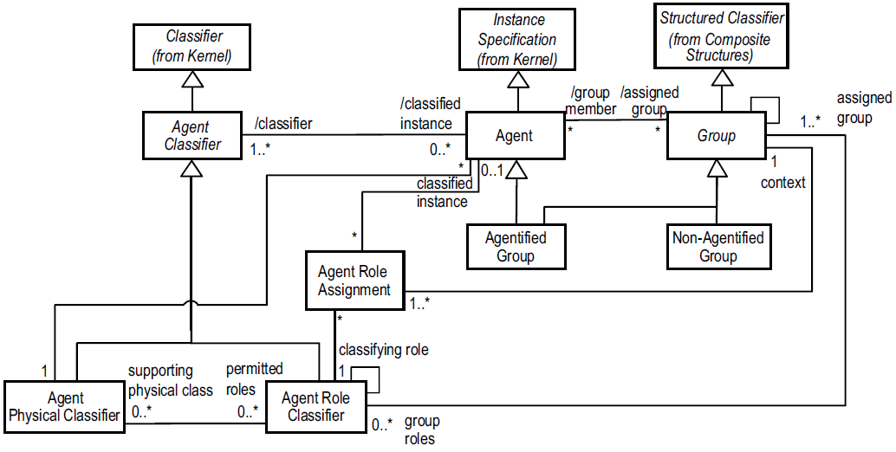
MAS Modeling
ACSM (Odell et al., 2005)

Slide 12
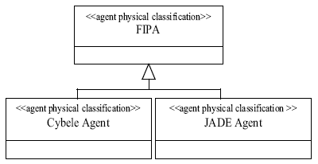
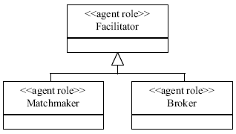
MAS Modeling
Agent Class Superstructure Metamodel (ACSM) (Odell et al., 2005)
A generalization hierarchy for agent physical classifiers
A generalization hierarchy for agent role classifiers
Odell, J., Nodine, M., Levy, R. (2005) “A Metamodel for Agents, Roles and Groups”. Lecture Notes in Computer Science, 3382: 78-92

Slide 13
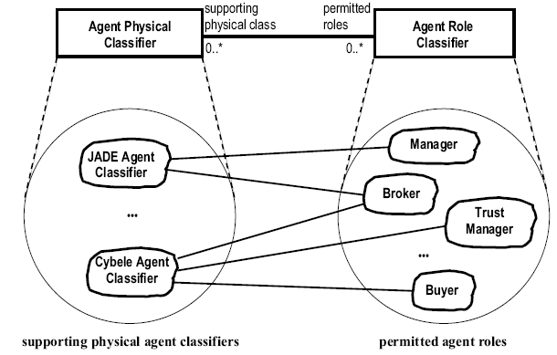
MAS Modeling
Agent Class Superstructure Metamodel (ACSM) (Odell et al., 2005)
Sample relations between agent physical classifiers and agent role classifiers
Odell, J., Nodine, M., Levy, R. (2005) “A Metamodel for Agents, Roles and Groups”. Lecture Notes in Computer Science, 3382: 78-92

Slide 14
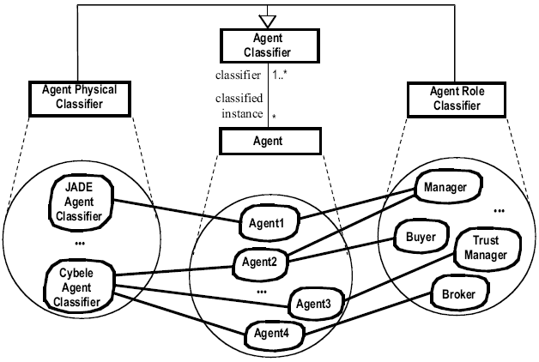
MAS Modeling
Agent Class Superstructure Metamodel (ACSM) (Odell et al., 2005)
Sample relations between agents and agent classifiers
Every agent should be associated with an agent physical classifier
It is not mandatory to associate an agent with an agent role classifier. However, such agents with no roles can not be included in a Group
Odell, J., Nodine, M., Levy, R. (2005) “A Metamodel for Agents, Roles and Groups”. Lecture Notes in Computer Science, 3382: 78-92

Slide 15
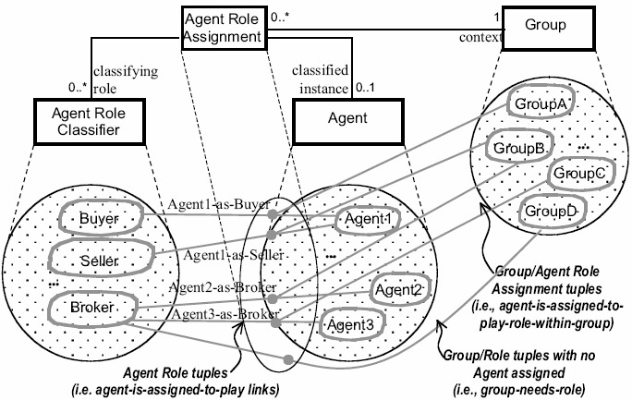
MAS Modeling
ACSM contextualizes agent roles to agent groups by introducing an association meta-entity called Agent Role Assignment
Each instance of the ternary Agent Role Assignment associates a role, a group and an agent
Example of Agent Role Assignments in ACSM (Odell et al., 2005)
A role assignment between an agent and its role must be qualified by a group context

Slide 16
MAS Modeling
ACSM is too abstract with definition of just 8 basic meta-entities and their relations
needs extensions for the exact modeling of a MAS especially when we consider
internal agent behaviours and
agent communications

Slide 17
MAS Modeling
Agent UML (AUML) (Bauer et al., 2001):
Probably the most well-known modeling language in AOSE
Presents new agent based extensions to
package and template structures and
sequence, interaction, activity and class diagrams of UML
e.g. sequence diagrams are extended to describe dynamic agent-role assignment and concurrent communication
Agent protocols are defined with a three-layered notation:
First layer defines the overall protocol with UML package and templates structures
Second layer defines interactions between agents by extending sequence, collaboration, interaction and activity diagrams and statecharts of UML
Third layer defines an agent’s internal processing by using UML activity diagrams and statecharts again
Bauer, B., Muller, J. P., Odell, J. (2001), “Agent UML: A formalism for specifying multiagent software systems”, International Journal of Software Engineering and Knowledge Engineering, 11(3): 207-230

Slide 18
MAS Modeling
Some recommended AUML extensions to UML that support concurrent threads of interaction (CA: an agent communication act)
(a) indicates that all threads CA-1 to CA-n are sent concurrently (AND communication)
(b) includes a decision box indicating an inclusive OR (will decide which CAs (zero or more) will be sent)
If more than one CA is sent, the communication is concurrent
(c) indicates an exclusive OR, so that exactly one CA will be sent

Slide 19
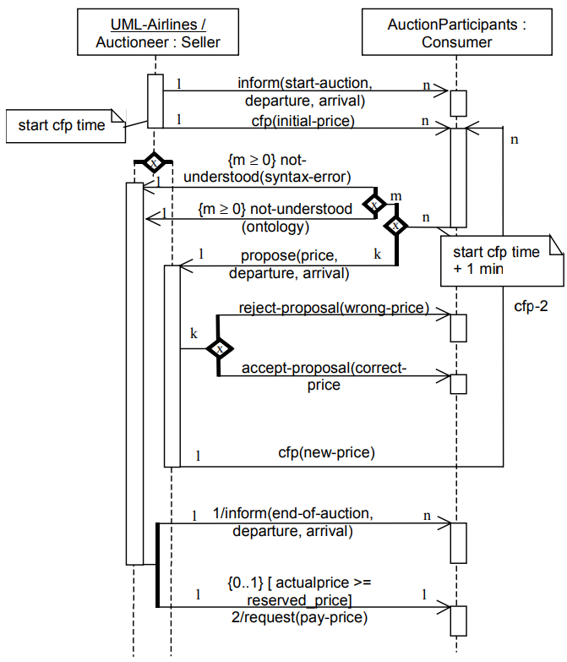
MAS Modeling
An Example for Agent UML Interaction Protocols (Bauer et al., 2001):
English-Auction protocol for surplus flight tickets
Bauer, B., Muller, J. P., Odell, J. (2001), “Agent UML: A formalism for specifying multiagent software systems”, International Journal of Software Engineering and Knowledge Engineering, 11(3): 207-230

Slide 20
MAS Modeling
Although AUML was popular (at least until 2010), experiences show that its UML extensions also bring some deficiencies
AUML relies too much on UML which is proposed for object-oriented system specification
This dependency causes the inability of AUML to be abstract enough from object considerations.
AUML’s visual notation is incomplete
AUML does not provide a textual notation to exchange with other developers
AUML semantics is semi-formal and again based on the UML (Huget, 2005)
Huget, M-P (2005) “Modeling Languages for Multiagent Systems”, In proc. 6th Int. Workshop on Agent-Oriented Software Engineering (AOSE 2005)

Slide 21
MAS Modeling
Agent Modeling Language (AML) (Cervenka et al., 2005):
developed by Whitestein Technologies Co., Switzerland
provides a semi-formal and visual modeling of agent systems
composed of two distinct levels:
AML Metamodel and Notation
defines the AML abstract syntax, semantics and notation
AML Profiles
present two UML profiles, built upon the previous layer, to enable implementation of AML according to UML 1.* and UML 2.0 specifications respectively
newer than the AUML and has a more complete set of notations
utilizing all the different symbols of AML’s notation is complicated (Huget, 2005)
does not have a textual notation
Cervenka, R., Trencansky, I., Calisti, M., Greenwood, D. (2005) “AML: Agent Modeling Language – Toward Industry-Grade Agent-Based Modeling”, Lecture Notes in Computer Science, 3382, 31-46

Slide 22
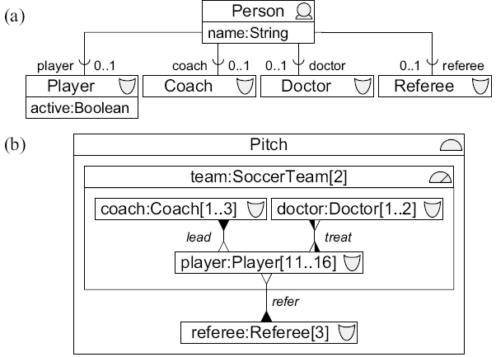
MAS Modeling
AML Example: Modeling agent social structures by using the AML (Cervenka et al., 2005):
part (a) expresses that an agent of type Person can play entity roles of type Player, Doctor, Coach or Referee
part (b) shows an organization structure containing the entities participating in a soccer match
e.g. the players are subordinate to
the coaches (by the lead connector) and
to referees (by the refer connector)
but peers to doctors (by the treat connector)
Cervenka, R., Trencansky, I., Calisti, M., Greenwood, D. (2005) “AML: Agent Modeling Language – Toward Industry-Grade Agent-Based Modeling”, Lecture Notes in Computer Science, 3382, 31-46

Slide 23
MDD of MAS
Solutions and approaches can be grouped into three categories (Kardas, 2013):
Complete MDA implementations
define new MAS metamodels in various abstraction levels,
derive model transformation rules from the entity mappings between these metamodels and
provide model transformation patterns which are applied to generate instance MAS models conforming to the proposed metamodels
Partial MDA implementations
partial application of the traditional MDA process.
model-to-model transformation or just code generation from MAS models are implemented based on requirements
Reorganization / Extension of existing MAS Development Methodologies
Kardas, G. (2013) “Model-driven development of multi-agent systems: a survey and evaluation", The Knowledge Engineering Review, 28(4): 479-503

Slide 24
MDD of MAS
Evaluation of the Approaches for MDD of MAS (Kardas, 2013):
Five fundamental criteria on capabilities and possessions of the proposed approaches
Approaches are evaluated according to those criteria with a three-level grading
Some of those criteria are inherited from the model quality work ((Solheim and Neple, 2006) and (Mohagheghi and Aagedal, 2007)) and
re-construed within the scope of the MAS modeling
Kardas, G. (2013) “Model-driven development of multi-agent systems: a survey and evaluation", The Knowledge Engineering Review, 28(4): 479-503
Mohagheghi, P., Aagedal, J. (2007) “Evaluating Quality in Model-Driven Engineering”, In proc. Int. Workshop on Modeling in Software Engineering (MISE 2007)
Solheim, I., Neple, T. (2006) “Model Quality in the Context of Model-Driven Development”. In proc. 2nd Int. Workshop on Model-Driven Enterprise Information Systems (MDEIS 2006), pp. 27-35

Slide 25
MDD of MAS
5 criteria:
Generic Platform Independent Metamodel (PIMM) definition
provision of a metamodel for platform independent metamodeling of MASs.
Model-to-Model (M2M) Transformability
inclusion of transformable MAS metamodel(s) and a M2M transformation mechanism
Model-to-Text (M2C) Transformability
inclusion of a model-to-code transformation phase for automatic generation of MAS software codes
Support for multiple platforms
specification and implementation of M2M (and M2C) transformations for at least two different MAS platforms
Tool support
support of software modeling and code generation tools for the MAS developers

Slide 26
MDD of MAS
Evaluation of each work according to each criterion is graded with one of the following graduation symbols: -, +, ++.
The interpretation of each graduation symbol is different for each criterion
Table 1: Grading of the approaches according to criterion: Generic PIMM definition
Symbol | Interpretation
- | No inclusion of a PIMM for MASs
+ | There is inclusion of a PIMM for MASs but the PIMM is not generic enough to support a variety of MAS platforms. It mostly defines meta-entities of a specific MAS methodology.
++ | There is inclusion of a generic PIMM for MASs. It is possible to implement MASs modeled according to this PIMM in various MAS platforms.

Slide 27
MDD of MAS
Table 2: Grading of the approaches according to criterion: M2M Transformability
Symbol | Interpretation
- | Transformation of models is missing.
+ | There is support for model-to-model transformation to a certain degree. Entity mappings between models or transformation rules are not defined (or they are defined but incomplete). Transformation mechanism is too abstract and not implemented.
++ | There is support for a complete model-to-model transformation phase in which entity mappings between models and the implementation of the written model transformation rules are all included. Application of the transformations within a case study may also be presented.

Slide 28
MDD of MAS
Table 3: Grading of the approaches according to criterion: M2C Transformability
Symbol | Interpretation
- | Generation of software codes from MAS models is missing.
+ | There is support for model-to-code transformation to a certain degree. Transformations are defined but not implemented or transformations are incomplete and code generation needs too much intervention.
++ | There is support for an automatic and a complete code generation from models for at least one MAS software development framework. Generated template codes are nearly executable. Application of the transformations within a case study may also be presented.

Slide 29
MDD of MAS
Table 4: Grading of the approaches according to criterion: Support for multiple platforms
Symbol | Interpretation
- | There is support at most one MAS platform.
+ | Definition and implementation of two M2M (and perhaps M2C) transformations for two different MAS platforms.
++ | There is support for more than two different MAS platforms. Generality of the introduced platform independent agent metamodel is proved by showing its transformability to at least three different platform specific MAS metamodels.

Slide 30
MDD of MAS
Table 5: Grading of the approaches according to criterion: Tool support
Symbol | Interpretation
- | Software modeling and code generation tool support for the MAS developers is missing.
+ | Software tool support to a certain degree. Textual or graphical modeling of MASs is realized only. Extra mechanism is needed for the support of model transformation
++ | Various software tools exist for graphical MAS modeling, application of automatic transformation between models and generating MAS software codes from MAS models.

Slide 31
Complete MDA Implementations
Cougaar MDA (Gracanin et al., 2005)
The implementation platform is an agent architecture called the Cognitive Agent Architecture (Cougaar)
Two important abstraction layers
Generic Domain Application Model (GDAM) layer represents the PIMM and provides a model of generic agent components found in the domain workflow
Generic Cougaar Application Model (GCAM) layer reflects the Platform Specific Metamodel (PSMM) or Cougaar architecture
Application requirements are defined with a Cougaar-specific process definition language
GDAM components for these requirements are obtained after an automatic transformation.
Platform specific GCAM components are converted to Cougaar/Java codes at the end of the MDA process
Gracanin, D., Singh, H. L., Bohner, S. A., Hinchey, M. G. (2005) “Model-Driven Architecture for Agent-Based Systems”, Lecture Notes in Artificial Intelligence, 3228: 249-261

Slide 32
Complete MDA Implementations
Evaluation of Cougaar MDA
GDAM represents a PIMM for cognitive agent architectures which is too specific for the Cougaar
Transformations defined between GDAM and GCAM but entity mappings and transformation rules are not provided
Transformation mechanism is not clear and exemplified. Generation of Cougaar/Java code is only mentioned
Only supports Cougaar agent platform
A tool with a GUI is provided for modeling Cougaar agent systems and generating Java codes
Criterion | Grade
Generic PIMM definition | +
M2M Transformability | +
M2C Transformability | +
Support for multiple platforms | -
Tool support | ++

Slide 33
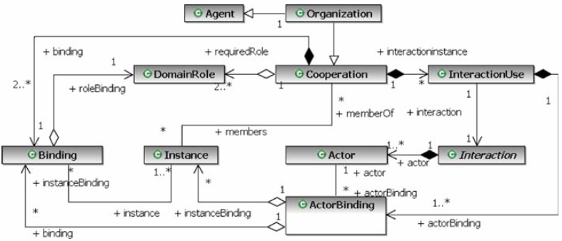
Complete MDA Implementations
PIM4Agents (Hahn et al., 2009)
Proposed a PIMM, called PIM4Agents, grouping agent modeling concepts in seven MAS viewpoints:
Multiagent, Agent, Behavioural, Organization, Role, Interaction, Environment
The metamodel reflecting the organizational aspect of PIM4Agents (Hahn et al., 2009):
Hahn, C., Madrigal-Mora, C., Fischer, K. (2009) “A platform-independent metamodel for multiagent systems”, Autonomous Agents and Multi-agent Systems 18(2): 239-266

Slide 34
Complete MDA Implementations
PIM4Agents (Hahn et al., 2009)
For MDD of MAS, model transformations between PIM4Agents and metamodels of two agent development frameworks:
JADE (http://jade.tilab.com/)
JACK (http://aosgrp.com/products/jack/)
Metamodels of JADE and JACK are considered as PSMMs and integrated into the proposed MDA
Mappings between PIM4Agents and JACK metamodel are more complete than the mappings between PIM4Agents and JADE
Design principles of JACK framework and PIM4Agents is coinciding with each other
Extensions for the standard JADE framework are required for the transformations from PIM4Agenst to JADE models

Slide 35
Complete MDA Implementations
Evaluation of PIM4Agents
Abstracting from existing agent-based metamodels, programming languages and platforms, it presents a PIMM for modeling MASs from various agent viewpoints
Model transformations (including mappings and transformation rules) between PIM4Agents and metamodels of two agent development frameworks are given
Code generation from JADE and JACK is considered but the implementation is not clear
Supports two different MAS platforms
A graphical editor is employed in modeling MASs and generating required codes
Criterion | Grade
Generic PIMM definition | ++
M2M Transformability | ++
M2C Transformability | +
Support for multiple platforms | +
Tool support | ++

Slide 36
Complete MDA Implementations
MDD4SWAgents (Kardas et al., 2009)
In the Semantic Web, software agents
collect Web content from diverse sources
process the information
exchange the results on behalf of their human users
collaborate with semantically defined entities such as semantic web services
an MDA-based MAS development process (shortly called MDD4SWAgents) to facilitate the implementation of agent systems working on the Semantic Web
Major entities of the PIMM are
Semantic Web Agent, Semantic Web Organization, Semantic Web Service, Ontology and
agent plan entities (e.g., Semantic Service Register Plan, Semantic Service Finder Plan and Semantic Service Executor Plan) for modeling agent behaviours and task executions
Kardas, G., Goknil, A., Dikenelli, O., Topaloglu, N. Y. (2009) “Model Driven Development of Semantic Web Enabled Multi-agent Systems”, International Journal of Cooperative Information Systems, 18(2): 261-308

Slide 37
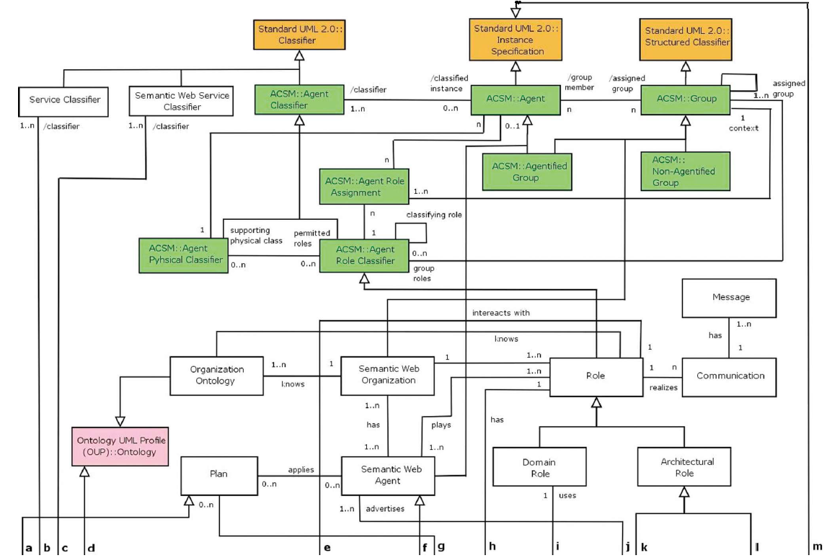
Complete MDA Implementations
MDD4SWAgents PIMM (Kardas et al., 2009):

Slide 38
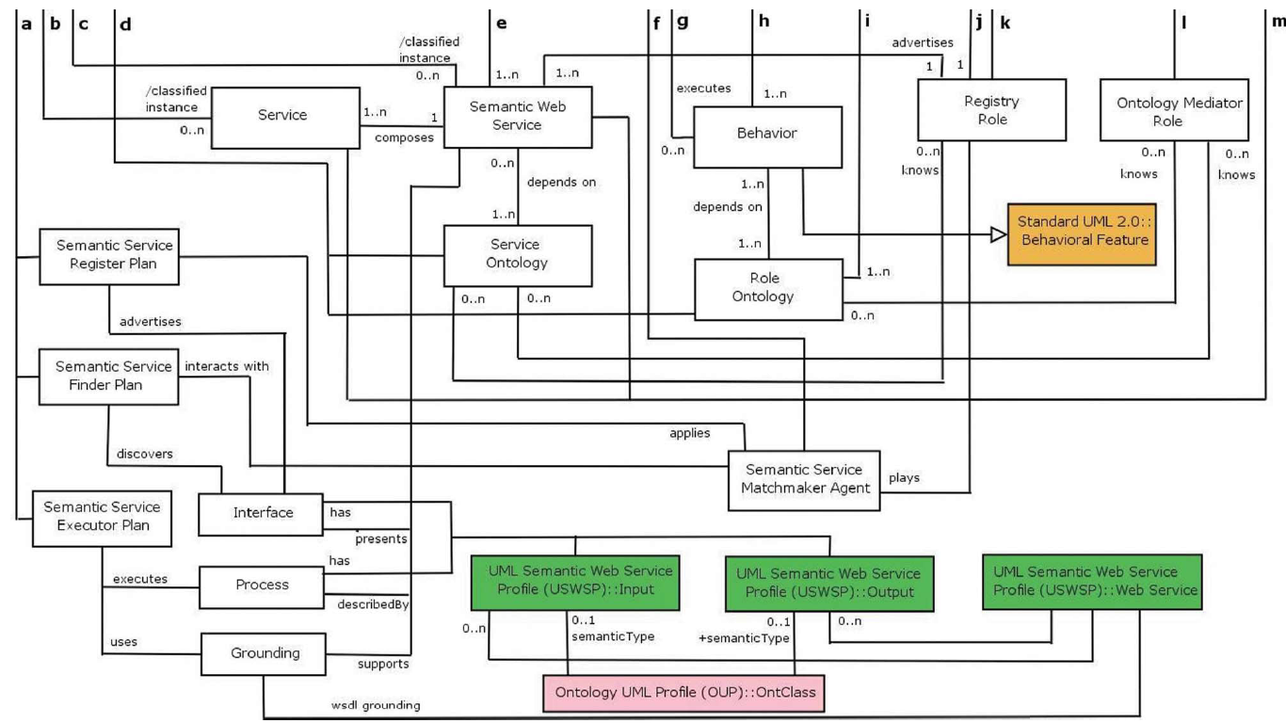
Complete MDA Implementations
MDD4SWAgents PIMM (Kardas et al., 2009):

Slide 39
Complete MDA Implementations
MDD4SWAgents (Kardas et al., 2009)
model transformations between MDD4SWAgents PIMM and metamodels of two Semantic Web enabled agent development frameworks
SEAGENT (Dikenelli et al., 2006)
NUIN (Dickinson and Wooldridge, 2003)
Model transformations for SEAGENT PSMM is more complete and productive
Since SEAGENT platform and the proposed PIMM are compatible due to their abstractions, design mechanisms and environments that they model
New entity definitions are required for NUIN metamodel to complete the exact realization of agent PIMs in NUIN environment
Because semantic web support of NUIN remains only in agent configuration and knowledge store declaration
Dickinson, I., Wooldridge, M. (2003) “Towards Practical Reasoning Agents for the Semantic Web”, In proc. 2nd Int. Joint Conf. on Autonomous Agents and Multiagent Systems (AAMAS 2003), pp. 827-834
Dikenelli, O., Erdur, R. C., Kardas, G., Gümüs, O., Seylan, I., Gurcan, O., Tiryaki, A. M., Ekinci, E. E. (2006) “Developing Multi Agent Systems on Semantic Web Environment using SEAGENT Platform”, Lecture Notes in Artificial Intelligence, 3963: 1-13

Slide 40
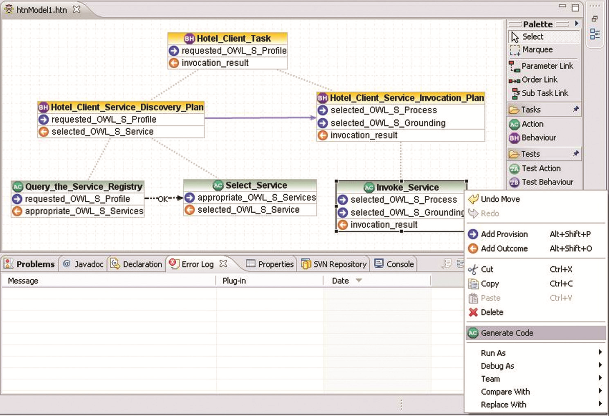
Complete MDA Implementations
MDD4SWAgents’ Hierarchical Task Network (HTN) Planner editor which provides plan code generation for agents working on the SEAGENT framework (Kardas et al., 2009):

Slide 41
Complete MDA Implementations
Evaluation of MDD4SWAgents
A PIMM for MASs is introduced
Model transformations (including mappings and transformation rules) between the PIMM and metamodels of two agent development frameworks are given
M2C Transformations are incomplete and generated codes need too much intervention at later.
MDD of MASs in SEAGENT and NUIN agent platforms are supported
Various MDD4SWAgents tools exist for graphical MAS modeling, application of automatic transformation between models and generating software codes from MAS models
Criterion | Grade
Generic PIMM definition | ++
M2M Transformability | ++
M2C Transformability | +
Support for multiple platforms | +
Tool support | ++

Slide 42
Partial MDA Implementations
Malaca Model (Amor et al., 2005)
aims to realize transition between agent methodologies and implementation platforms by representing an intermediate agent model
The idea behind the work is to define
entity mappings and model transformations between AOSE methodologies and Malaca model
and then between Malaca model and agent development platforms
model transformations defined for the Malaca model can not be automated in situations where the requirements of the design phase are not given in detail
the proposed model to be applicable only for the AOSE methodologies with the detailed design phase
many of the current AOSE methodologies do not include a standard procedure for automatic model transformation
This prevents the exact implementation of the Malaca based MDA
Amor, M., Fuentes, L., Vallecillo, A. (2005) “Bridging the Gap Between Agent-Oriented Design and Implementation Using MDA”, Lecture Notes in Computer Science, 3382: 93-108

Slide 43
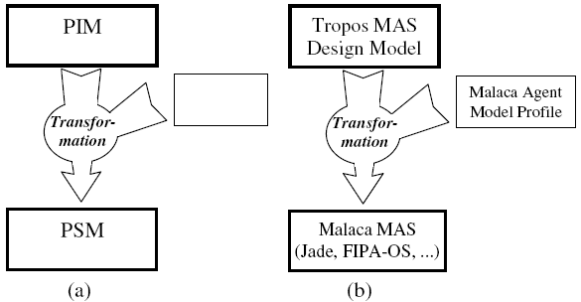
Partial MDA Implementations
MDA application between Tropos design model and Malaca agent model (Amor et al., 2005)
(a) The MDA pattern for model transformation
(b) The MDA model transformation from Tropos design model to the Malaca MAS specification using the Malaca Agent Model Profile
Amor, M., Fuentes, L., Vallecillo, A. (2005) “Bridging the Gap Between Agent-Oriented Design and Implementation Using MDA”, Lecture Notes in Computer Science, 3382: 93-108

Slide 44
Partial MDA Implementations
Evaluation of Malaca Model
Platform-neutral Malaca metamodel includes entities and their relations for modeling both internal design of agents and coordination between agents
Transformations based on the defined entity mappings usually can not be automated
Only PIM to PSM transformation is proposed. No M2C Transformability
Conceptual generality of Malaca model is only tested with Tropos design model
Malaca model is not supported with any software modeling and code generation tools for the MAS developers
Criterion | Grade
Generic PIMM definition | ++
M2M Transformability | +
M2C Transformability | -
Support for multiple platforms | -
Tool support | -

Slide 45
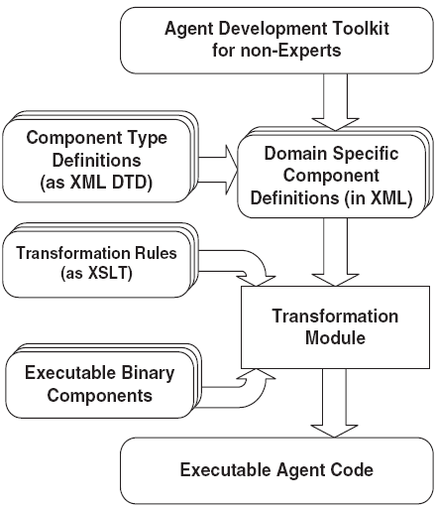
Partial MDA Implementations
Component Agent Framework for domain Experts (CAFnE) (Jayatilleke et al., 2007)
This conceptual framework aims to formulate agent systems and modification of agent structures as needed
Definition of each component type in the framework is denoted with a XML Document Type Definition (DTD)
Domain specific component specifications are given to a transformation module as XML elements conforming to these DTDs
In the transformation module, executable agent codes for each domain component are generated by using XSLT rules and executable binary components
Jayatilleke, G. B., Padgham, L., Winikoff, M. (2007) “Evaluating a Model Driven Development Toolkit for Domain Experts to Modify Agent Based Systems”, Lecture Notes in Computer Science, 4405: 190-207

Slide 46
Partial MDA Implementations
Evaluation of CAFnE
The introduced component model can be accepted as a PIMM for modeling agents, their goals, beliefs and plans.
However this PIMM appears to be too abstract for especially modeling coordination and interaction of agents
Transformation of models in different abstraction levels is not considered
Generation of executable agent codes from the DTDs of model elements via XSLT transformation is mentioned.
However application of the transformations is not illustrated
only JACK agent platform is supported
Toolkit provides graphical design of the agent systems but code generation capability is uncertain
Criterion | Grade
Generic PIMM definition | +
M2M Transformability | -
M2C Transformability | +
Support for multiple platforms | -
Tool support | +

Slide 47
Partial MDA Implementations
TAOM4e (Perini and Susi, 2006)
Applies MDA’s model transformation pattern in order to obtain UML models from Tropos MAS structures
Model transformations are designed and implemented according to Query-View-Transformation (QVT) Specification
Plans in a Tropos plan structure are mapped and transformed into Activity nodes in a UML Activity diagram
Automatic application of the model transformation rules is realized by using a software toolkit called TAOM4e
Tropos system models are developed graphically in TAOM4e’s GUI and given as an input to the integrated model transformation engine of TAOM4e.
Model transformation engine applies the transformation rules on the input model and successfully generates the output model(s)
Providing a software tool for the real implementation of the transformations is worthwhile
Agent metamodel used during the model transformations is only composed of Tropos structures and the development process is dependent on the Tropos methodology
Perini, A., Susi, A. (2006) “Automating Model Transformations in Agent-Oriented Modeling”, Lecture Notes in Computer Science, 3950: 167-178

Slide 48
Partial MDA Implementations
Evaluation of TAOM4e
Only the metamodel of the Tropos methodology is used as a PIMM
Model transformations are designed and implemented according to MOF QVT specification
No M2C transformation for real MAS implementations
No support for agent execution platforms
The modeler provides just graphical modeling of MASs according to the Tropos metamodel. Code generation capability is uncertain
Criterion | Grade
Generic PIMM definition | +
M2M Transformability | ++
M2C Transformability | -
Support for multiple platforms | -
Tool support | +

Slide 49
Partial MDA Implementations
PIM4SOA (Zinnikus et al., 2006)
Agents may provide the interoperability with other environment resources based on the business process specifications of SOAs
Autonomous agents deal both with designing and enacting service compositions as well as performing mediation, negotiation and brokering in SOAs
A rapid prototyping framework for SOAs is introduced
The framework is built around an MDD methodology which can be used for transforming high level SOA specifications into executable artefacts
both for Web Services and BDI agents
a PIMM for SOAs called PIM4SOA
⬇ Model transformations rules
PSMMs for BPEL processes and BDI Agents working on the JACK environment
Transformation from an agent-free SOA domain to a MAS domain
Zinnikus, I., Benguria, G., Elvesæter, B., Fischer, K., Vayssière, J. (2006) “A Model Driven Approach to Agent-Based Service-Oriented Architectures”, Lecture Notes in Artificial Intelligence, 4196: 110-122

Slide 50
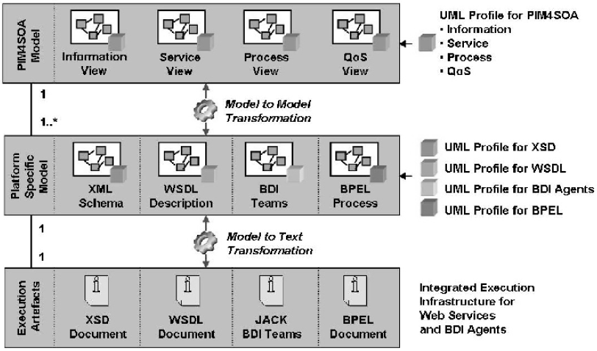
Partial MDA Implementations
MDD framework based on PIM4SOA (Zinnikus et al., 2006):
Zinnikus, I., Benguria, G., Elvesæter, B., Fischer, K., Vayssière, J. (2006) “A Model Driven Approach to Agent-Based Service-Oriented Architectures”, Lecture Notes in Artificial Intelligence, 4196: 110-122

Slide 51
Partial MDA Implementations
Evaluation of PIM4SOA
No PIMM for MAS
Deals with the agents only in the platform specific layer.
The platform independent modeling of the MASs is not included
Model transformations between PIM4SOA and PSMM of JACK BDI agents are mentioned. But mappings and transformation process are not clear
No M2C transformation
JACK is the only agent development platform supported
Software modeling tools are utilized during only the specification of agent plans
Criterion | Grade
Generic PIMM definition | -
M2M Transformability | +
M2C Transformability | -
Support for multiple platforms | -
Tool support | +

Slide 52
Reorganization / Extension of Existing MAS Development Methodologies
Some AOSE researchers reorganize or extend the existing MAS development methodologies to support model-driven agent development
Originating from the common belief on advantages and facilities of MDD for easy and rapid development of MASs, researchers
work on the existing MAS methodologies,
produce new versions of these methodologies and
provide tool support for the agent development according to these methodologies

Slide 53
Reorganization / Extension of Existing MAS Development Methodologies
IDK (Pavon et al., 2006)
Reformulation of existing agent-oriented methodology called INGENIAS in terms of the MDD paradigm
A metamodel for MASs is generated based on the experiences gained by using the INGENIAS methodology in several projects
Modeling and code generation from this metamodel are supported by a software tool called INGENIAS Development Kit (IDK)
IDK provides capabilities for model edition, model verification and automatic code generation
Refined INGENIAS methodology includes two main roles in the development process:
MAS developer
INGENIAS engineer
Pavon, J., Gomez-Sanz, J. J., Fuentes, R. (2006) “Model Driven Development of Multi-Agent Systems”, Lecture Notes in Computer Science, 4066: 284-298

Slide 54
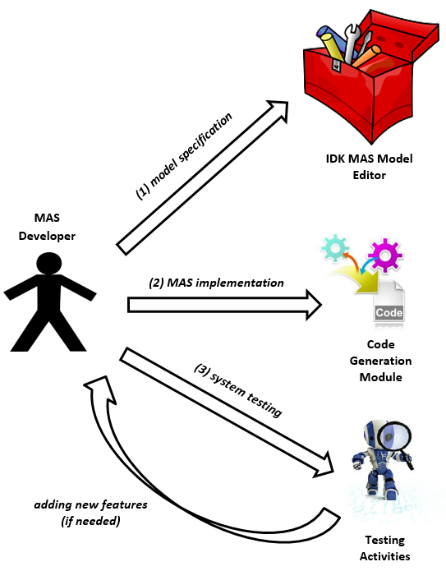
Reorganization / Extension of Existing MAS Development Methodologies
IDK (Pavon et al., 2006)
MAS Developer uses the IDK Model Editor to specify MAS models
After these models have been validated, code generation modules facilitate the implementation to deploy in a target platform
The developer may come back to modeling to add new features after testing

Slide 55
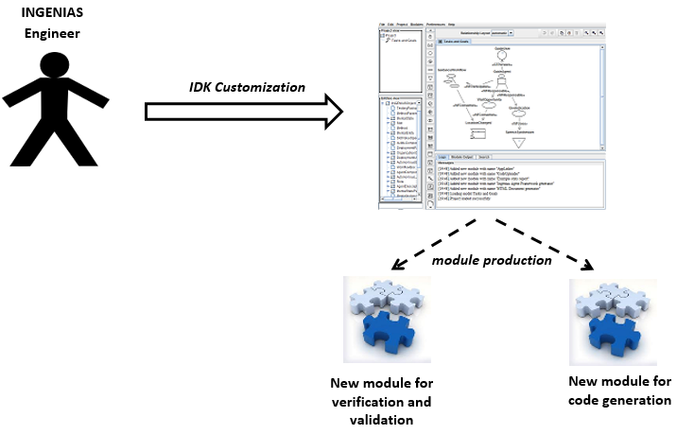
Reorganization / Extension of Existing MAS Development Methodologies
IDK (Pavon et al., 2006)
INGENIAS Engineer can customize the editor for a specific purpose by modifying the INGENIAS metamodel if required
He can also produce new modules for verification and validation or for code generation in the target platform

Slide 56
Reorganization / Extension of Existing MAS Development Methodologies
Evaluation of IDK
Reformulated model-driven INGENIAS methodology includes MAS modeling conforming to a generic PIMM which is structured in five packages
Agents, Organizations, Goals/Tasks, Interactions and Environment
Transformation of models in different abstraction levels is not included
Model-driven process of the IDK is mostly based on the code generation from MAS models. However implementation of the transformation is not given
None of the agent development platforms is supported
IDK MAS Model Editor provides graphical modeling of MASs according to INGENIAS metamodel. However no model transformation capability
Criterion | Grade
Generic PIMM definition | ++
M2M Transformability | -
M2C Transformability | +
Support for multiple platforms | -
Tool support | +

Slide 57
Reorganization / Extension of Existing MAS Development Methodologies
Model-driven Tropos (Penserini et al., 2006)
Ideas and standards from MDA are adopted in refining the modeling process algorithm and building tools of Tropos methodology
The conceptual agent model of Tropos is evaluated as a PIMM
Transformations from this PIMM to JADE metamodel are defined
Provides an agent architecture and interaction protocols complying with the IEEE FIPA specifications
Uses AUML for activity and interaction diagrams
Penserini, L., Perini, A., Susi, A., Mylopoulos, J. (2006) “From Stakeholder Intentions to Software Agent Implementations”, Lecture Notes in Computer Science, 4001: 465-479

Slide 58
Reorganization / Extension of Existing MAS Development Methodologies
Evaluation of Model-driven Tropos
The conceptual agent model of the Tropos methodology is evaluated as a PIMM
Model transformations between platform independent and platform specific models are given with their transformation rules and examples
Generation of Java codes for JADE agents is mentioned
The intention is to represent capability of agents in the JADE platform
But implementation of the M2C transformation is not given
JADE is the only agent platform taken into account
A model transformation tool is used for the automatic transformation of Tropos models to JADE agent models
Criterion | Grade
Generic PIMM definition | +
M2M Transformability | ++
M2C Transformability | +
Support for multiple platforms | -
Tool support | +

Slide 59
Reorganization / Extension of Existing MAS Development Methodologies
Model-driven ADELFE (Rougemaille et al., 2007)
Aims to add a MDD phase to ADELFE (Bernon et al., 2003) methodology according to adaptive MAS paradigm
two adaptation levels called functional and operational
functional level is application dependent and close to the decision process of agents
operational level is related to elementary skills of agents
Inside Model-driven ADELFE:
a MAS developer can define the functional adaptation in a model conforming to a specific metamodel
then a model transformation can be executed on this model according to the entity mappings between metamodel of this model and metamodel of an agent architecture for the operational level
Bernon, C., Gleizes, M-P., Peyruqueou, S., Picard, G. (2003) “ADELFE: A methodology for adaptive multi-agent systems engineering”, Lecture Notes in Artificial Intelligence, 2577, 70-81
Rougemaille, S., Migeon, F., Maurel, C., Gleizes, M-P. (2007) “Model Driven Engineering for Designing Adaptive Multi-Agent Systems”, Lecture Notes in Artificial Intelligence, 4995: 318-332

Slide 60
Reorganization / Extension of Existing MAS Development Methodologies
Evaluation of Model-driven ADELFE
An adaptive MAS metamodel (AMAS) for the ADELFE methodology is defined
Entity mappings between AMAS and metamodel of JavAct architecture.
But transformations are conceptual and not implemented
M2C transformation is conceptually given. However exact implementation is not taken into consideration
Only JavAct agent-based middleware is supported
Utilization of some existing model editing and transformation tools is mentioned.
There is no description and/or use example of these tools
Criterion | Grade
Generic PIMM definition | +
M2M Transformability | +
M2C Transformability | -
Support for multiple platforms | -
Tool support | -

Slide 61
General Evaluation
Almost all of the studies
provide a MAS metamodel and
define at least a model transformation employing this metamodel
Majority of the proposed MDD processes also include a code generation phase to implement MASs
Most of the research activities are supported with software tools which can be used in MAS modeling and M2M and/or M2C transformations
Support for multiple agent platforms is clearly a big challenge
Only MDD processes of PIM4Agents and MDD4SWAgents define transformations for two different agent platforms
None of the proposed approaches consider the transformability for more than two MAS development frameworks

Slide 62
General Evaluation
 | Generic PIMM definition | M2M Transformability | M2C Transformability | Support for multiple platforms | Tool support
CAFnE | + | - | + | - | +
Cougaar MDA | + | + | + | - | ++
IDK | ++ | - | + | - | +
Malaca Model | ++ | + | - | - | -
MDD4SWAgents | ++ | ++ | + | + | ++
Model-driven ADELFE | + | + | - | - | -
Model-driven Tropos | + | ++ | + | - | +
PIM4Agents | ++ | ++ | + | + | ++
PIM4SOA | - | + | - | - | +
TAOM4e | + | ++ | - | - | +

Slide 63
General Evaluation
Is there a complete and practical MDD for MAS?
Cougaar MDA, PIM4Agents, MDD4SWAgents and Model-driven Tropos can be accepted as complete
feasibility of the proposals is under debate
since none of the transformation patterns of these approaches support sufficient agent implementation environments
The lack of a generic and a widely-accepted PIMM for MASs
Such a PIMM can be
derived as a combination of already existing MAS metamodels (e.g. Bernon et al., 2005; Beydoun et al., 2009)
proposed as a brand new metamodel (e.g. PIM4Agents)

Slide 64
General Evaluation
Also, a metamodel for MAS should not be too abstract to be used as a PIMM
e.g. FIPA ACSM
If the PIMM is too abstract
model transformations from the metamodel would be very inefficient
output models of the transformations would be useless
The degree of PIMM generality is critical
MAS PIMM needs to be both
generic enough to support various MAS platforms and
concrete enough for productive model transformations

Slide 65
General Evaluation
Too difficult to provide unique MAS PIMM due to the broad diversity relating to purpose, organization and architecture of MASs
Instead, AOSE researchers propose their own metamodels specific to their agent development needs
Causes to be incapable of supporting more than one MAS platform
A general platform independent modeling approach
covers the utilization of the existing MAS metamodels
define horizontal transformations between these metamodels
apply these transformations between the instance models of these metamodels in order to provide implementation of the same MAS in various MAS platforms

Slide 66
General Evaluation
Model transformations in different abstraction levels:
Mens and Van Gorp (2006) state that refinement of a software system model can be considered as a vertical transformation example in which
a specification is gradually refined into a full-fledged implementation,
by means of successive refinement steps that add more concrete details
exactly describes the current research direction followed by most of the AOSE researchers in MDD of MAS
Mens, T., Van Gorp, P. (2006) “A Taxonomy of Model Transformation”, Electronic Notes in Theoretical Computer Science, 152: 125-142

Slide 67
General Evaluation
Also possible to define model transformations between the metamodels residing at the same abstraction level.
Horizontal transformations may be encouraging for MDD of MAS
Provides a general PIMM perspective based on the utilization of the already existing MAS metamodels that are acquired as the result of AOSE community’s significant effort
General platform independent modeling environment for MASs based on the horizontal transformations between existing MAS PIMMs:

Slide 68
General Evaluation
The practicability of this approach definitely needs further investigation.
Future work on this topic should consider questions such as:
What is the cost of such a design?
Should we always define transformations in a mesh structure (from all PIMMs to remaining PIMMs) or is just one-to-one transformation enough?
Do entity mappings between PIMMs provide an efficient transformation?
Is auto-generated PIM satisfactory?
To what extent should developers intervene in PIM generation?
What is the proportion of the auto-generated model entities (gained as the result of horizontal transformation) among all required MAS PIM entities?

Slide 69
General Evaluation
Last issue: The fruitful application of model-driven approaches in MAS development
Software codes for the exact system implementation should eventually be obtained
The validity of MDA’s promise on faster implementation for MAS development is doubtful at present
Many of the model-driven MAS development approaches include automatic code generation for various MAS software development frameworks
e.g., Cougaar MDA, PIM4Agents, MDD4SWAgents, CAFnE

Slide 70
General Evaluation
However, the quantity of the generated code is not satisfactory
Codes required for the agent interactions and internal behaviour (plan) structure of agents couldn’t be generated
or generated only at the template level in most situations
In order to be executable, vast amount of these auto-generated MAS codes need to be completed manually
Reflecting
autonomous and proactive features of agents and
their social relations
during model-driven MAS development is currently also in a preliminary state and needs further research

Slide 71
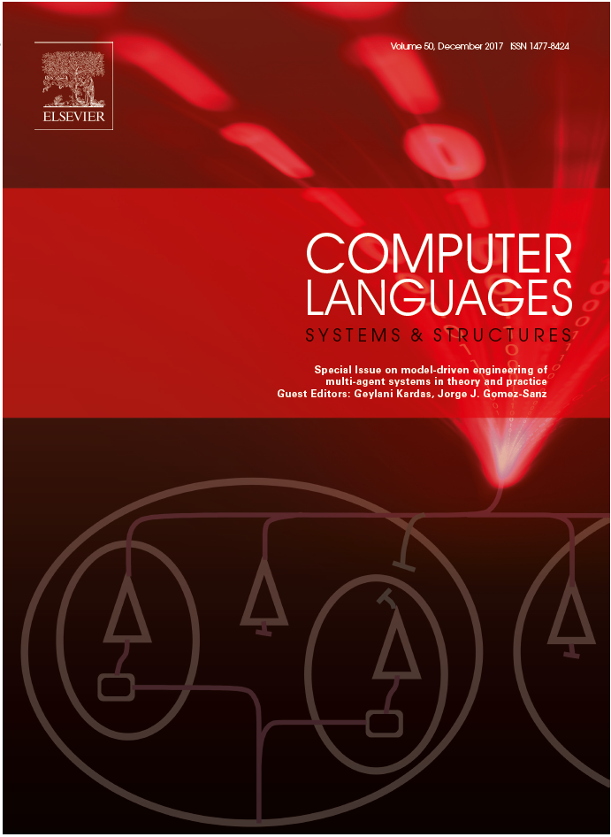
For further reading:

Slide 72
Thank You
&
Any Questions?

